Slide 1

Digital Red Light Camera System
黃家傑 WONG KA KIT AEnI/S/HK1

Slide 2
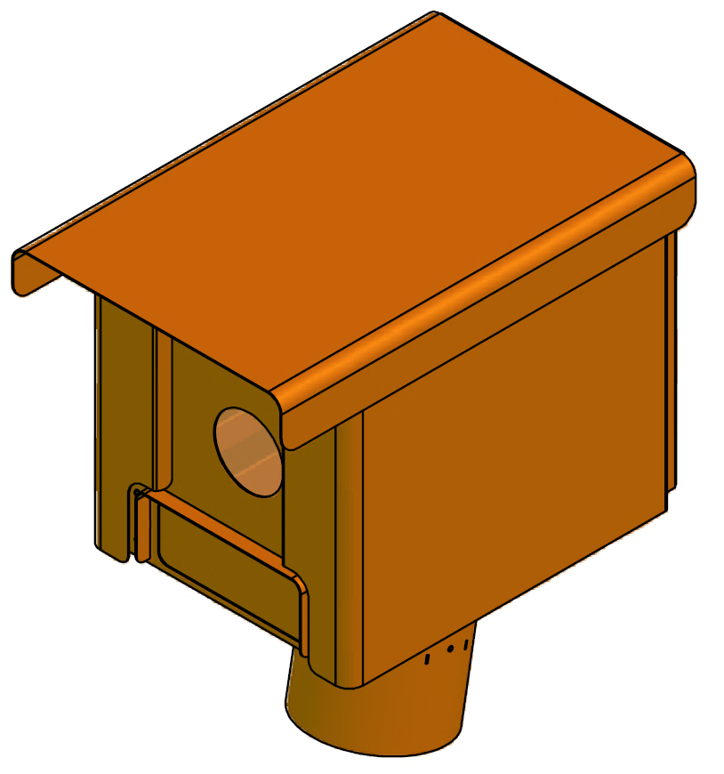
Table of Content
1). Background
2). History & Generation
Digital Red Light Camera System
3). How it work
4). Challenge
黃家傑 WONG KA KIT AEnI/S/HK1

Slide 3
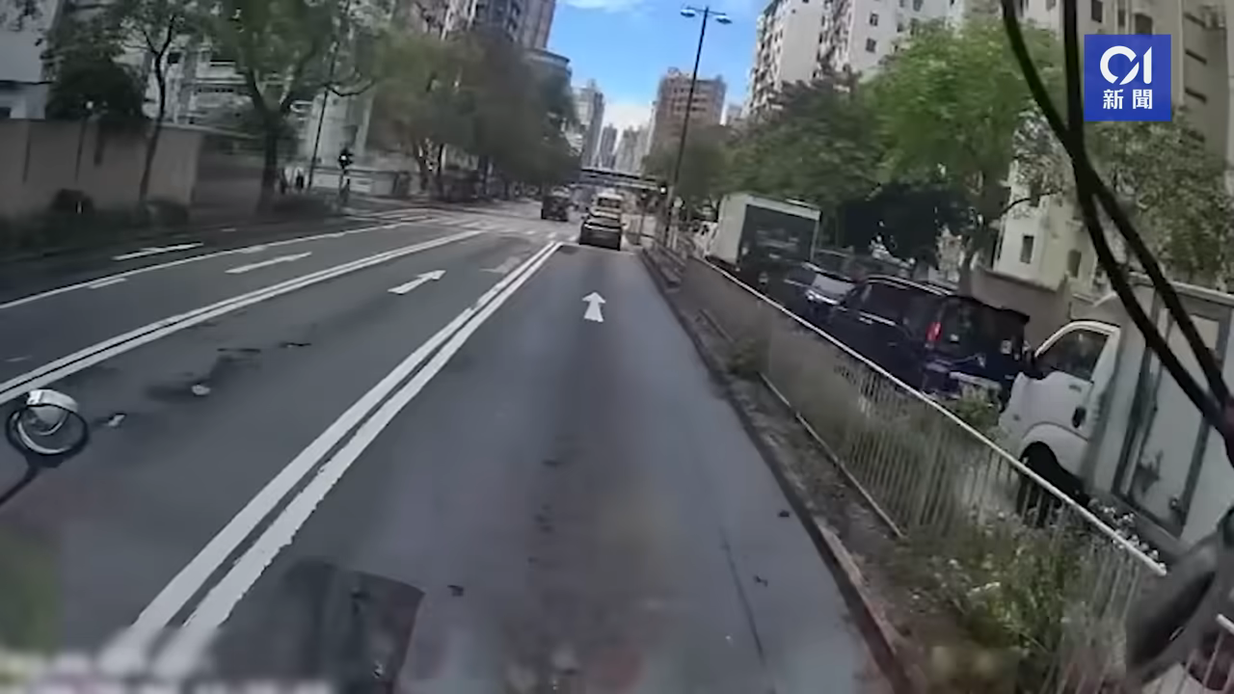
Digital Red Light Camera
數碼衝紅燈攝影機

Slide 4
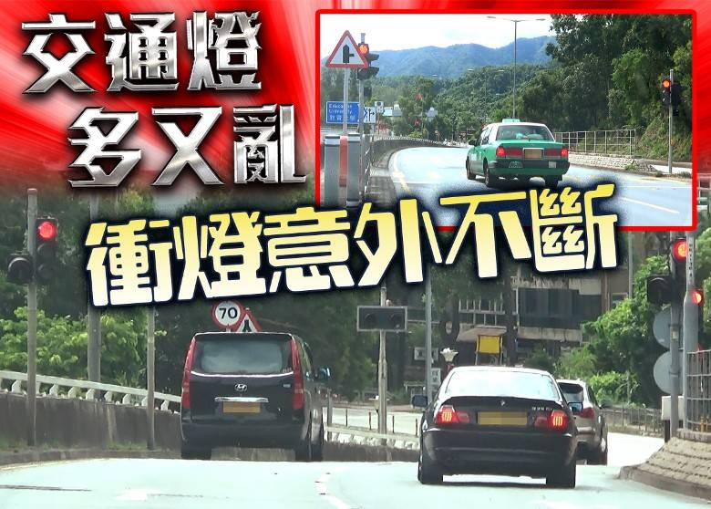
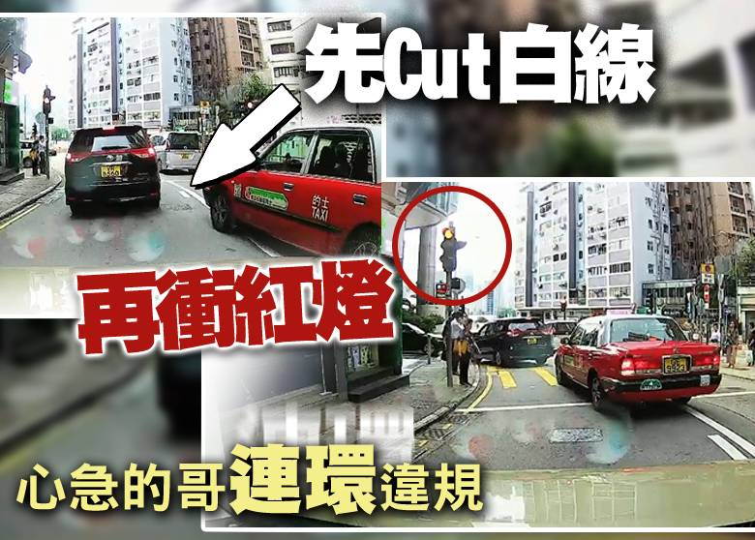

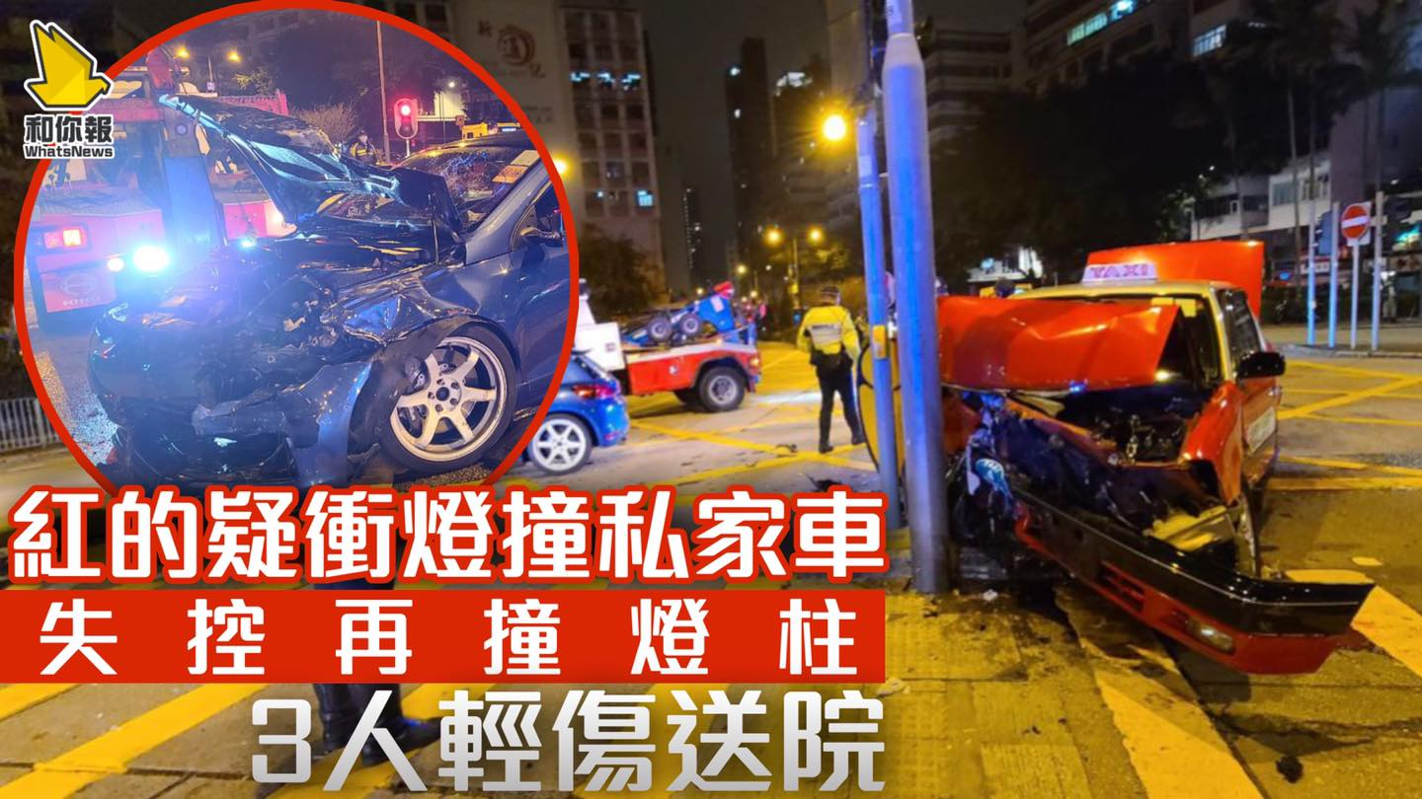
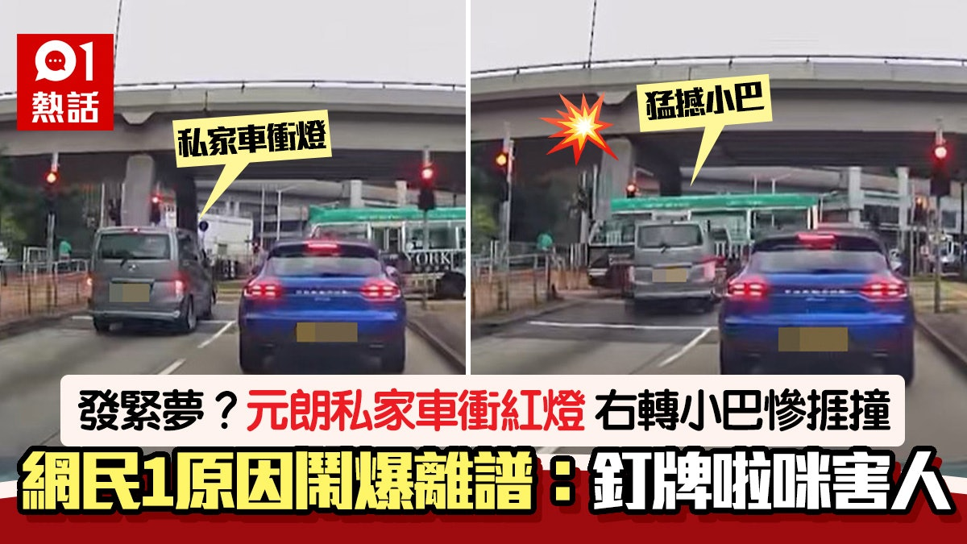
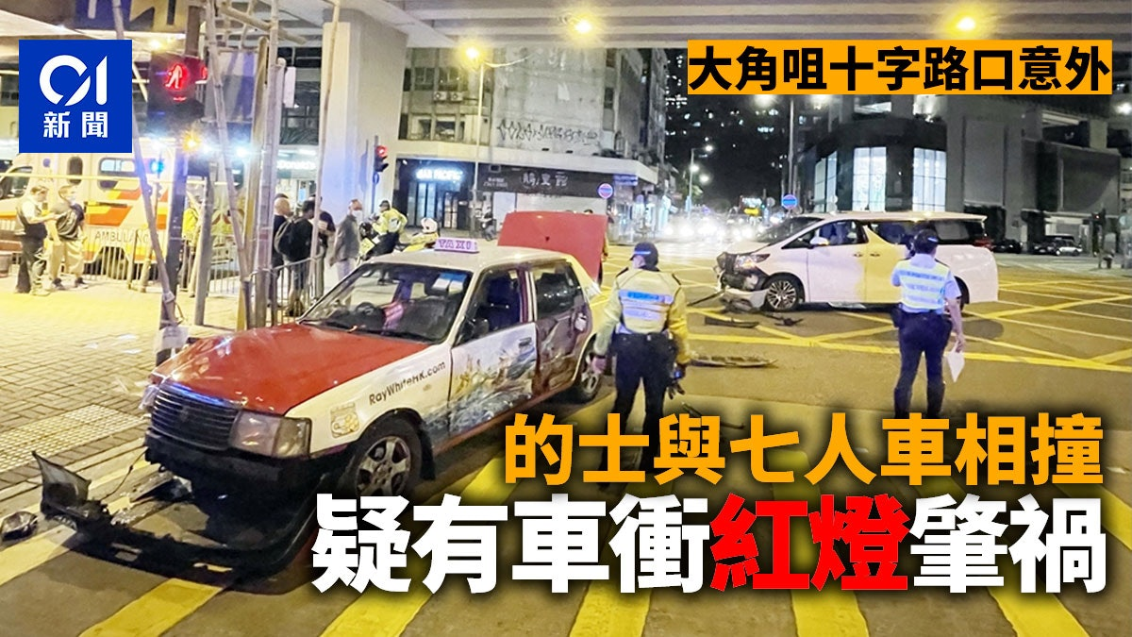
Digital Red Light Camera
數碼衝紅燈攝影機

Slide 5
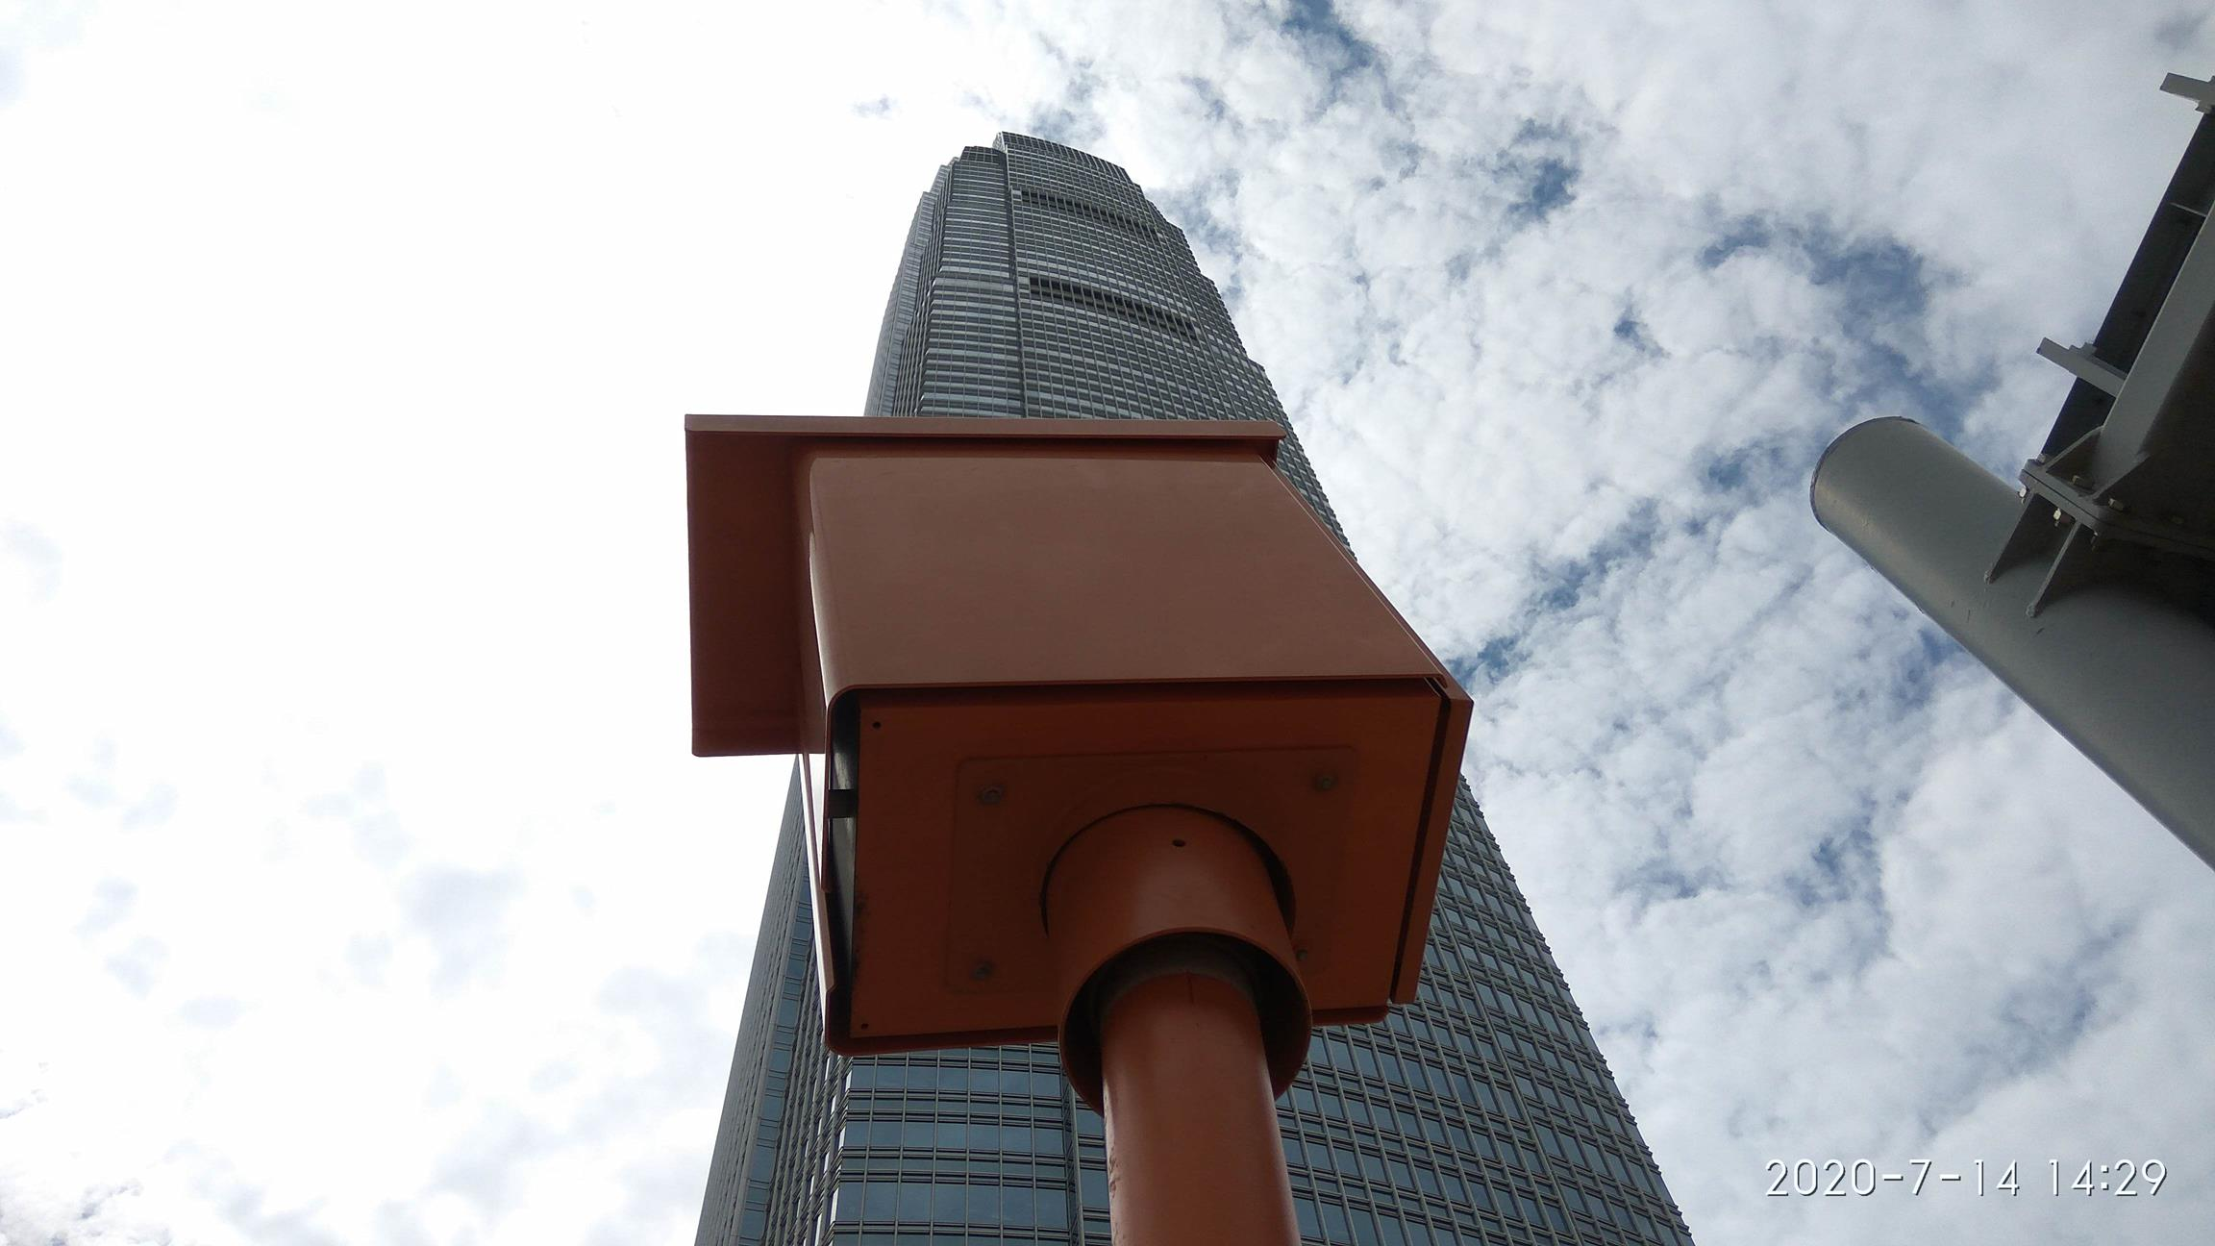



Digital Red Light Camera System
數碼衝紅燈攝影機
管理+operation
設備維修保養
運輸署
Transport Department

Slide 6
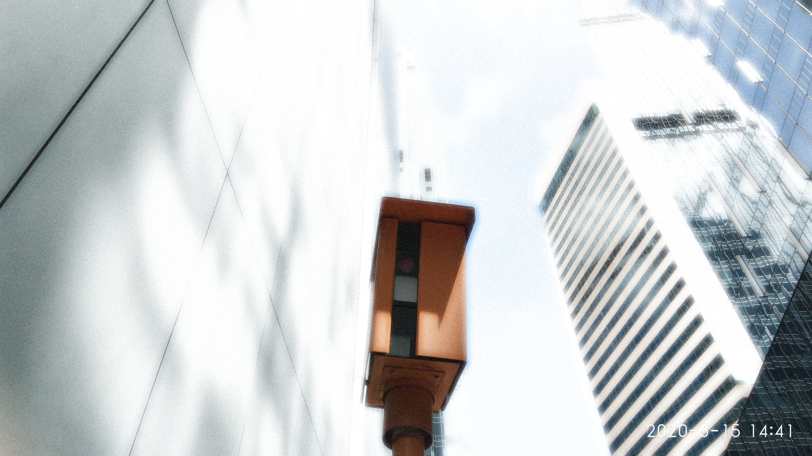

Digital Red Light Camera
數碼衝紅燈攝影機

Slide 7
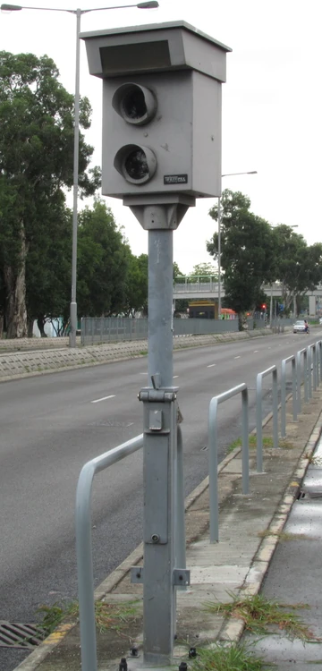
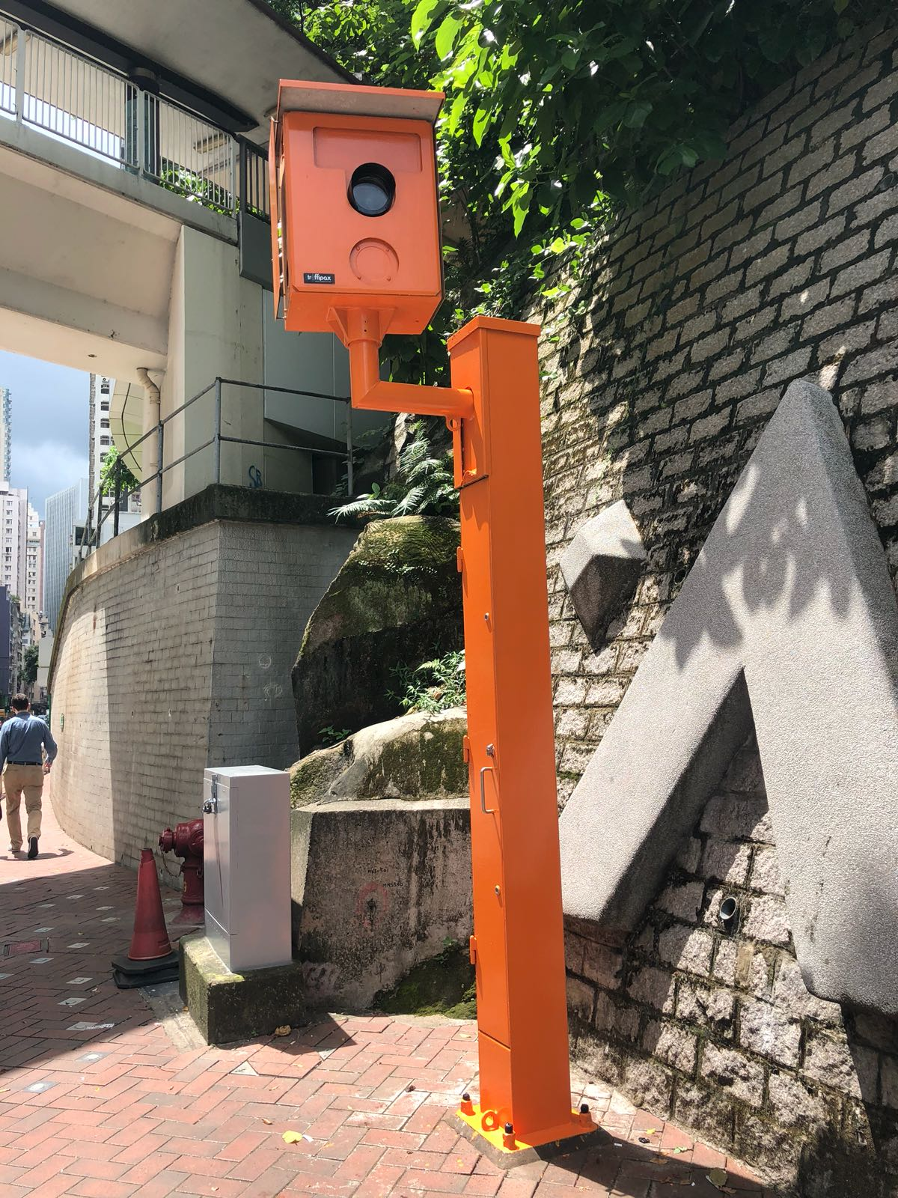
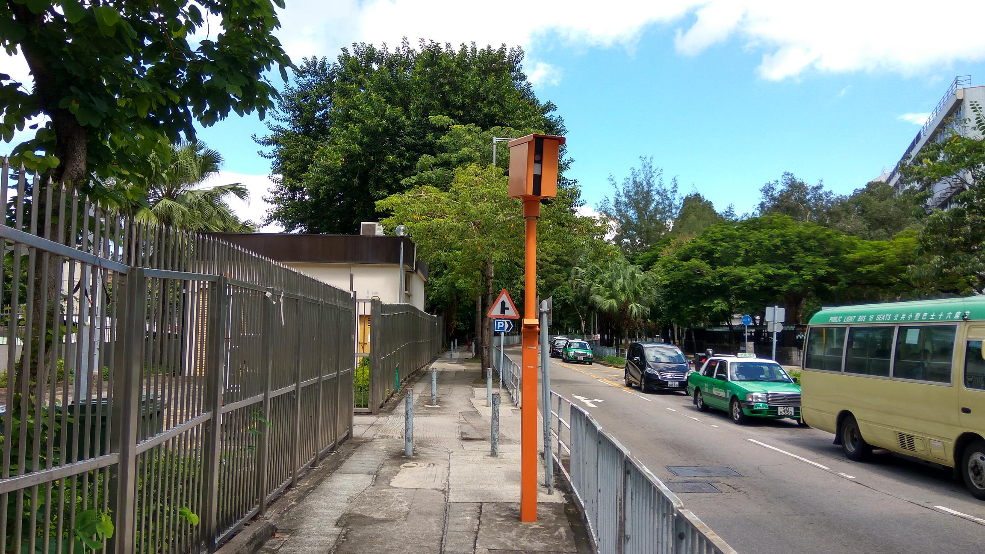
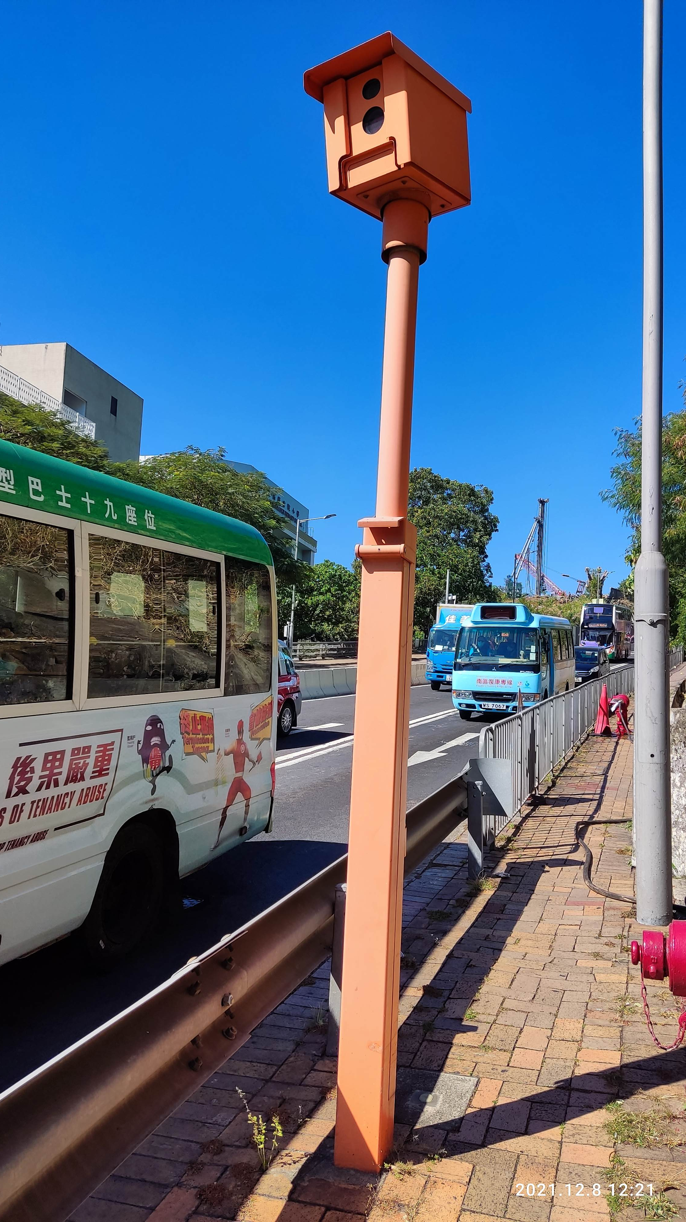
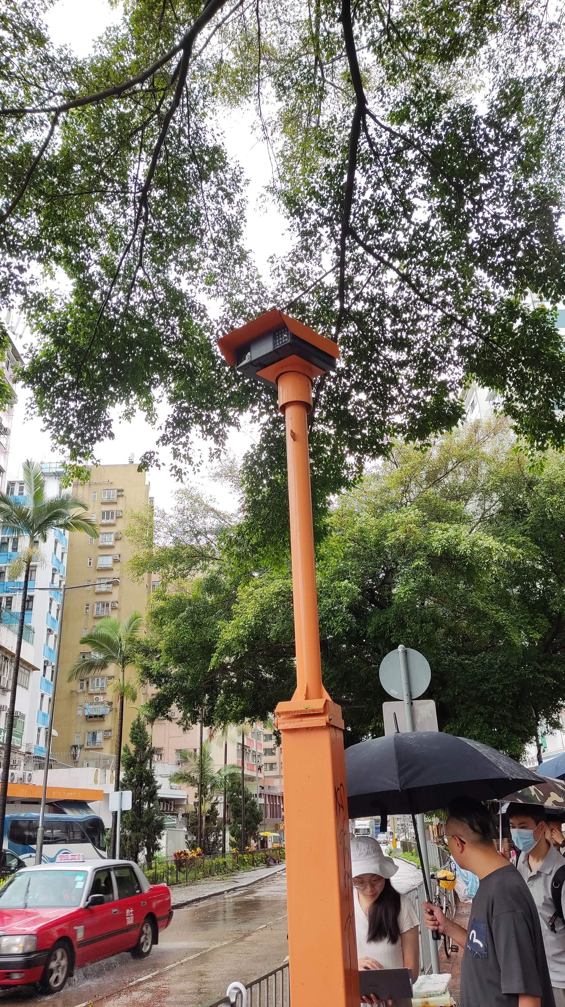
顯影式
1993 - 2003
DRLC I & II
2003 - 2024
DRLC III
2010 - Now
DRLC IV
2017 - Now
DRLC V
2024 - Now
80 set
76 set
58 set
84 set
Digital Red Light Camera
數碼衝紅燈攝影機

Slide 8
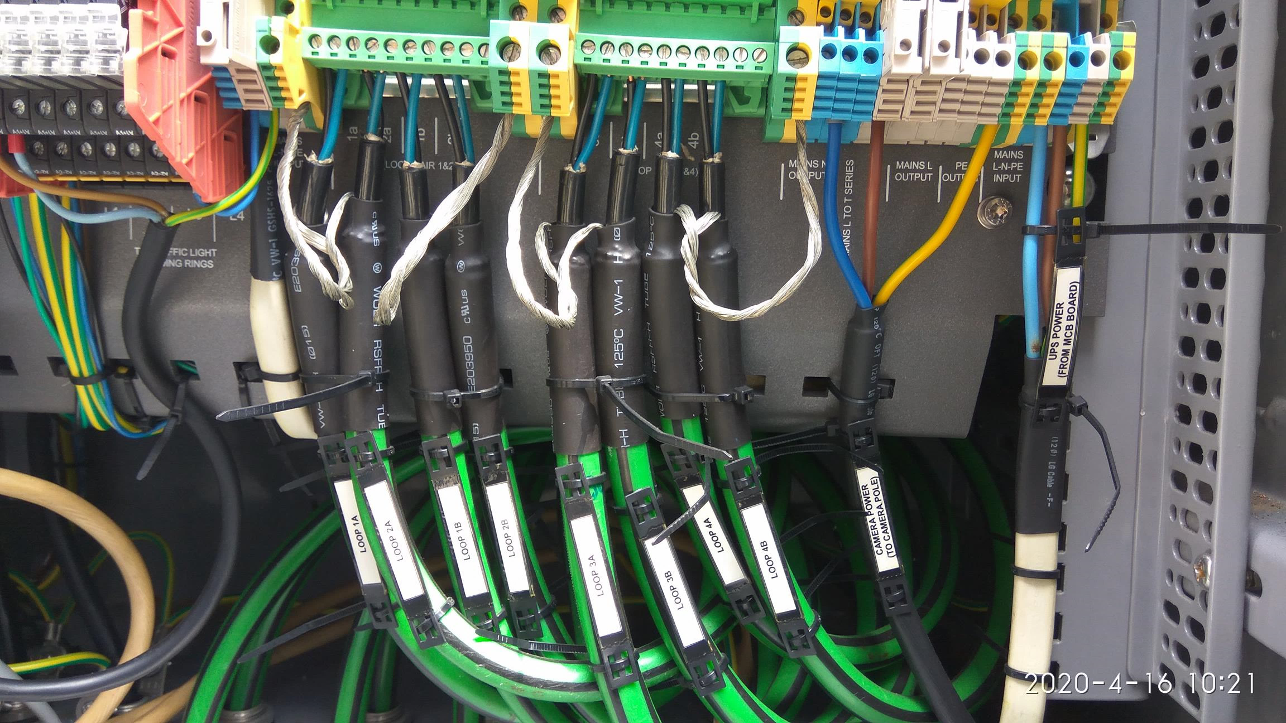

Digital Red Light Camera
數碼衝紅燈攝影機

Slide 9

Digital Red Light Camera
數碼衝紅燈攝影機

Slide 10

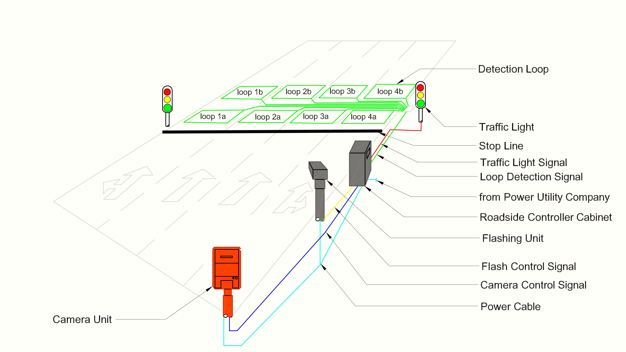
DRLC I, II, III
Digital Red Light Camera
數碼衝紅燈攝影機

Slide 11
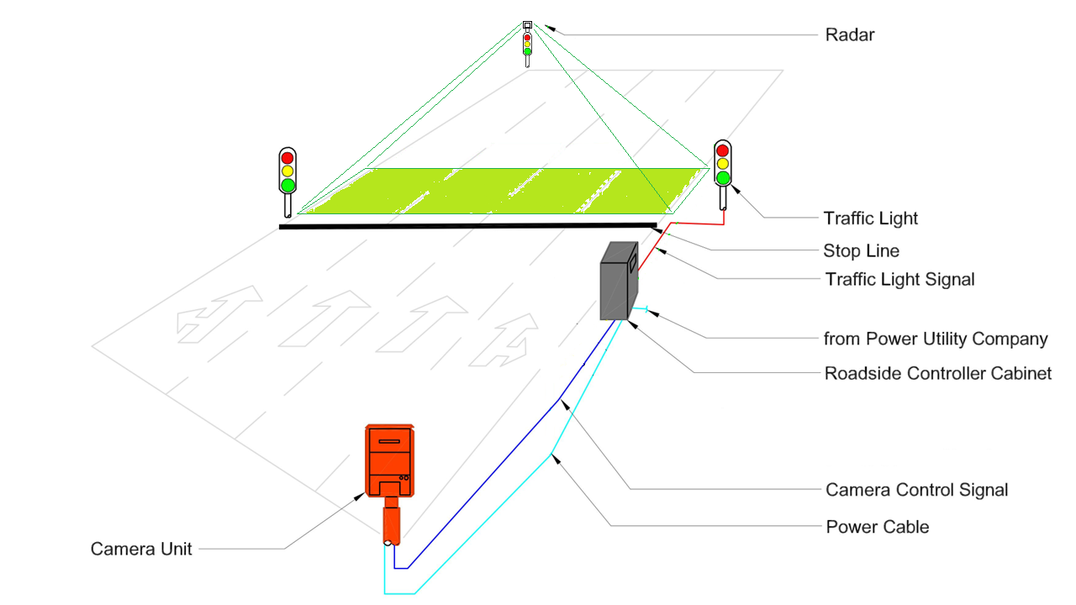
DRLC IV, V
Digital Red Light Camera
數碼衝紅燈攝影機

Slide 12


DRLC IV, V
Digital Red Light Camera
數碼衝紅燈攝影機

Slide 13
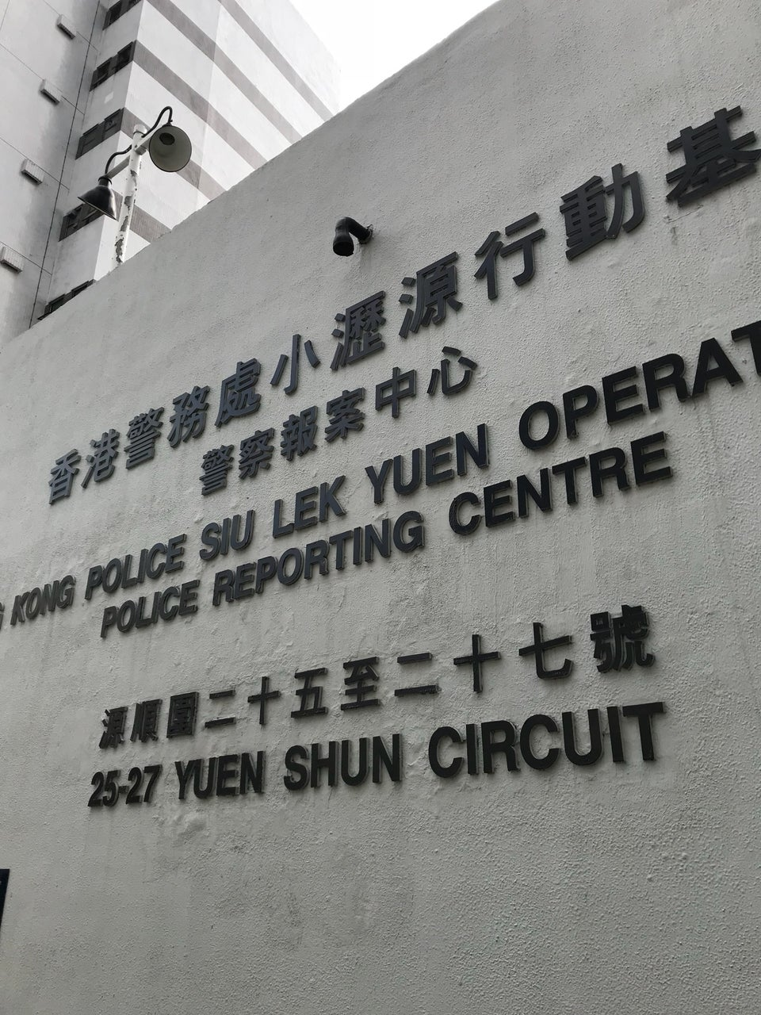
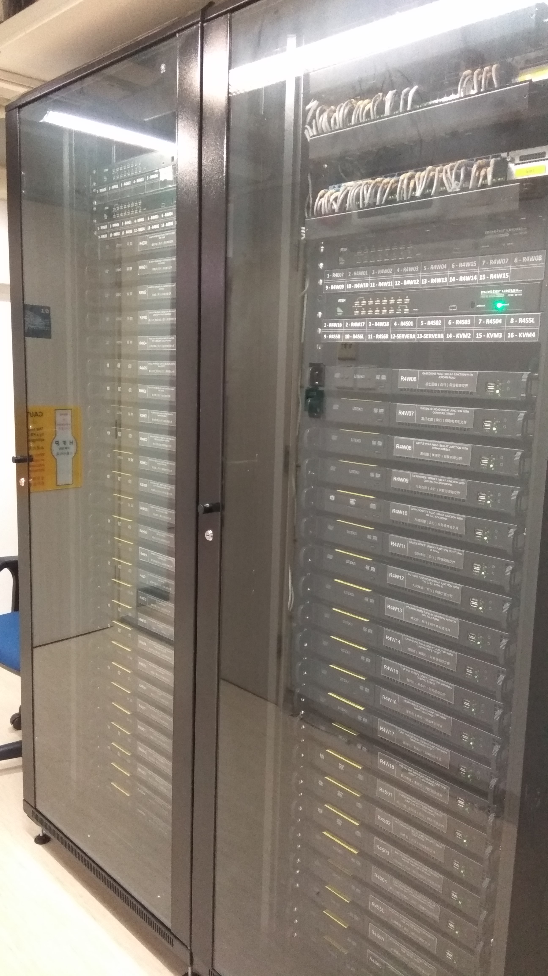
Digital Red Light Camera
數碼衝紅燈攝影機

Slide 14
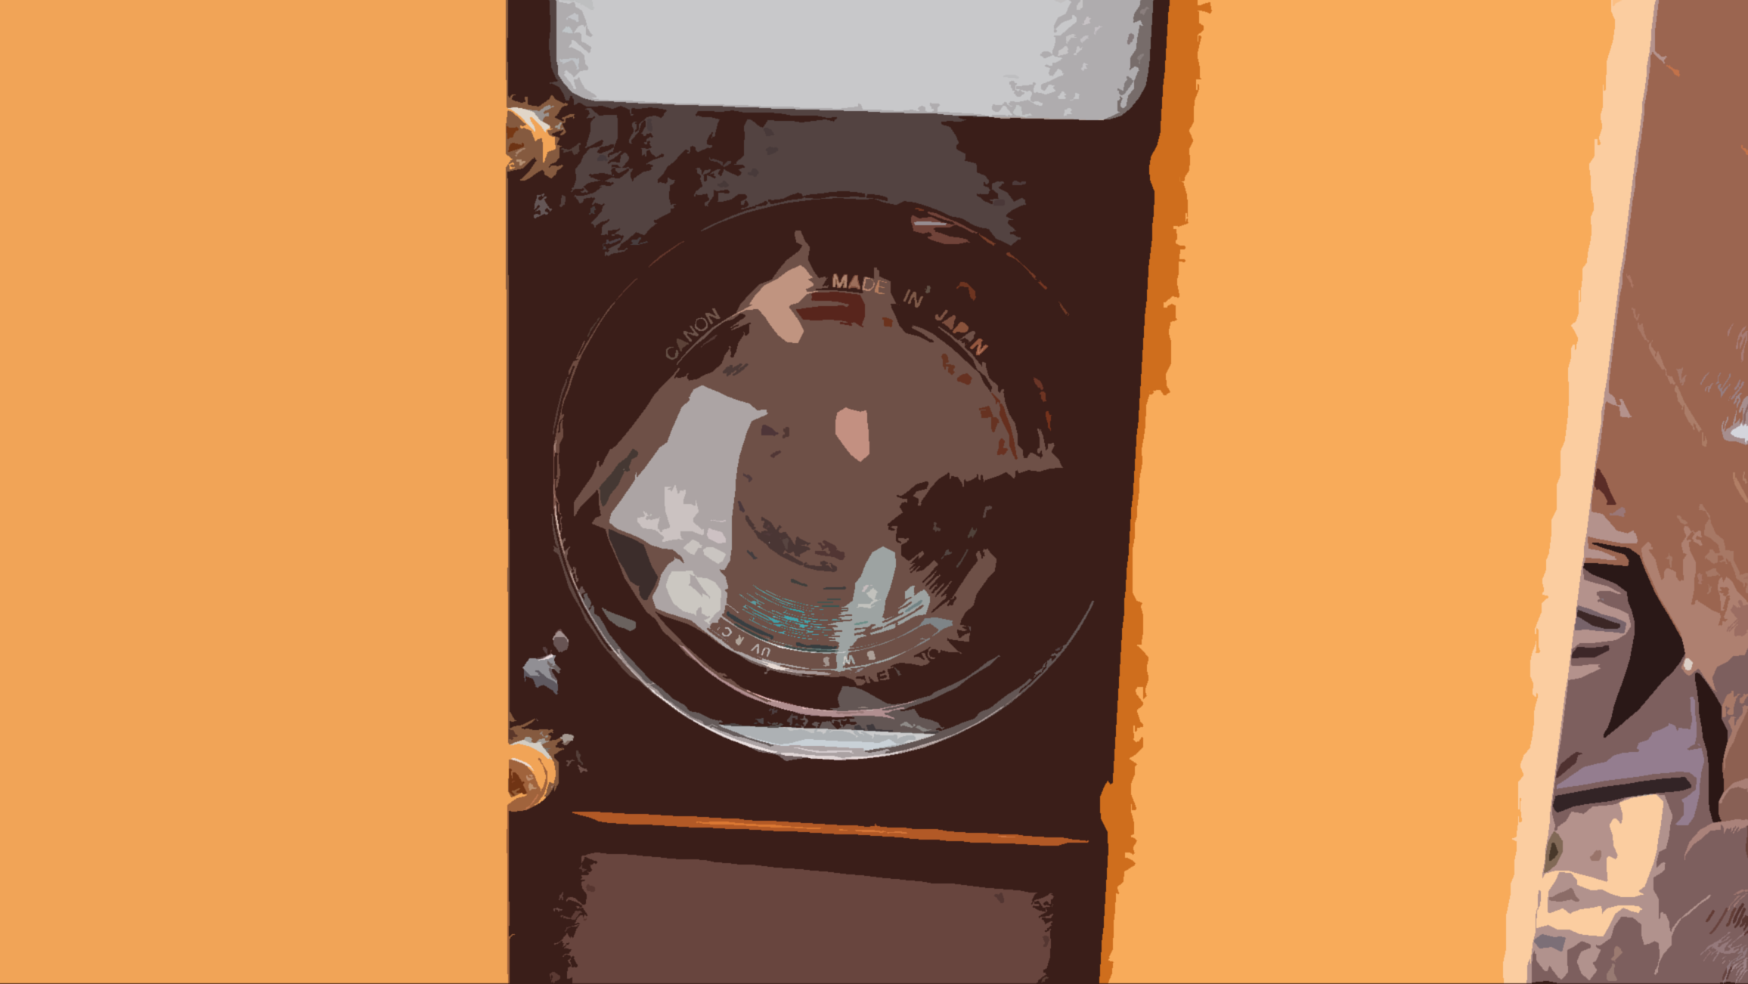

Digital Red Light Camera
數碼衝紅燈攝影機

Slide 15
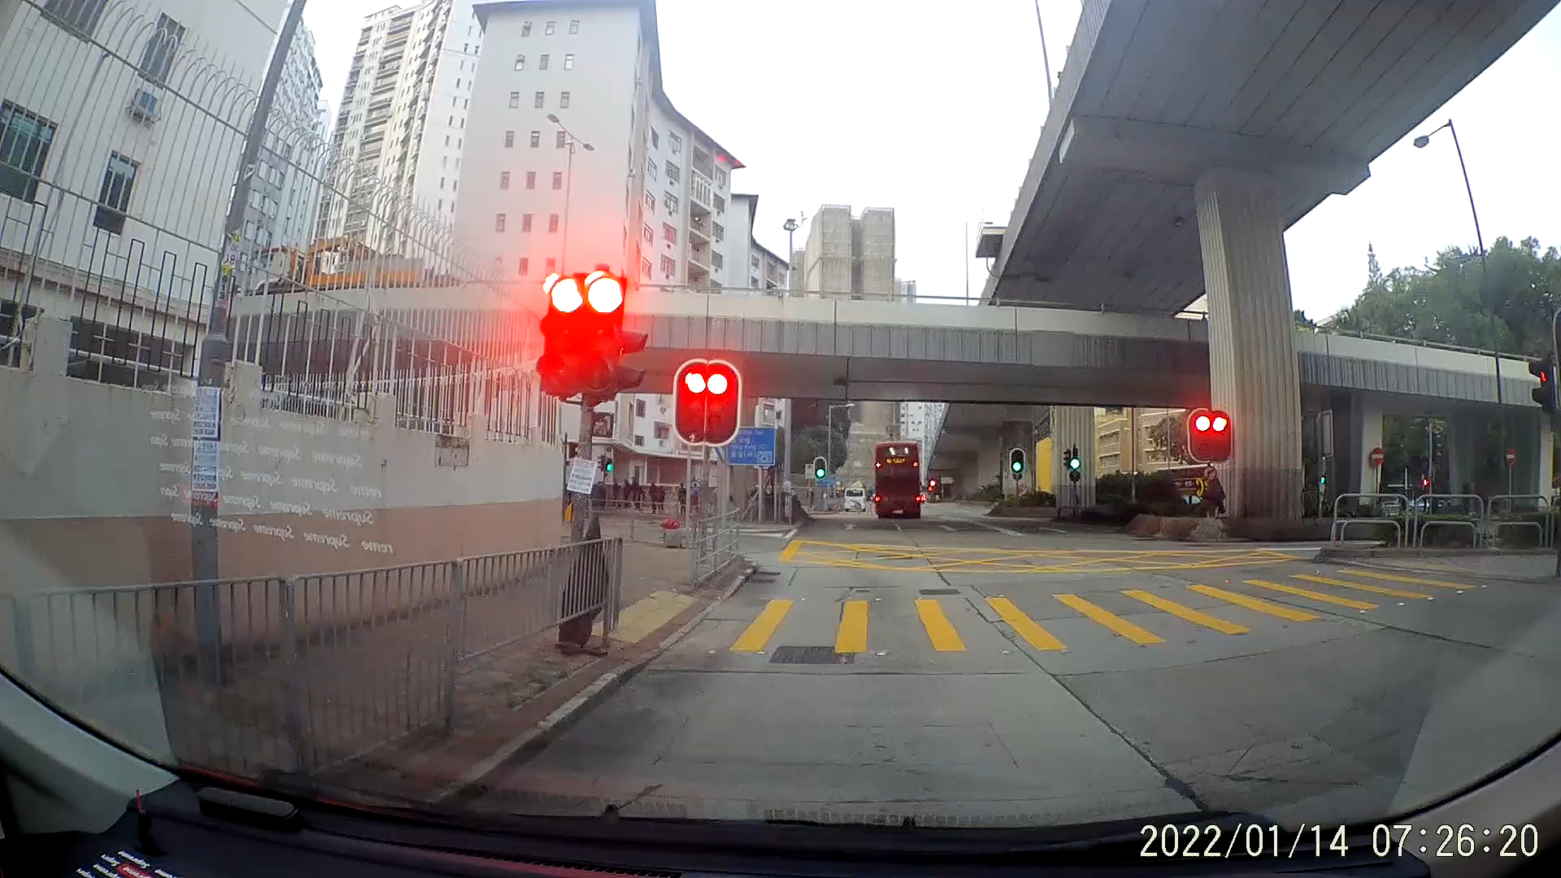
Digital Red Light Camera
數碼衝紅燈攝影機

Slide 16
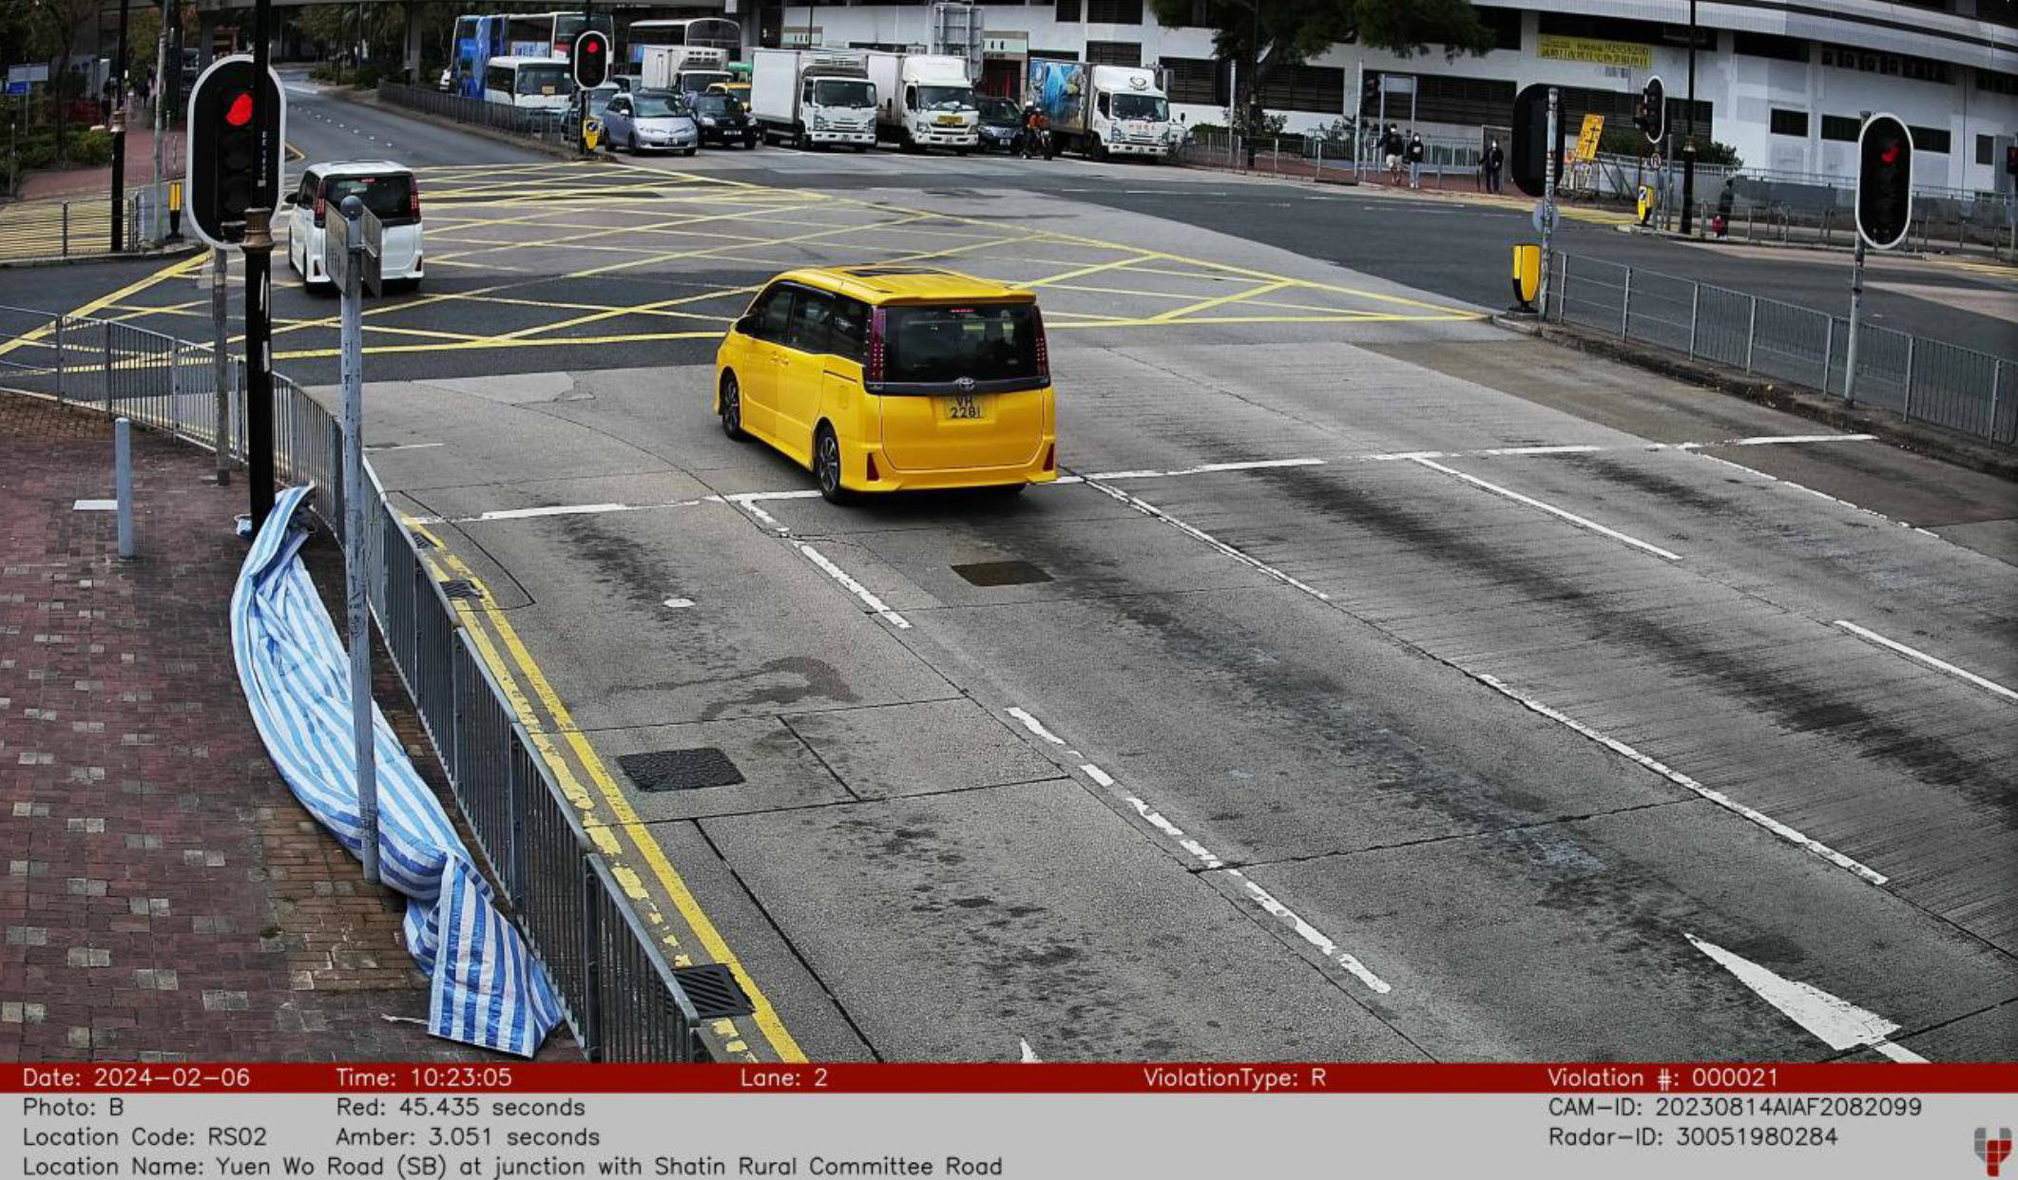
Digital Red Light Camera
數碼衝紅燈攝影機

Slide 17
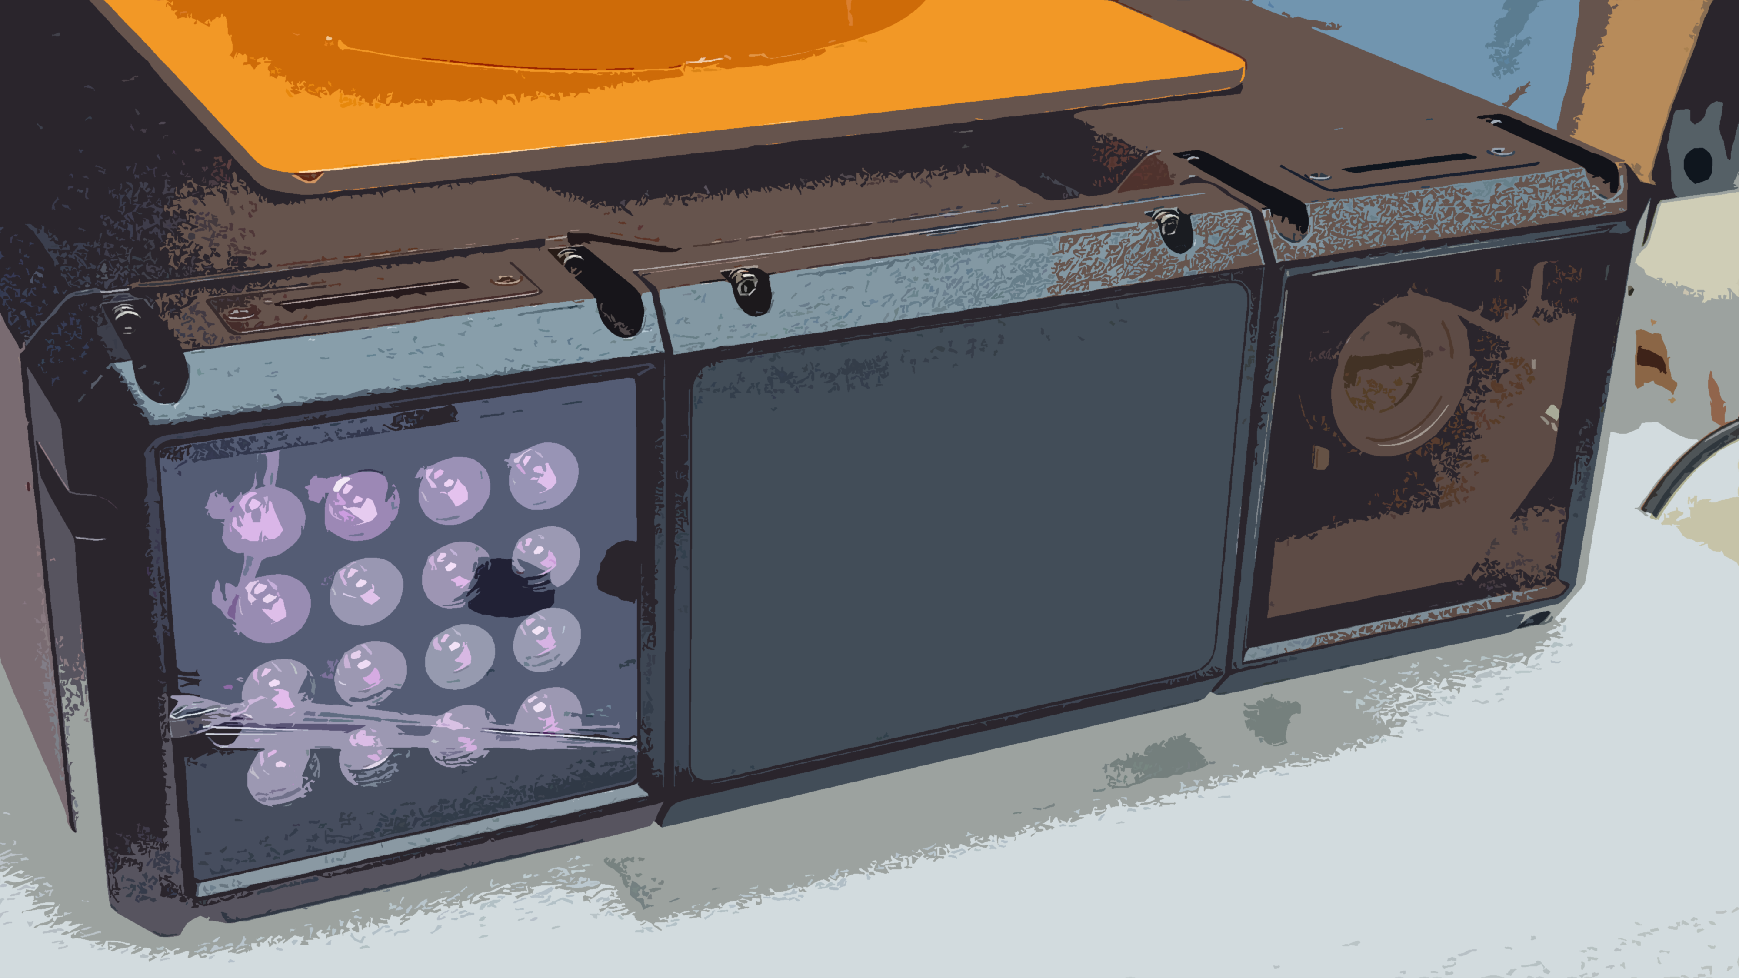
Challenge
Digital Red Light Camera
數碼衝紅燈攝影機

Slide 18
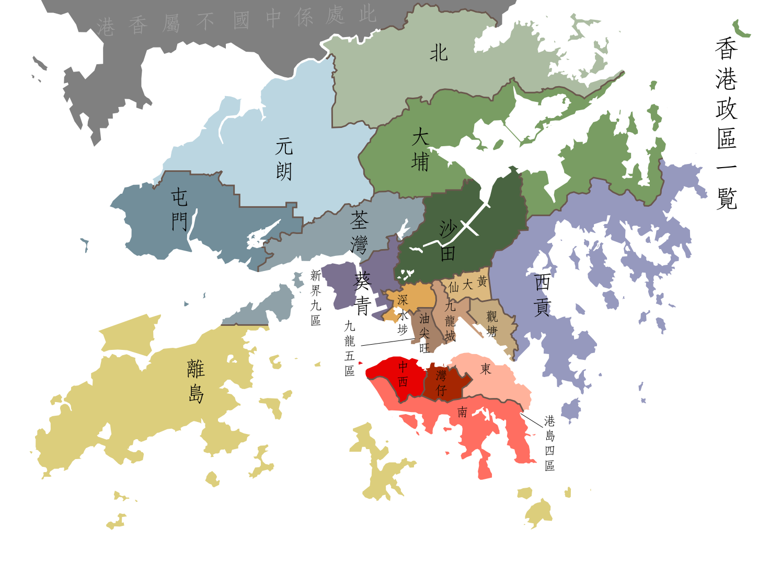

Cost Estimation
Supervision
Quotation
T&C
Settlement
Purchase Order
Renew contract
Funding Request

Slide 19
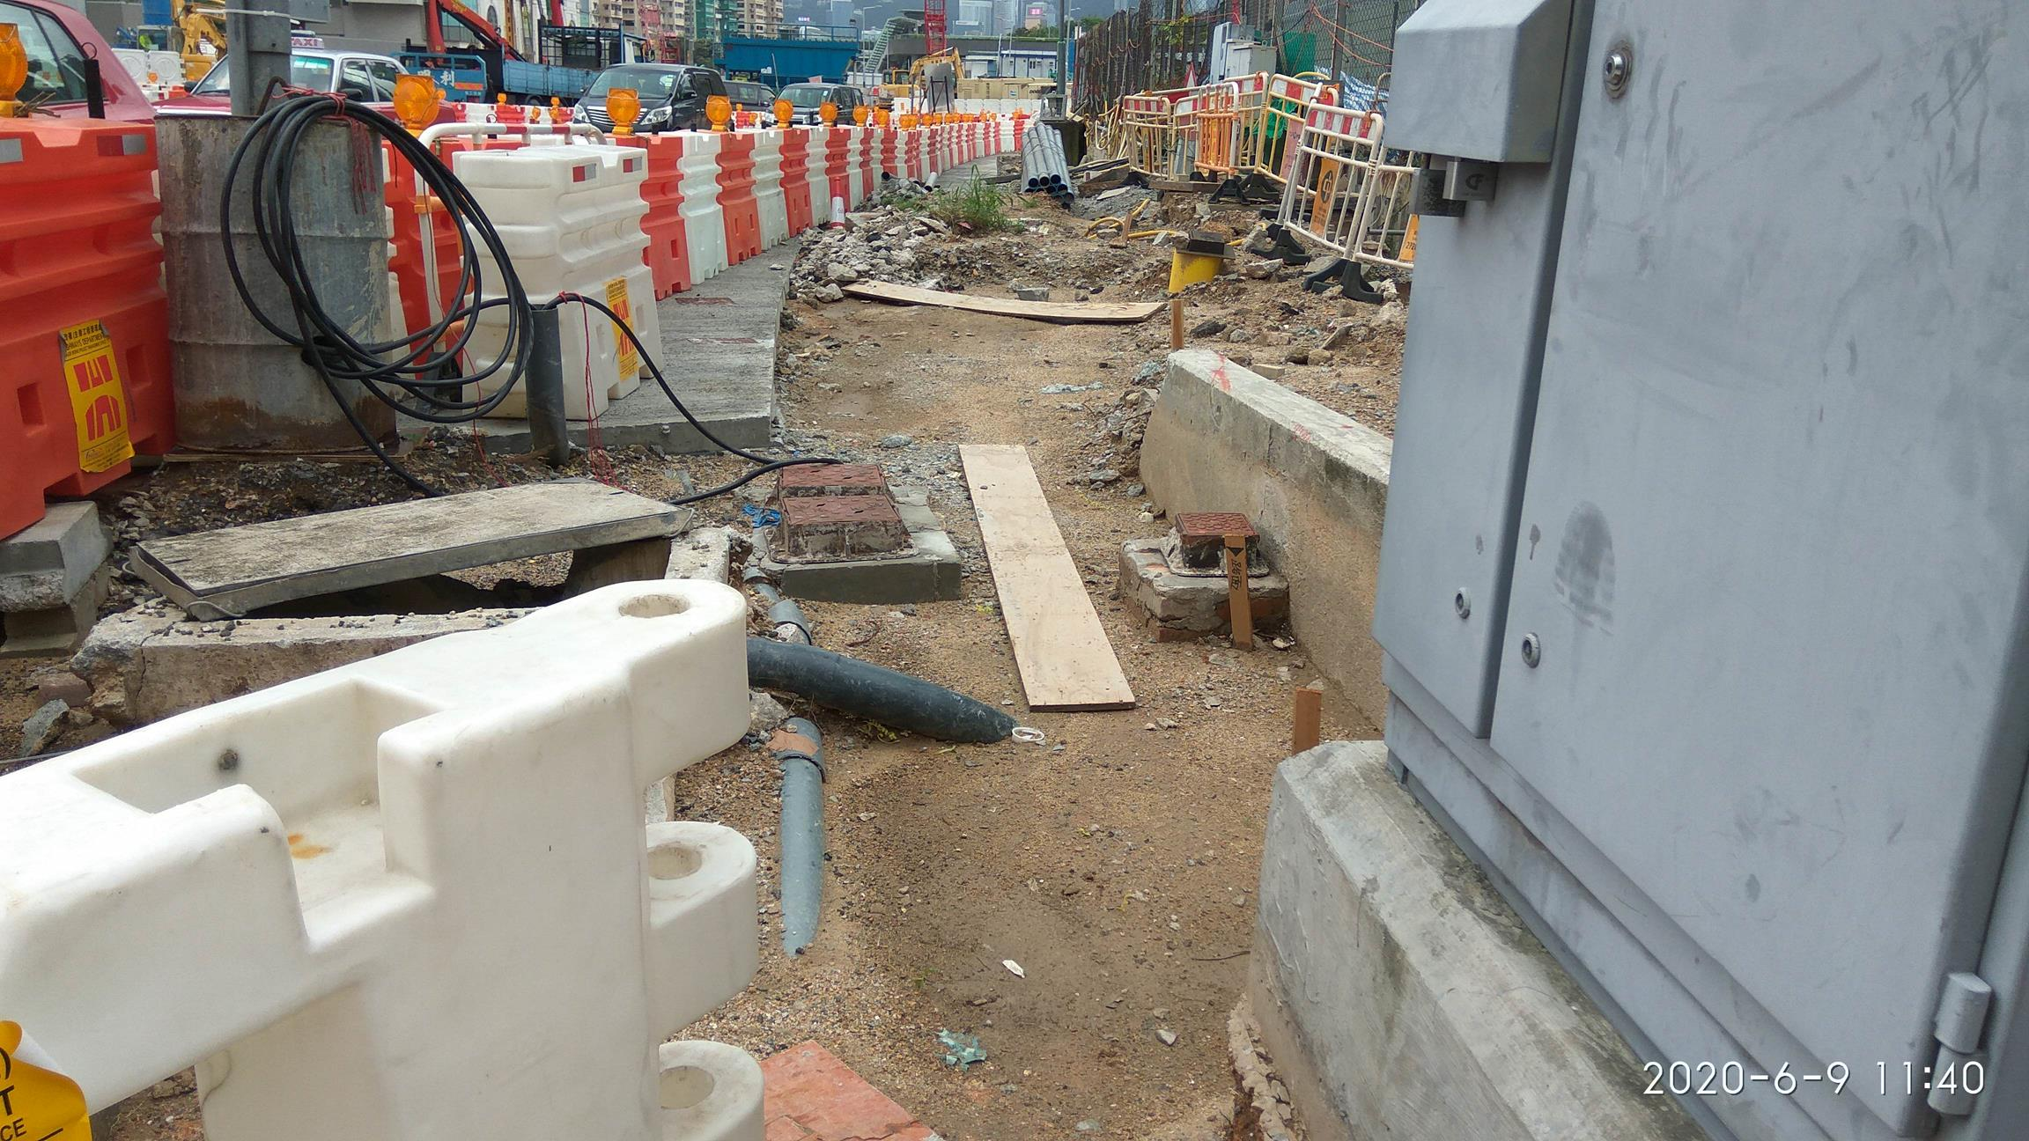
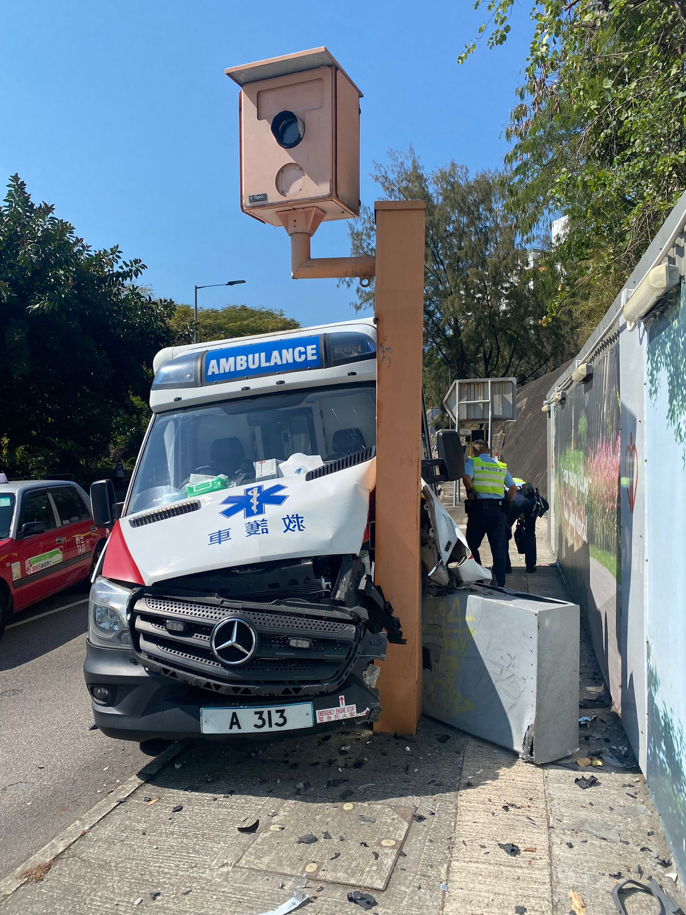
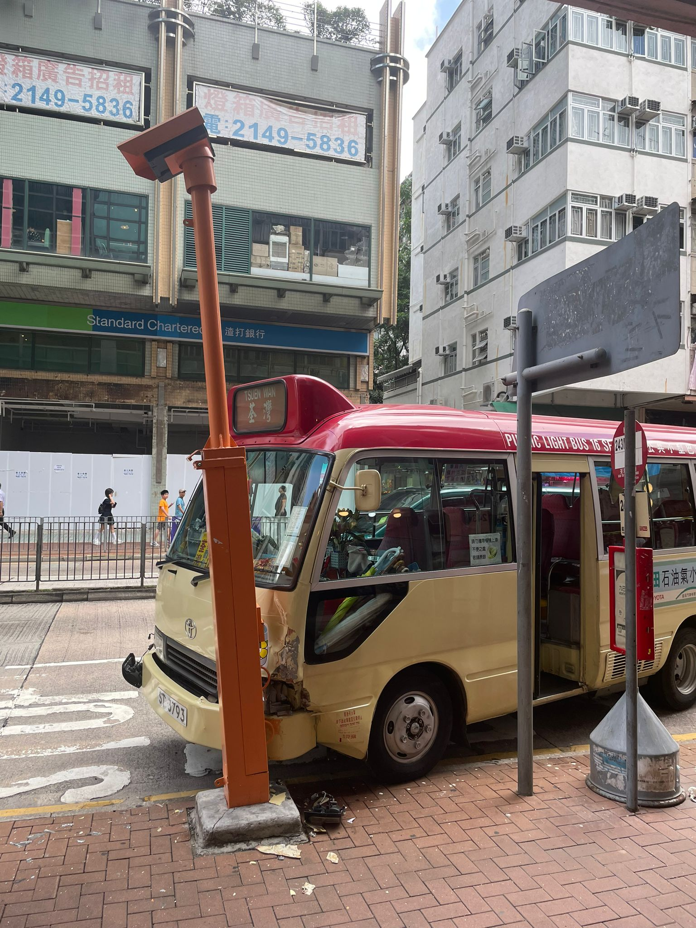
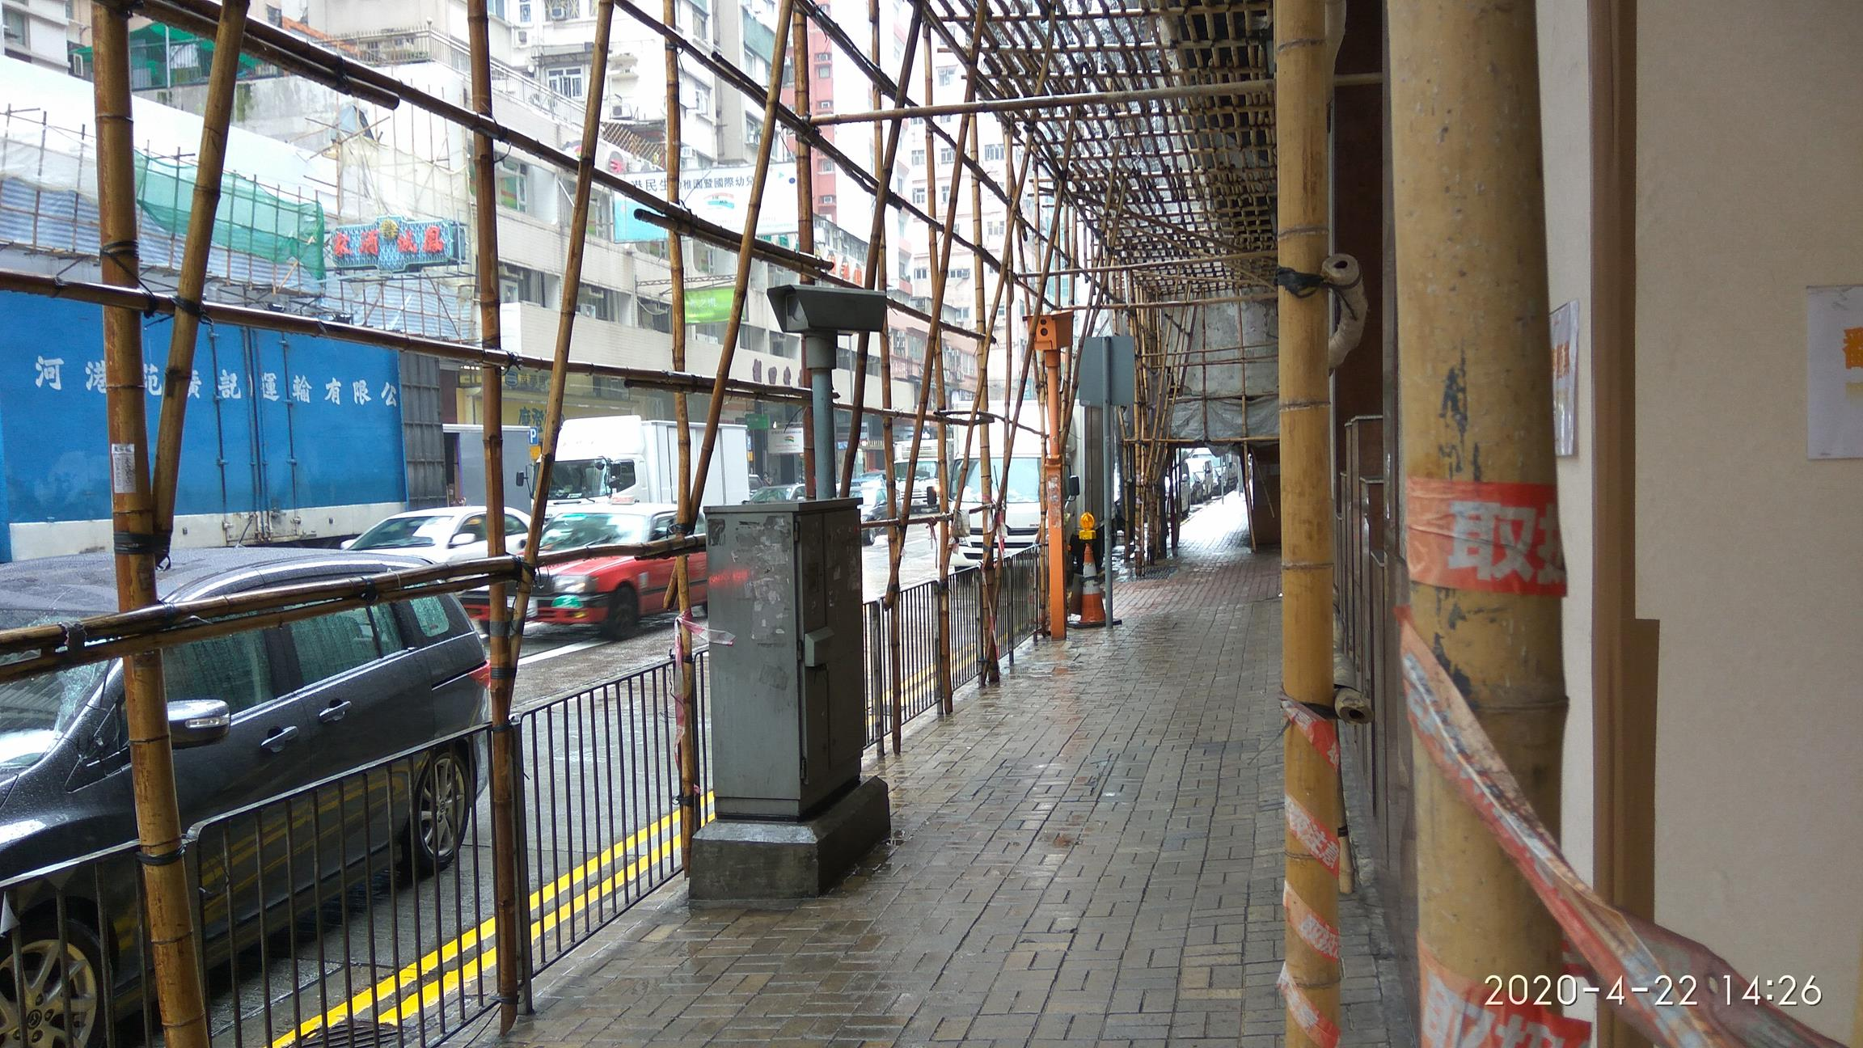

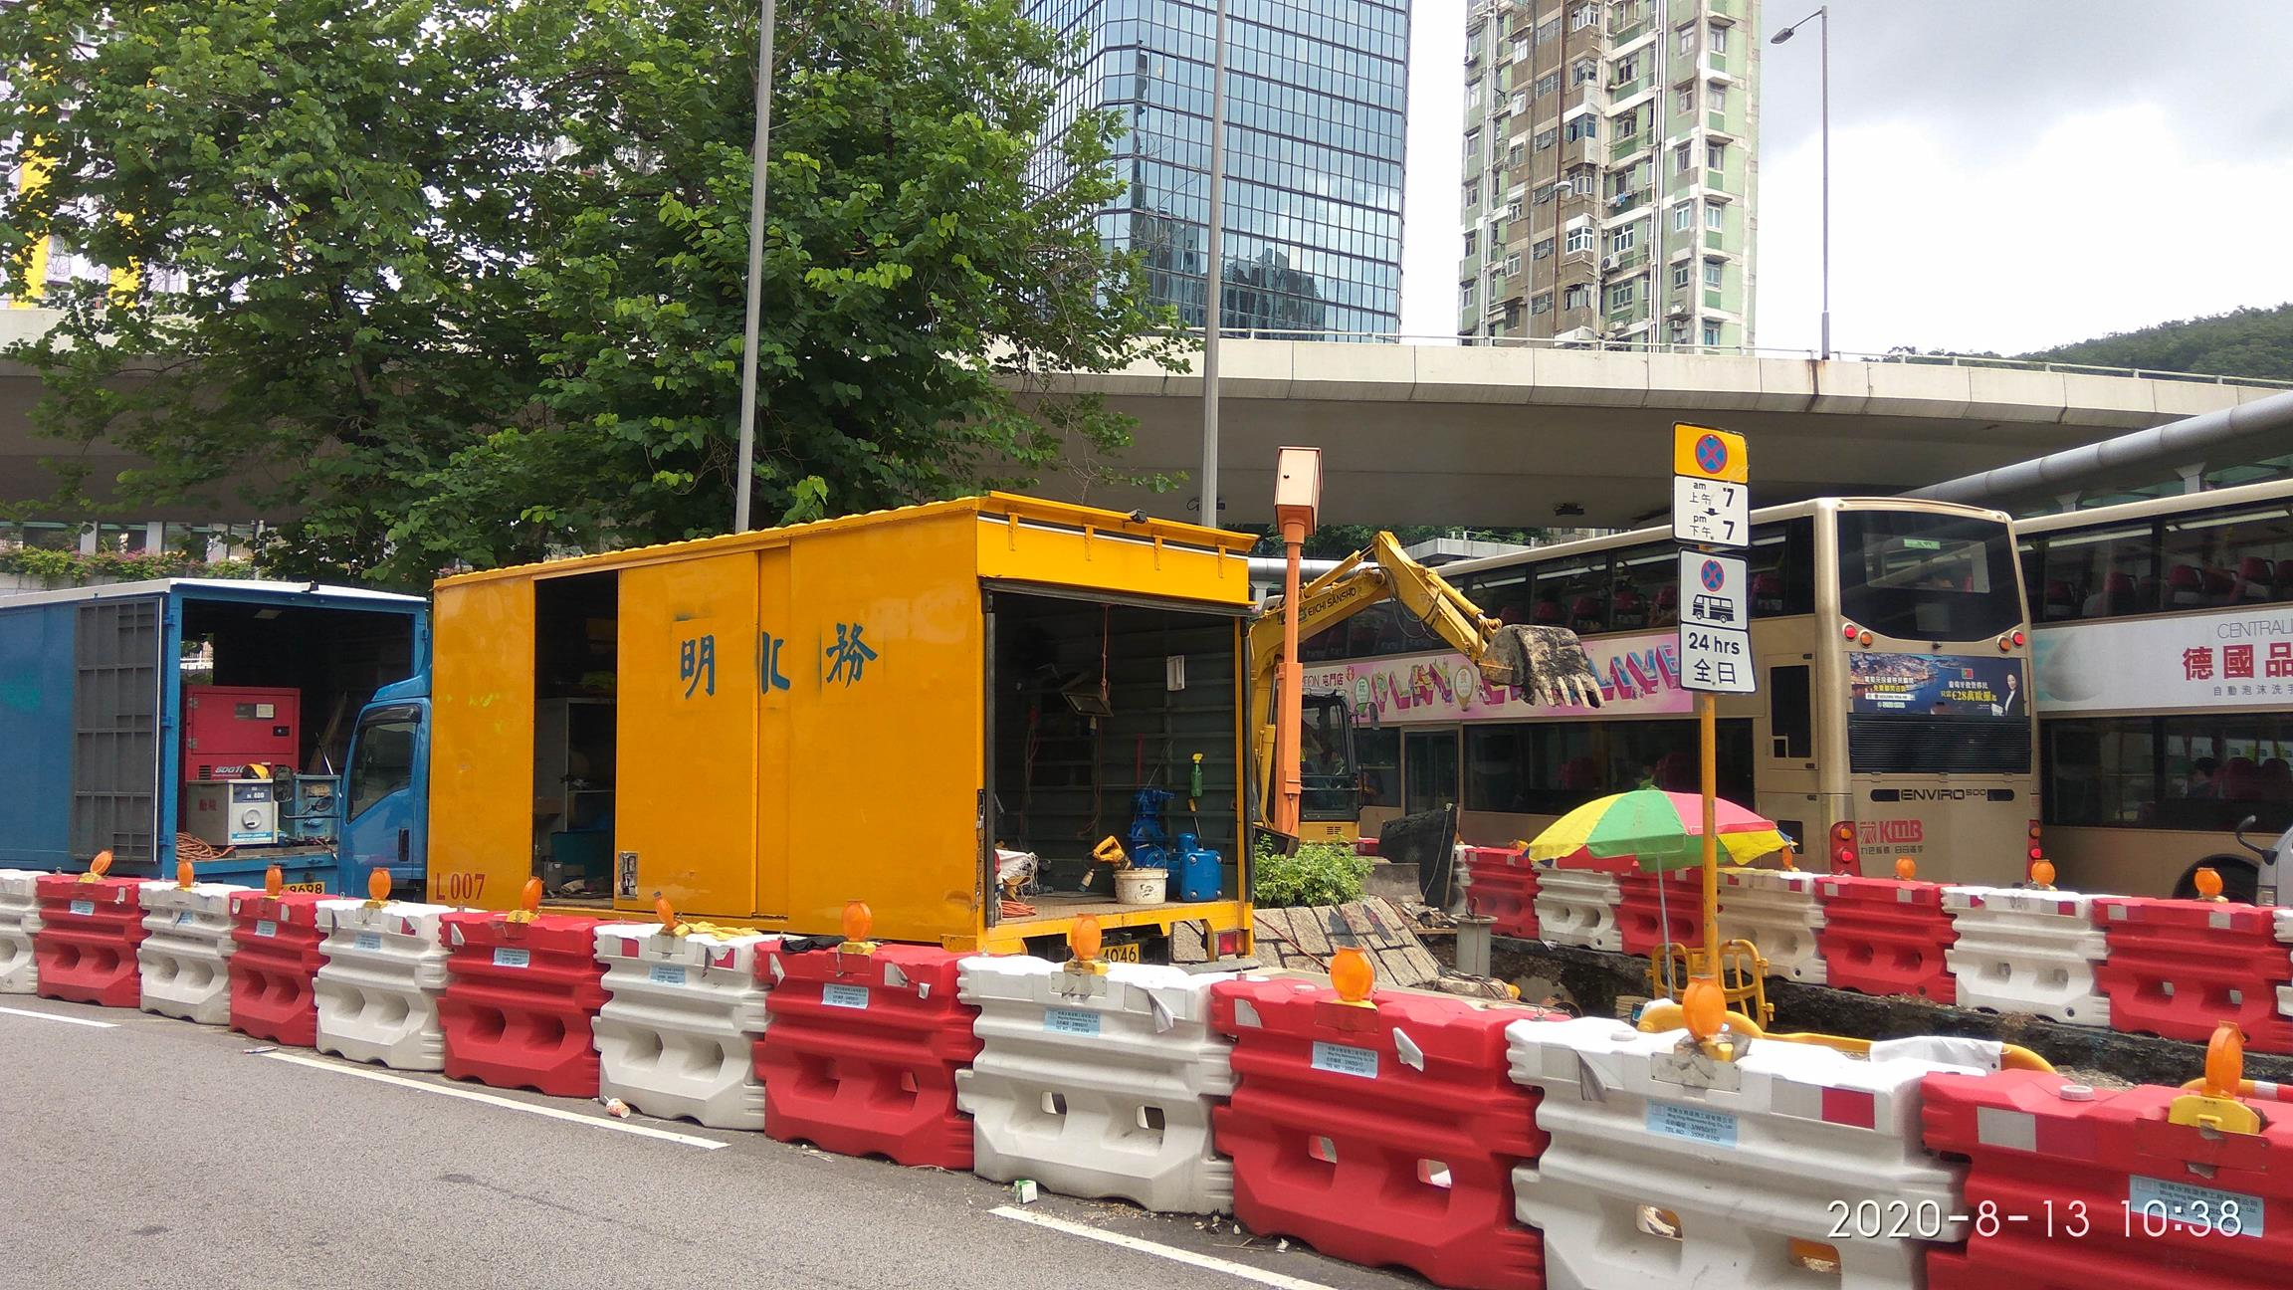
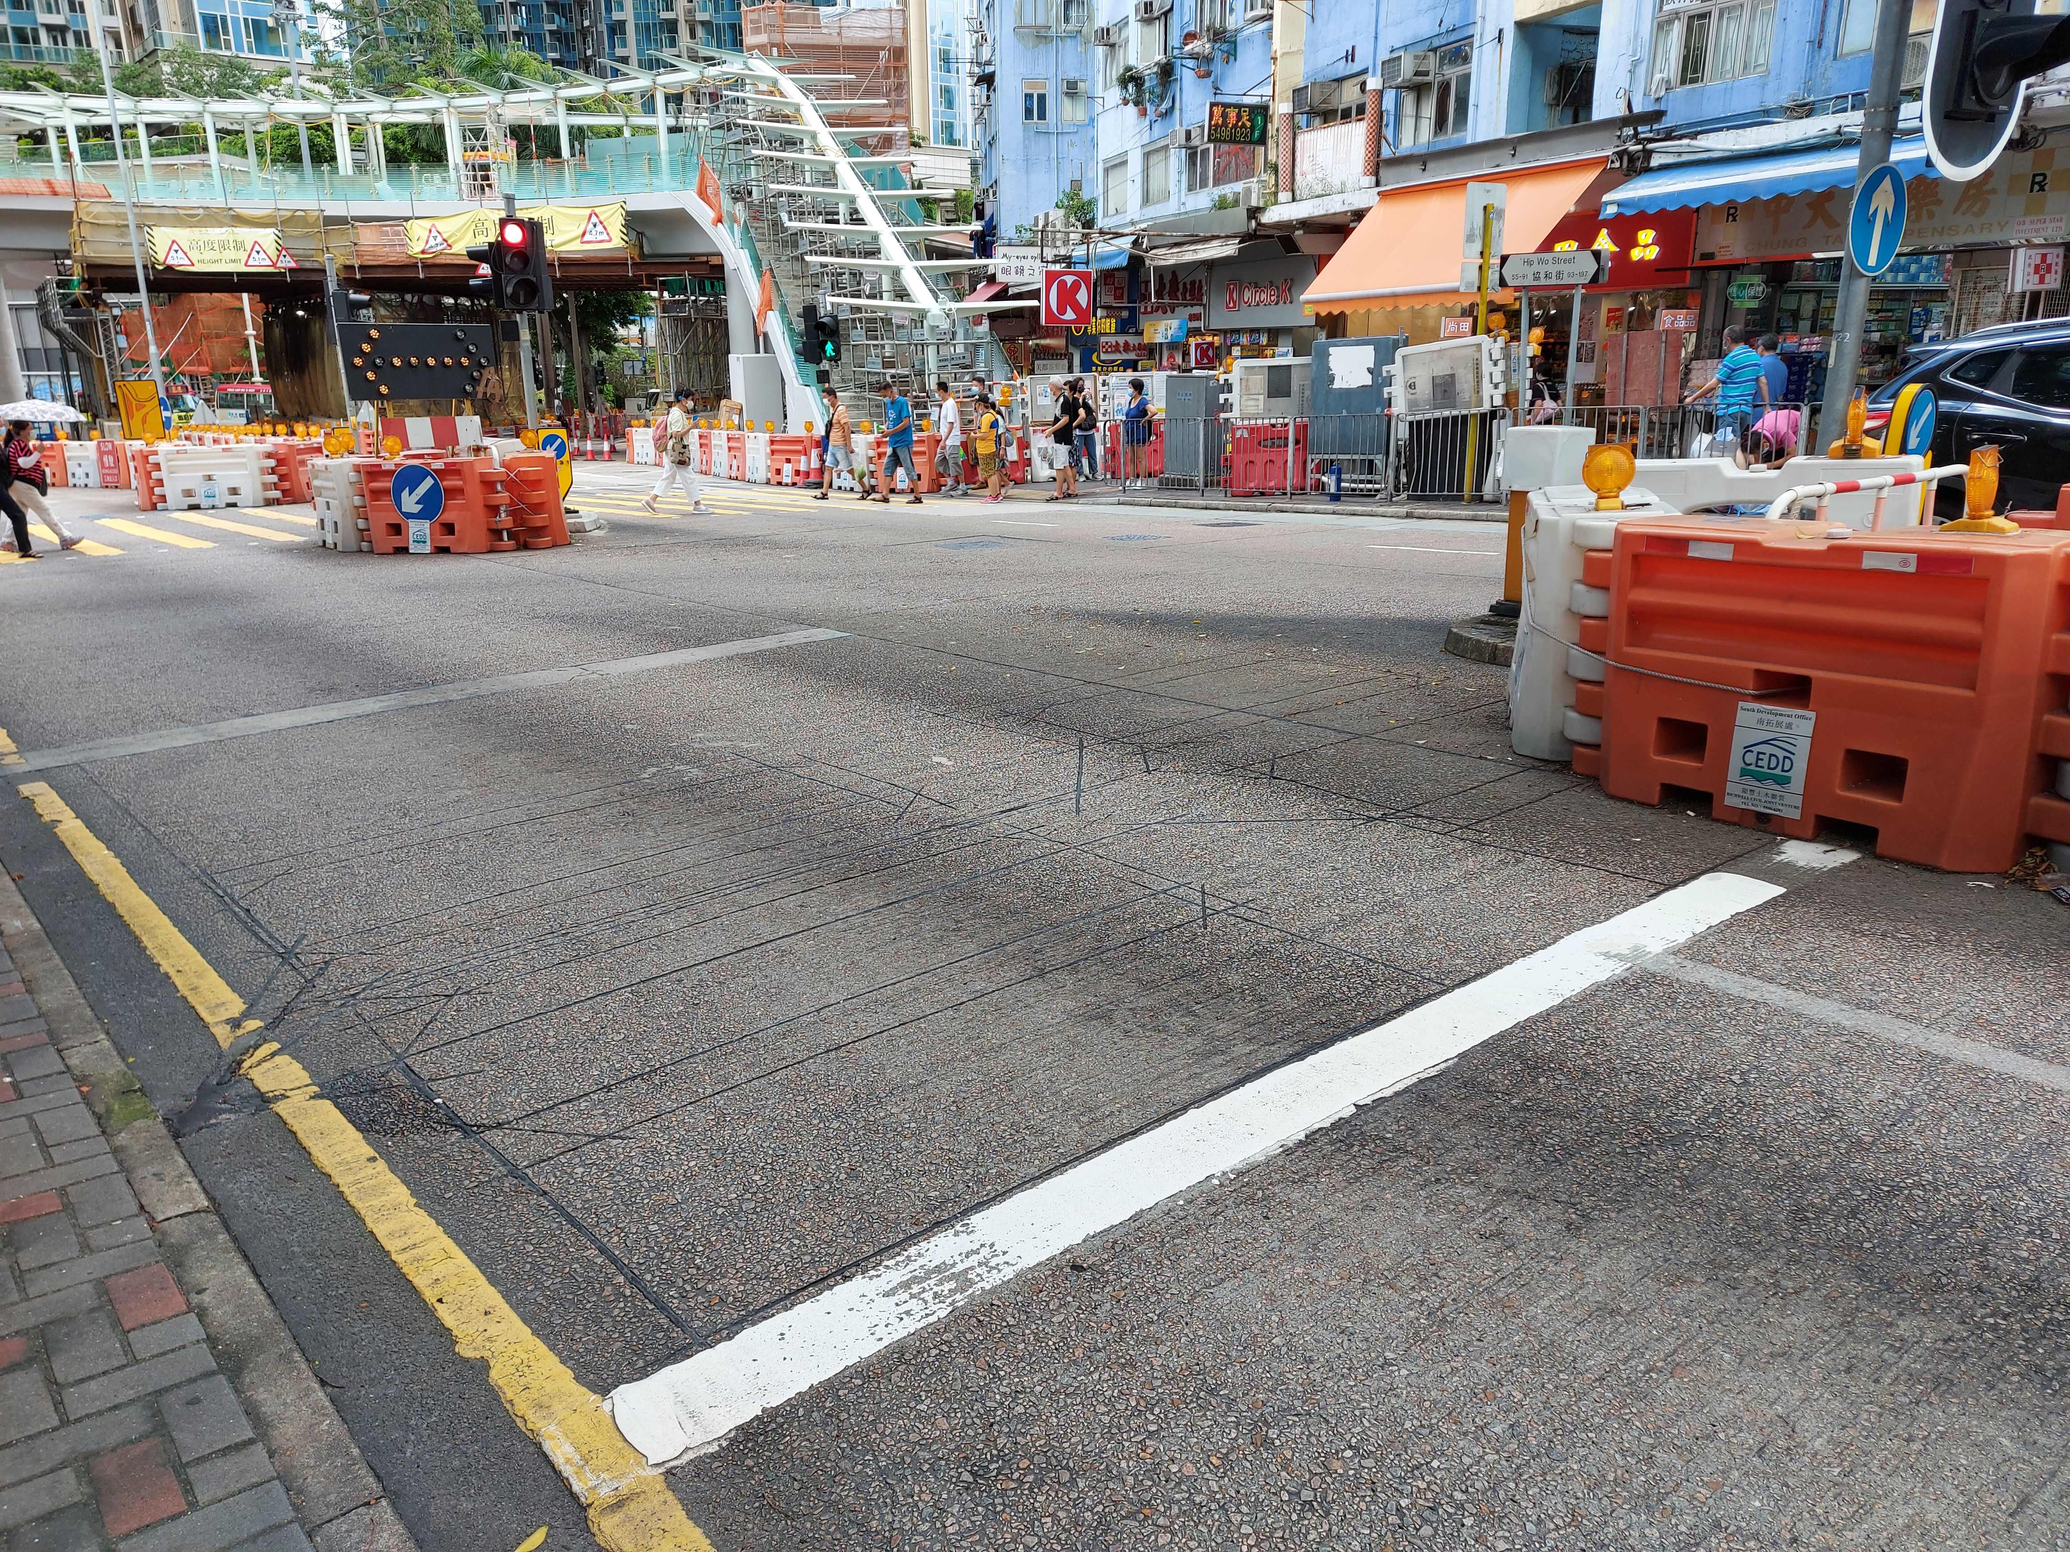
Digital Red Light Camera
數碼衝紅燈攝影機

Slide 20
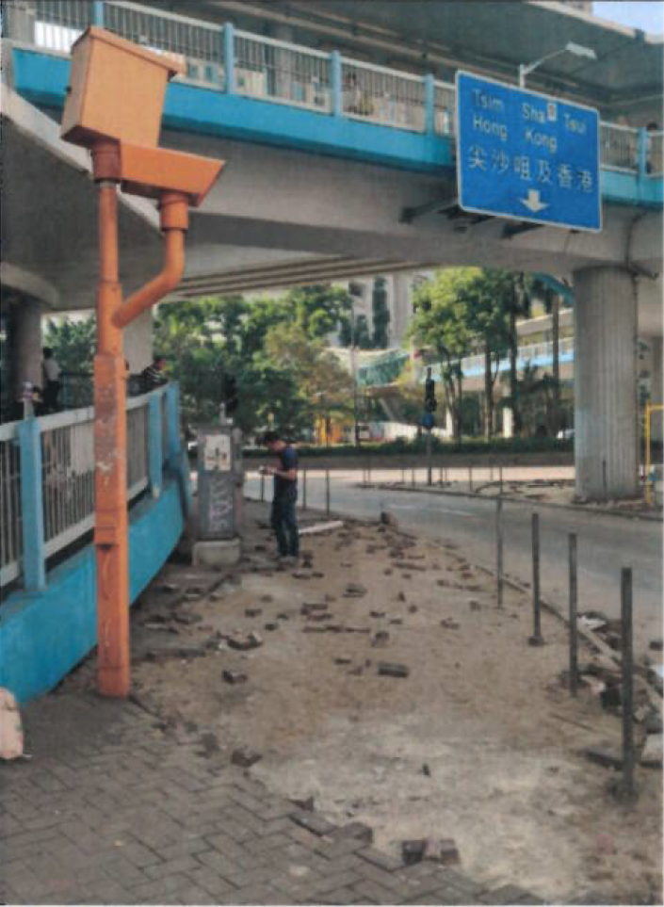
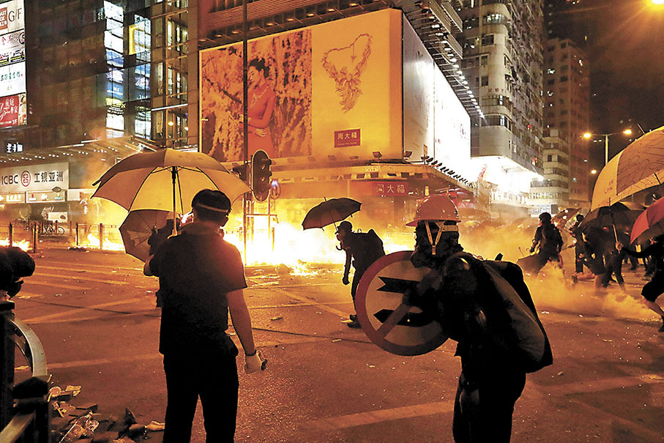
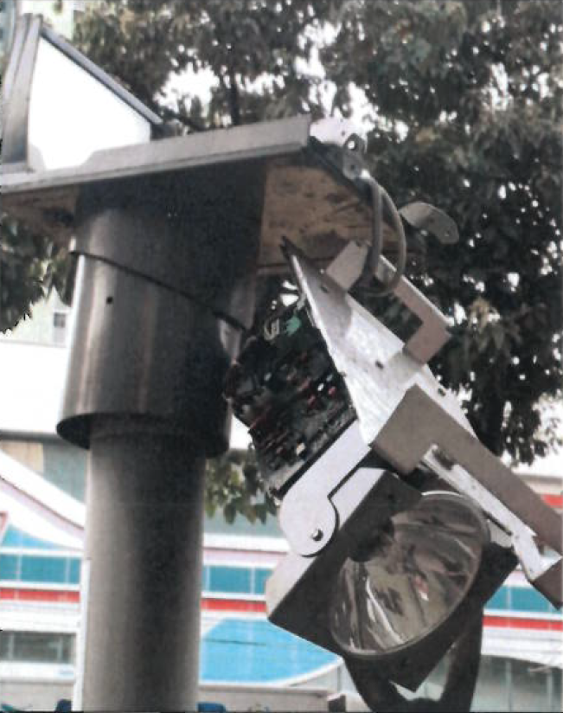
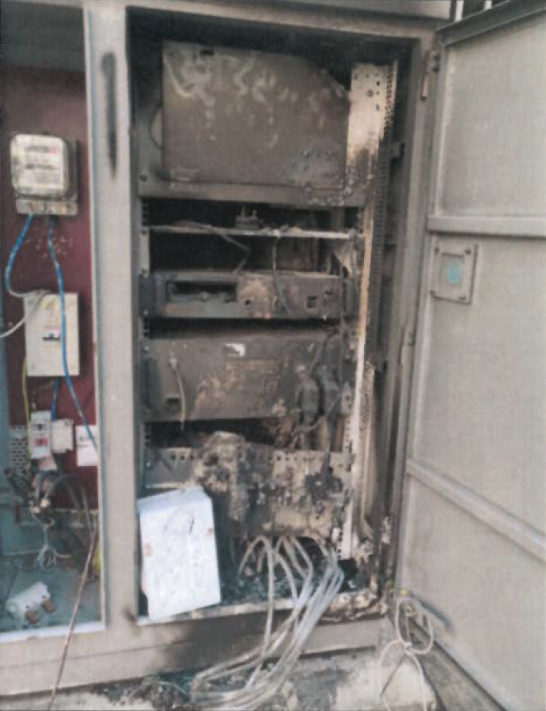
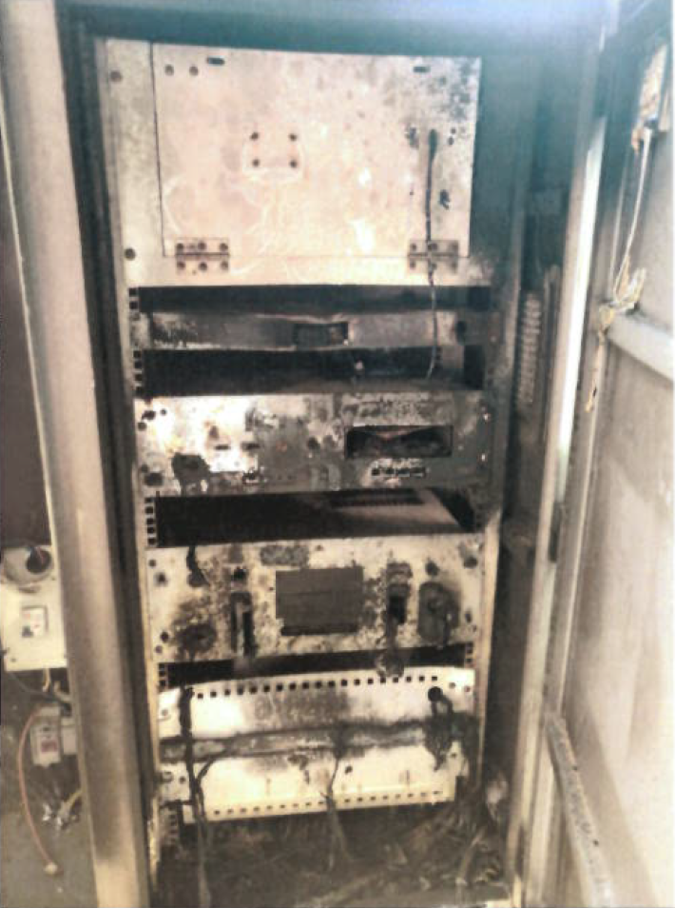
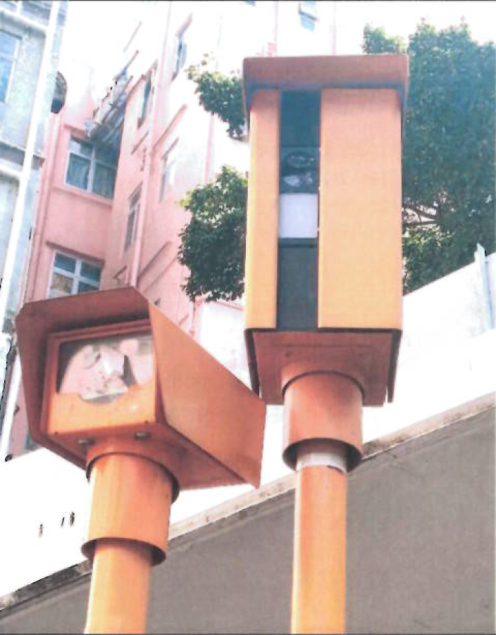
Digital Red Light Camera
數碼衝紅燈攝影機

Slide 21

Digital Red Light Camera
數碼衝紅燈攝影機

