Slide 1
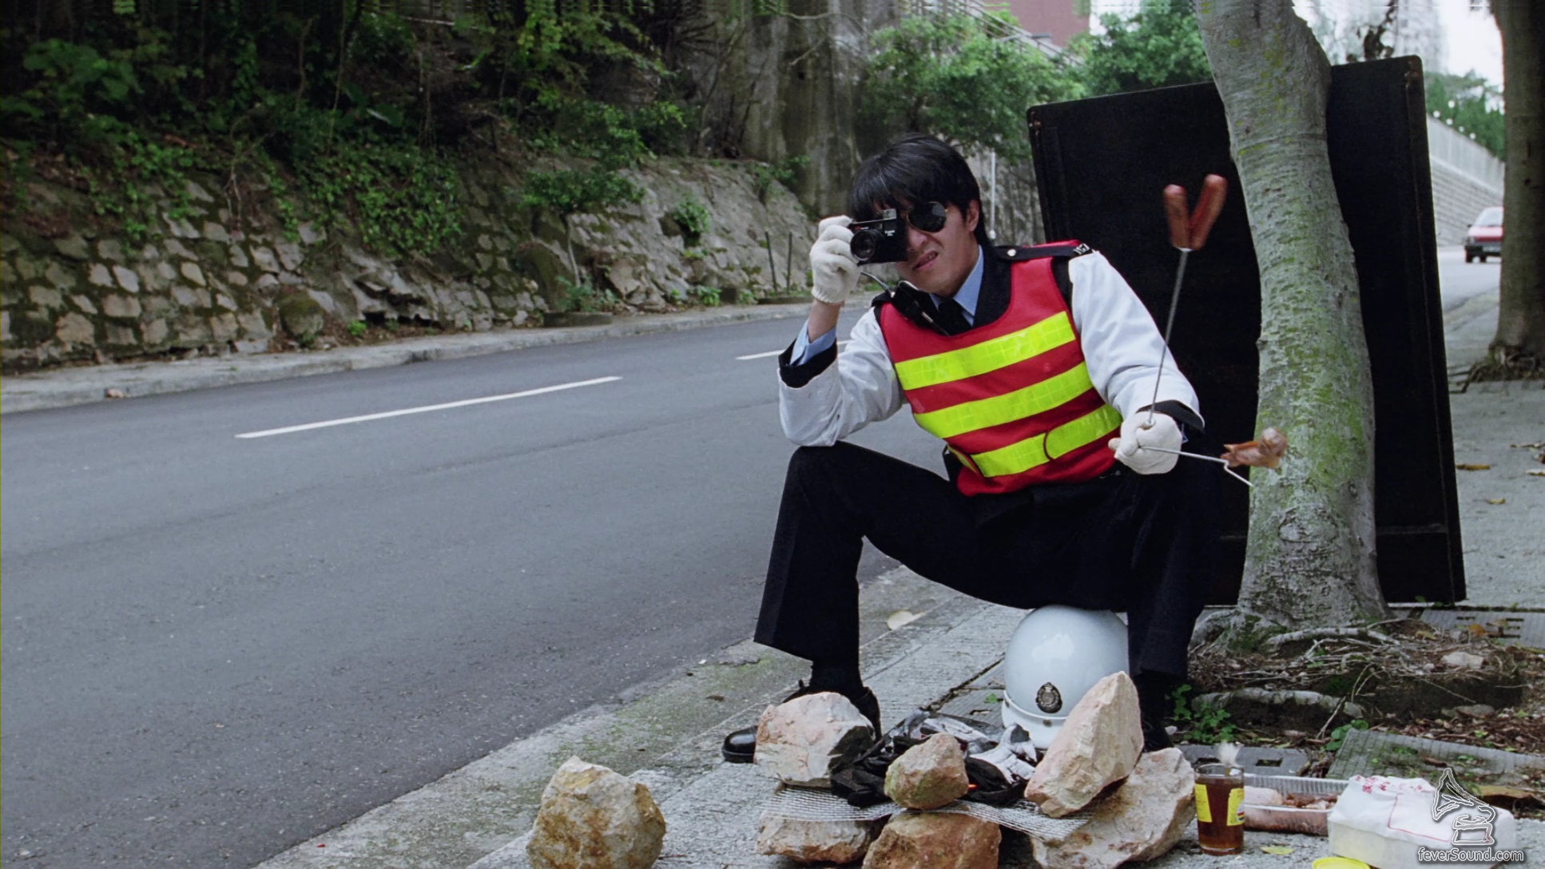
Speed Enforcement Camera System
Prepared By:
CHAN HEI, AEnI/S/HK2

Slide 2
Site Facilities
 | SEC II | SEC III | SEC IV
Detector type | Radar/Loop | Radar | Radar
Field Equipment | -Camera pole -Flash Pole -Pillar-box -Auxiliary Camera(VSLS) | -All-in-one camera pole -Pillar-box | - All-in-one camera pole -Pillar-box
Operation mode/ Communication mode | Local/Network(HZMB) | 4G network Central server | 4G/5G network Central server

Slide 3
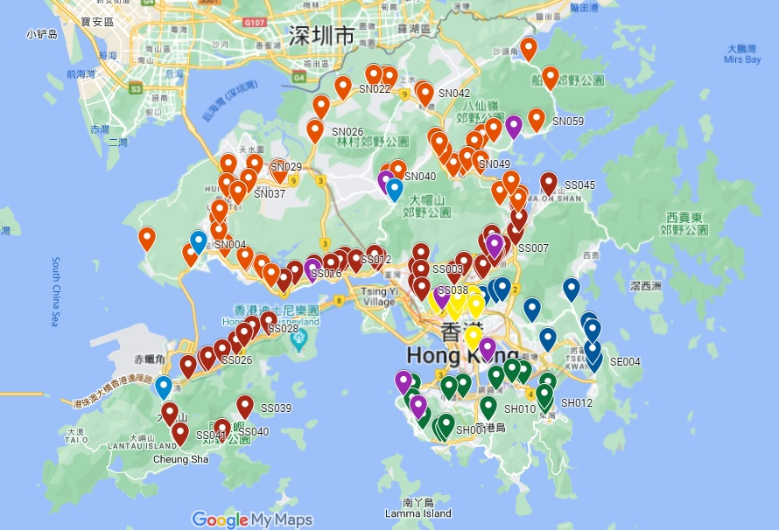
SEC Location

Slide 4
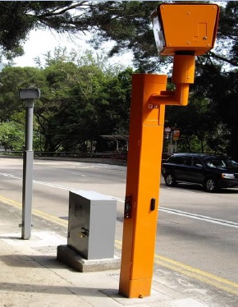
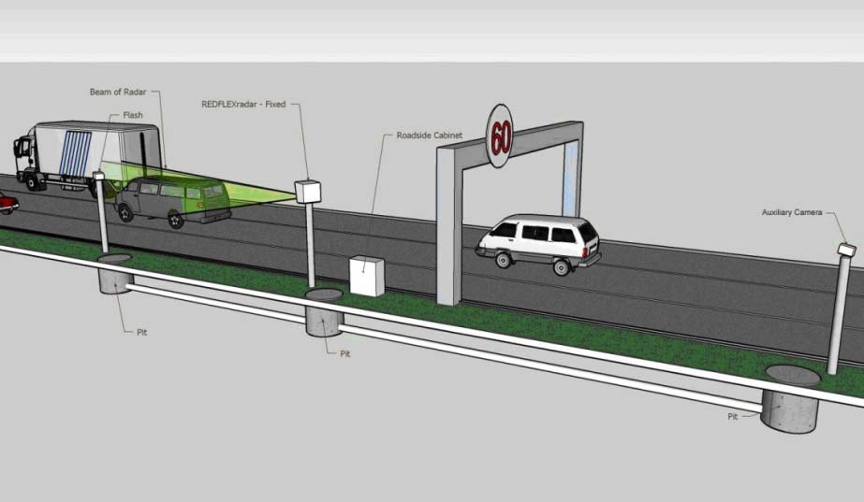
SEC II Site Facilities
Camera Pole
Auxiliary camera
Flash Pole
Pillar-Box

Slide 5
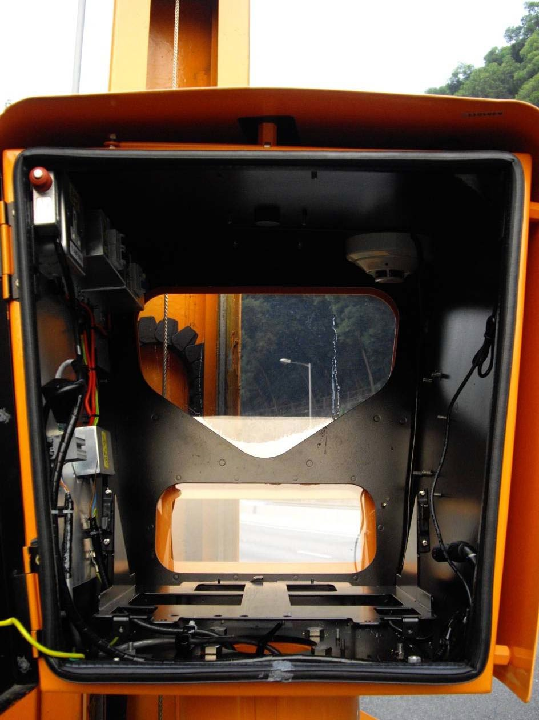
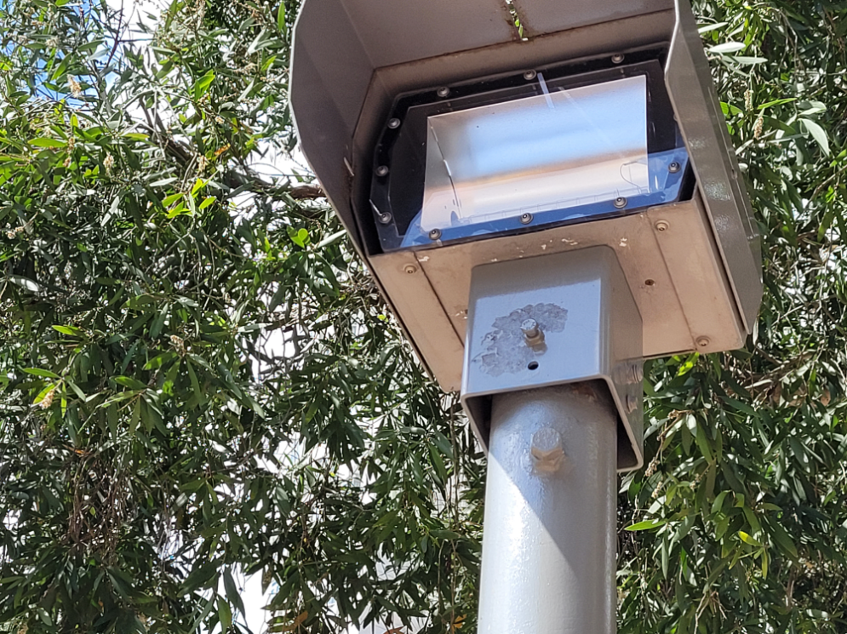
SEC II
MCB
Smoke detector
Sensor socket (smoke detector, flash trigger signal etc.)
GPS socket
VSLS socket
Network socket(HZMB)
Flash tube
1.
2.
7.
3.
5-6.
4.

Slide 6
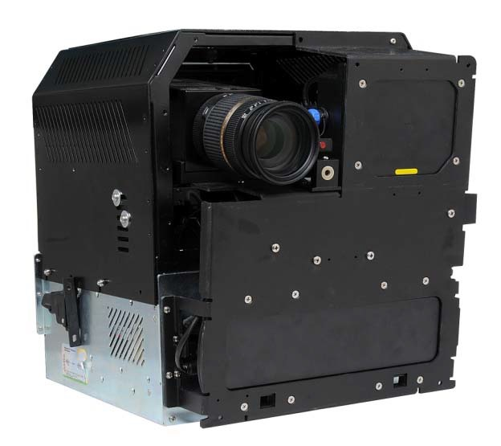
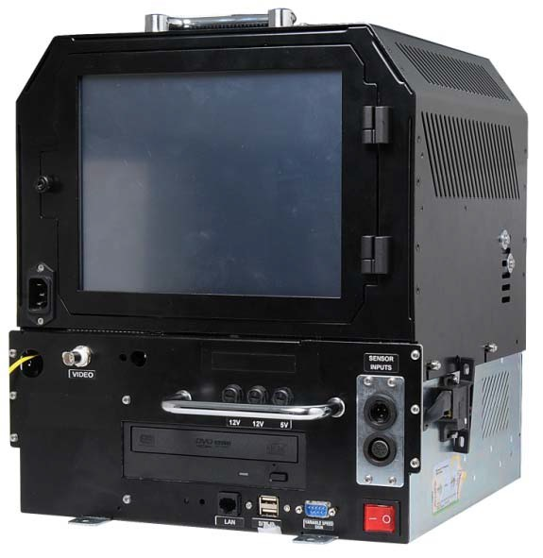
SEC II
1.
2.
1.Digital Camera
2.Tracking Radar
3.Speed Radar
4.Touch monitor
5. DVD Rom
6.CCU (Computer Control Unit)
7. Flash Electronics
8.UPS
3.
8.
Front Side
4.
7.
6.
5.
Rear Side

Slide 7
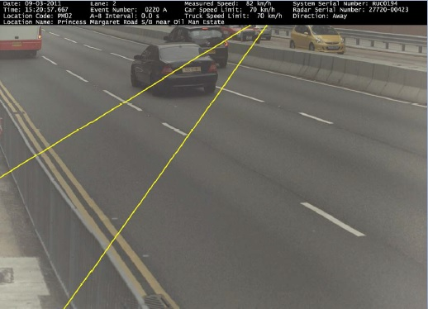
SEC II Violation Decision(radar)
• 如圖下所顯示，偵查區域投射在兩個不同的高度。
• 第一條線將投射在地面，平行及距離19.75° 線後6 米。
• 第二條線平行及距離19.75˚ 線後9 米。第二條線離地面提高1 米，以迎合實
際車輛之防撞槓(泵把)高度介乎於離地面0.5 米高(私家車) 至1 米高(貨車) 。

Slide 8
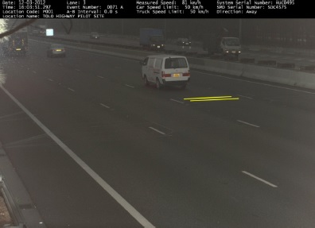
SEC II Violation Decision(loop)

Slide 9
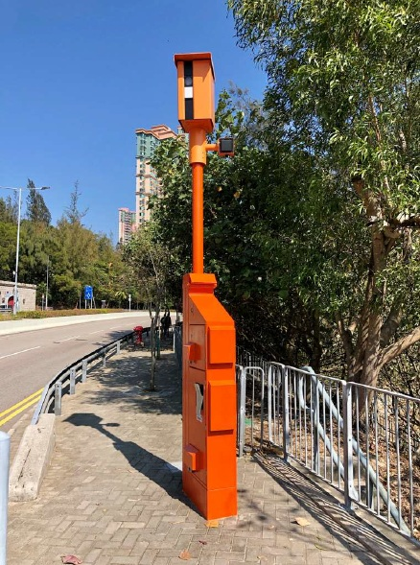
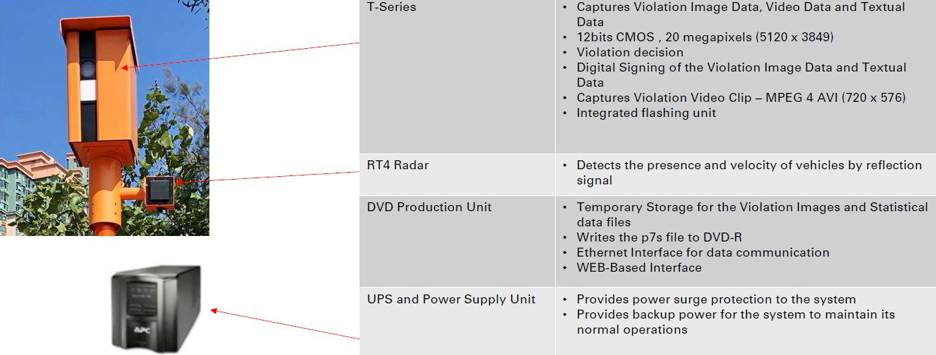
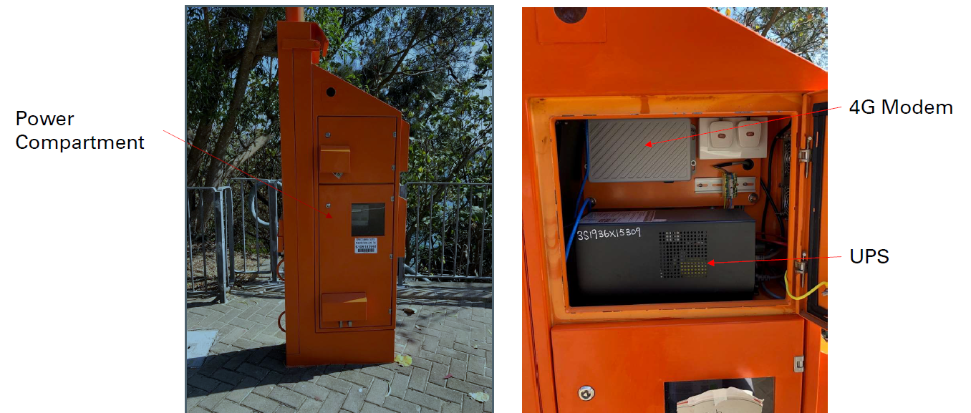
SEC III Site Facilities
Flash
All-in-one camera pole

Slide 10
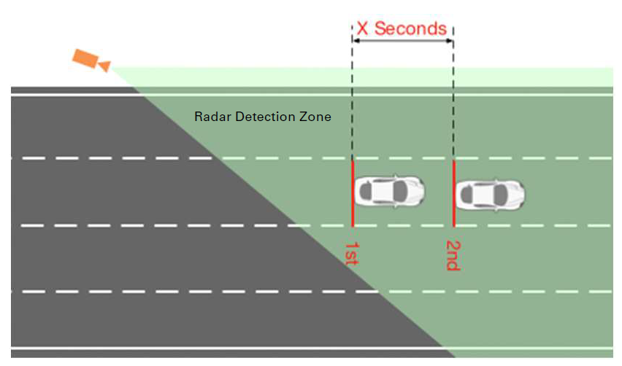
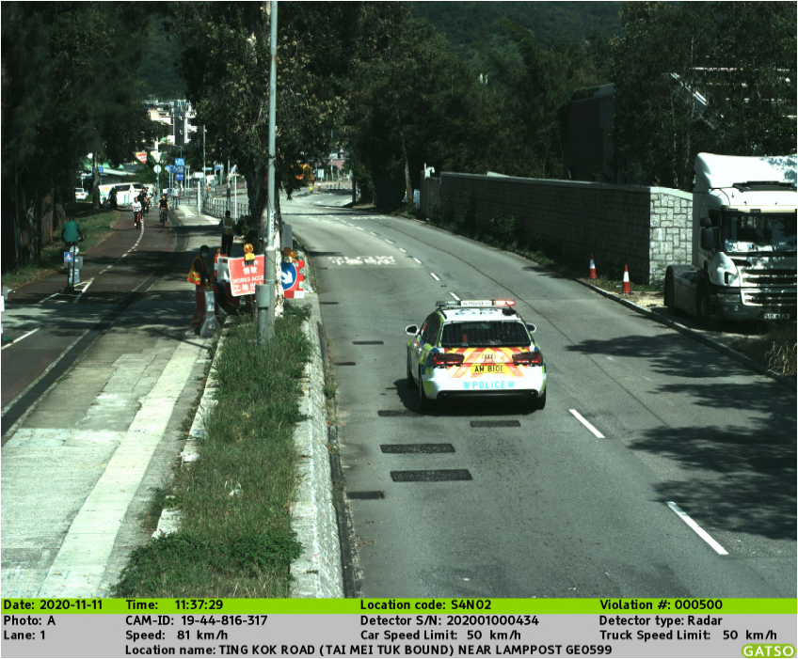
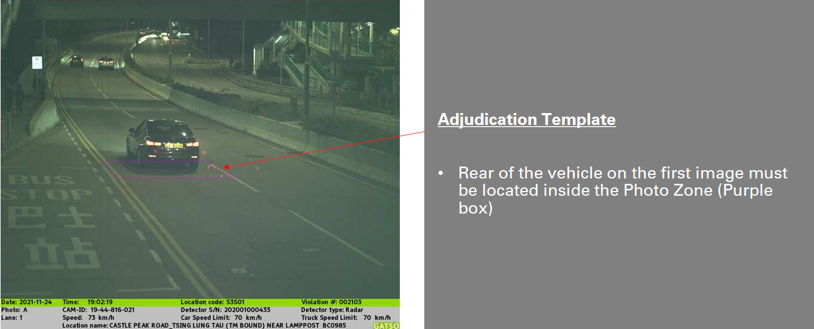
SECIII VIOLATION CAPTURING

Slide 11
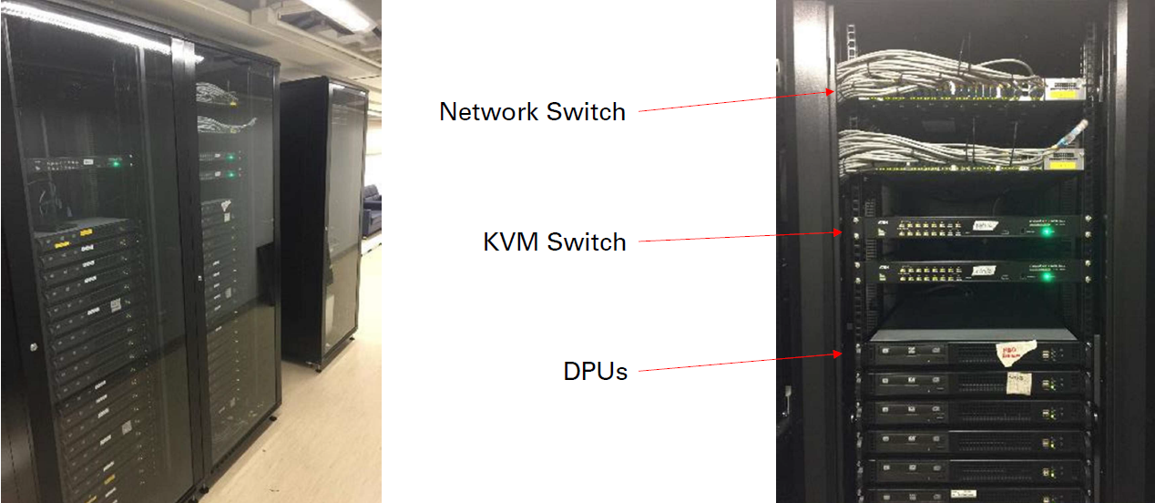
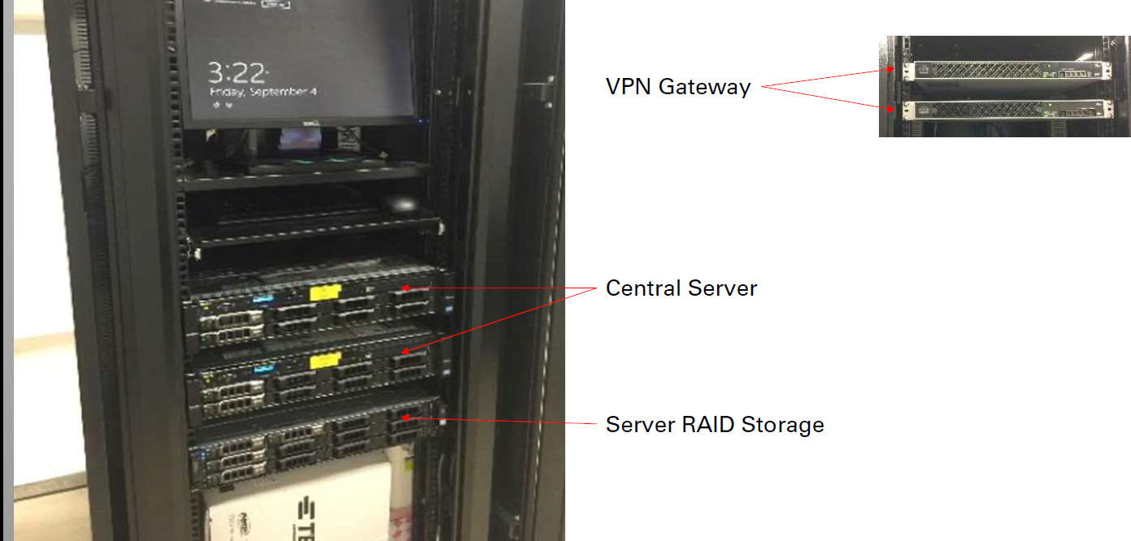
SECIII CENTRAL SERVER

Slide 12
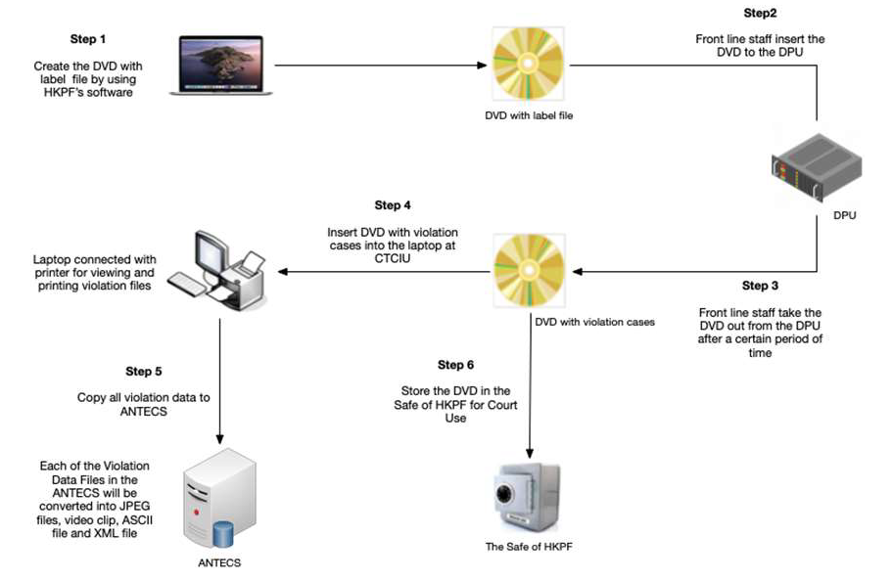
VIOLATION DVD HANDLING AND OPERATION FLOW

Slide 13
Violation information on photo
• 超速個案日期
• 超速個案時間
• 該位置編號
• 該位置之名稱
• 超速車輛之行車線
• 超速個案編號
• A-B 相之時間間距
• 超速車輛之速度
• 該位置之行車限速
• 貨車行車限速
• 運作之快相機編號
• 運作之快相機雷達編號或SMD 編號(線圈感應器）
• 行車方向

Slide 14
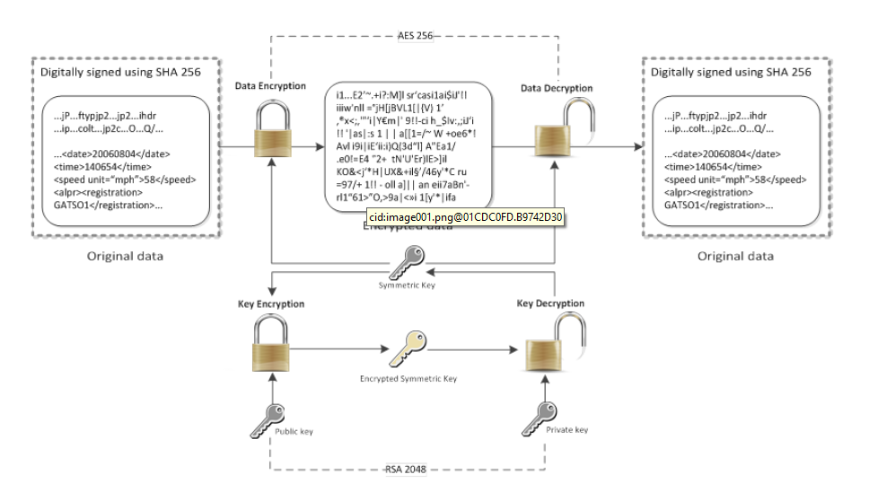
DATA Encryption
Encryption Process

Slide 15
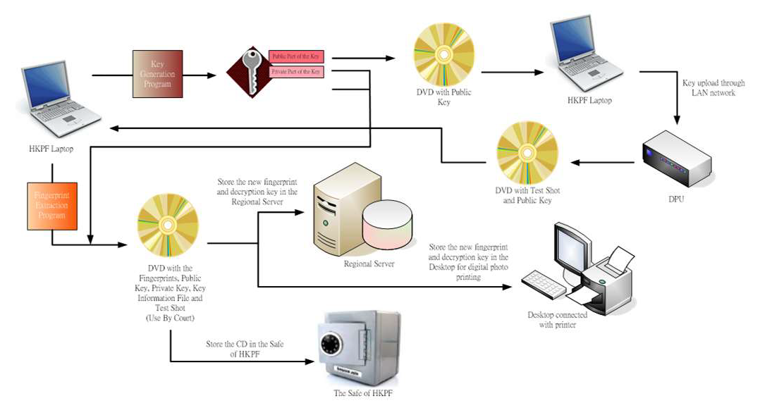
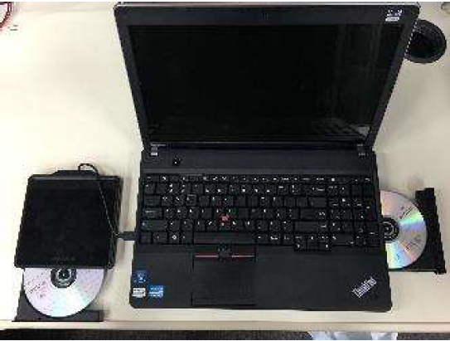
DATA Encryption

Slide 16
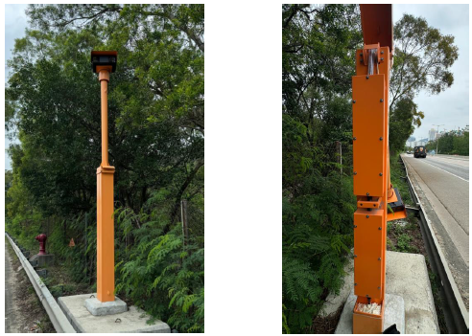
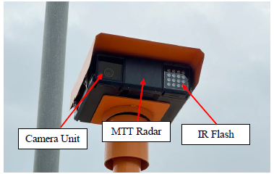
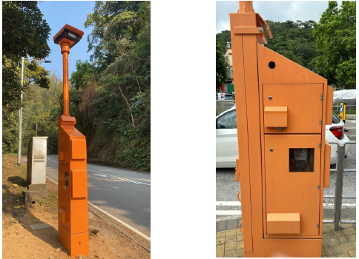
SEC IV Site Facilities

Slide 17
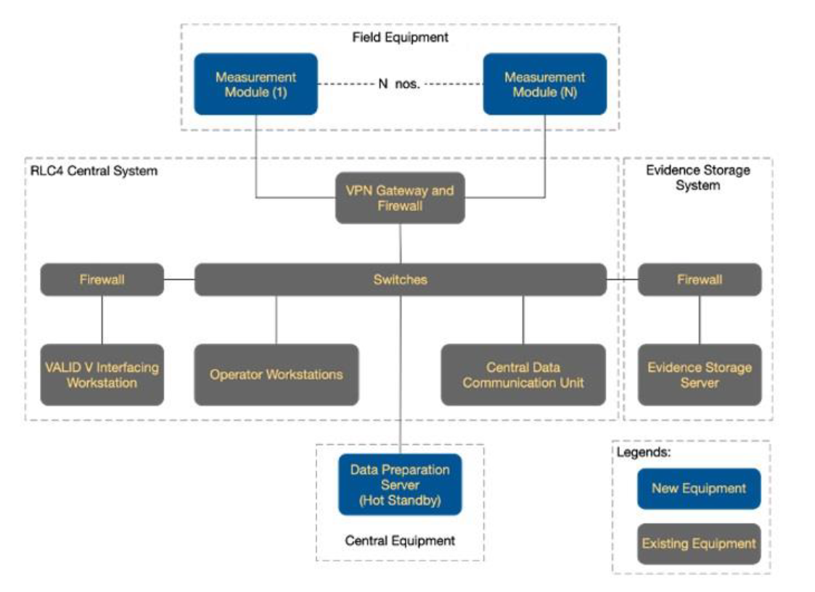
Overall Architecture of the Integrated System

Slide 18
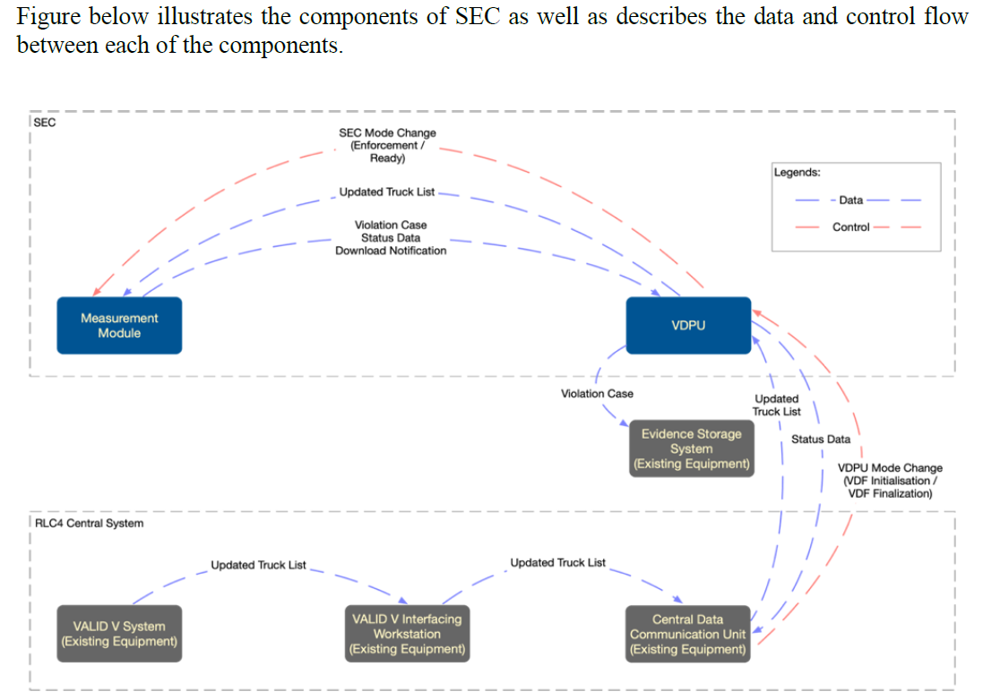
Data and Control Flow of the SEC IV

Slide 19
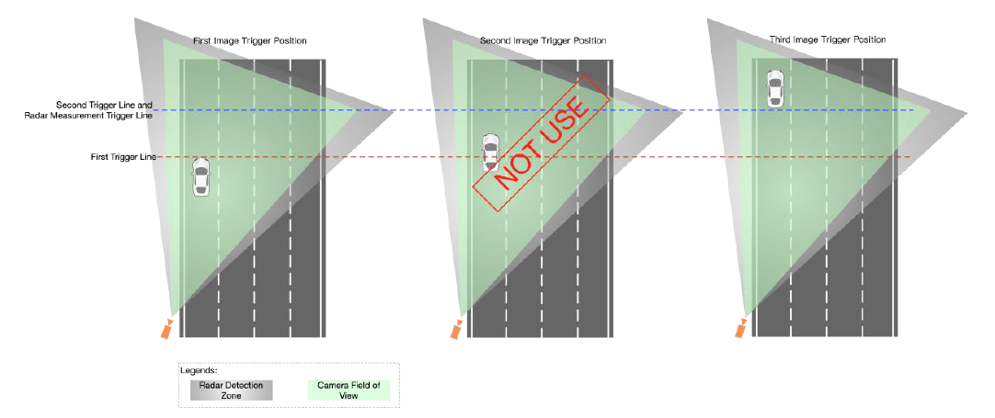
Operation Logic
Images are taken with reference to two preconfigured site-specific image trigger lines for each vehicle. The Camera Unit makes use of A.I. Machine Vision technology to determine the movements and locations of vehicles passing its field of view. A set of photos is taken with reference to the trigger lines for every vehicle.
1. The first image taken when the front of the vehicle has reached the first trigger line is used as the first image of a spot speed violation case
2. The third image taken when the back of the vehicle has just left the second trigger line is used as the second image of a spot speed violation case

Slide 20
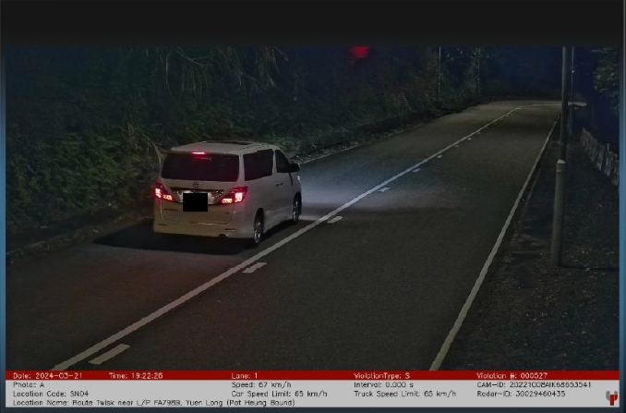
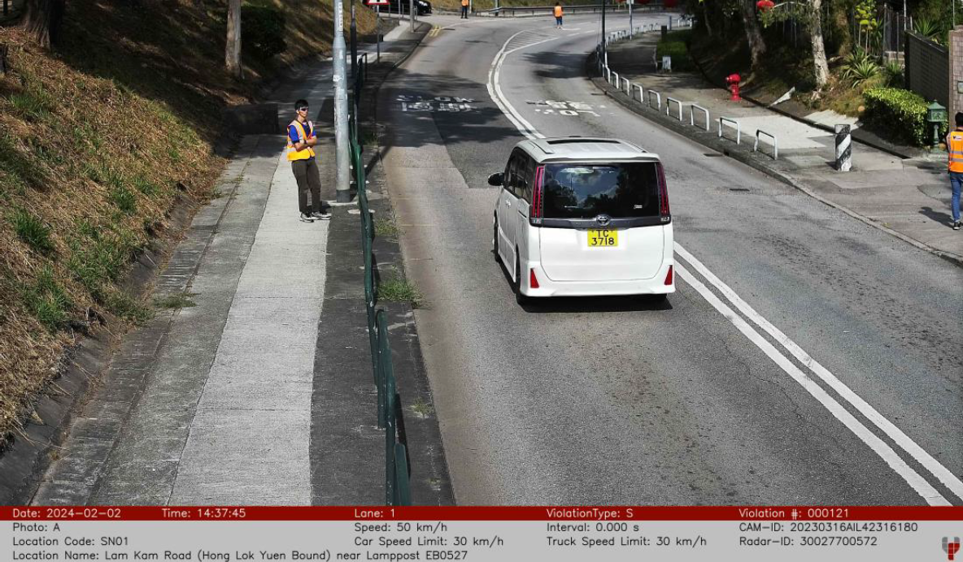
SEC IV Violation Photo
With the advanced dual CMOS technology incorporated in the Camera Unit, no white flash is required for colour images even under dark environment. Unlike the traditional systems using white flash that images can only be taken when a violation is confirmed (post-decision photo trigger), the MM of the System takes photos on every vehicle passing the field of view of its Camera Unit prior to the violation decisions are made (pre-decision photo trigger).

Slide 21
END
完

