Slide 1
Air Quality Measurement at Semi-Confined Public Transport Interchanges
Prepared by: Tam Tung Yau

Slide 2
Air Quality Measurement at Semi-Confined Public Transport Interchanges
Practice guide of Control of Air Pollution in Semi-Confined Public Transport Interchanges
PN 1/98 by Environmental Protection Department
Practice Note sets out the air quality guidelines for public transport interchanges (PTI) at semi-confined locations, and outlines major considerations for designing and operating a PTI to meet these guidelines.
A PTI is a public place where public transport such as buses , taxis , mini-buses or coaches pass or terminate , and passengers queen for public transport .

Slide 3
Air Quality Measurement at Semi-Confined Public Transport Interchanges
In HK , many PTIs are located under the podiums of residential or commercial complexes , and surrounded by structural columns or walls.
Air pollutants will accumulate to high concentrations inside these PTIs if natural ventilation there is not sufficient.
This guideline can help by ensuring proper design , operation and maintenance of mechanical ventilation systems in semi-confined PTIs , to prevent an air pollution problem from arising.
Air Quality Guidelines
Carbon monoxide , nitrogen dioxide and Sulphur dioxide are the major air pollutants of concern inside semi-confined PTIs.

Slide 4
Air Quality Guidelines
Air Pollutant | Maximum Concentration* Not to Be Exceeded
 | 1-Hour Average (μg/m ) ³ | 5-Minute Average (μg/m ) ³
Carbon monoxide | 30,000 | 115,000
Sulphur dioxide | 800 | 1,000
Nitrogen dioxide | 300 | 1,800
* Expressed at the reference condition of 25°C and 101.325kPa (one atmosphere)

Slide 5
Air Quality Measurement at Semi-Confined Public Transport Interchanges
To protect public health, the air quality at passenger waiting areas inside a semiconfined PTI should meet both the 1-hour and 5-minute average air quality guidelines as given in Table 1. At other places where passengers stay for not more than a few minutes, the air quality should at least meet the 5-minute average air quality guidelines.
To help minimize the accumulation of air pollutants, the layout of a PTI should avoid as far as possible solid walls or other barriers which inhibit natural air flow, and should have the vehicle entrances and exits strategically located so as to enhance air movements across the PTI. The layout should help minimize the accumulation of air pollutants.

Slide 6
Air Quality Measurement at Semi-Confined Public Transport Interchanges
Ventilation System
A. Natural Air
B. Mechanical Air
A PTI ventilation system should consist of fresh air supply units and exhaust air units, with the amount of fresh air supply greater than that of the exhaust air. In some circumstances, it may be necessary to provide air purifying units to clean the air supply.
The fresh air inlets should be so located that they can capture fresh air of a quality which is comparable to the ambient background level. They should be away from any major air pollution sources such as busy roads or polluted air outlets.

Slide 7
Air Quality Measurement at Semi-Confined Public Transport Interchanges
The exhaust air outlets should be located away from nearby residents or other receptors to avoid causing an air pollutant nuisance. If necessary, control equipment such as filters or scrubbing units should be used to minimize the pollution caused to the surroundings.
Inside the PTI, the fresh air delivery outlets should be positioned at a low level to discharge fresh air towards the passengers, whereas the extraction openings should be located at a high level. The fresh air outlet and the extraction openings should be placed as far away from each other as possible, and should be configured to avoid air short circulation.

Slide 8
Air Quality Measurement at Semi-Confined Public Transport Interchanges
Quantities of carbon monoxide, sulphur dioxide or nitrogen dioxide emissions from the vehicles should be estimated from considering:
A. types and models of the vehicles using the PTI
B. usage pattern of the vehicles, including speed, frequency, idling time and routing.
Inspection and maintenance of the ventilation system at regular intervals, to ensure proper operation of the ventilation system and minimize breakdown time
Proper fan operation schedule which should be reviewed once every three months, or a pollution level interlocked fan operation system, to ensure that there is always sufficient ventilation

Slide 9
Air Quality Measurement at Semi-Confined Public Transport Interchanges
Monitoring of the air quality inside the PTI from time to time to check the adequacy of the fan operation schedule or the interlocked fan operation system
Ventilation System
A. FAF – Fresh Air Fan
B. Exhaust Fan
C. Direct Digital Controller / Programmable Logic Controller
D. Gas Sensor
E. Main Controller ( e.g. Computer )

Slide 10
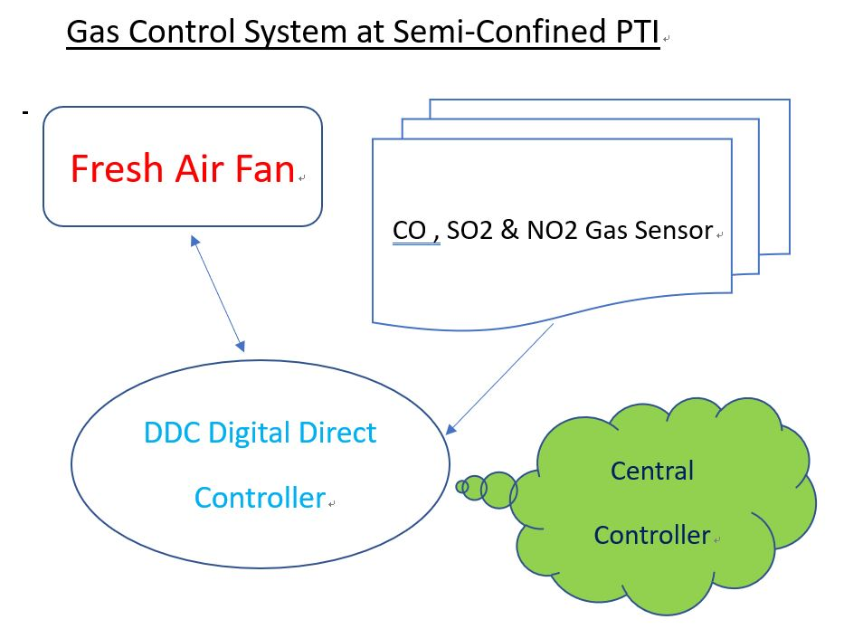

Slide 11
DDC Direct Digital Controller / Programmable Logic Controller
Interface with Gas Sensor
Output control signal to FAF controller
Getting command signal from Central Controller
Getting FAF state and condition to Central Controller

Slide 12
Gas Sensor - ElectroChemical type Gas Sensor
Electrochemical sensors react with the measured gas and generate an electrical signal proportional to the gas concentration. Most electrochemical gas sensors are current sensors, producing a current that is linearly proportional to the gas concentration.
The electrochemical gas sensors working principle: the gas passes through a diaphragm that prevents condensation, and this diaphragm also has a dust-proof effect. The gas molecules then diffuse through the filter and reach the working electrode. Here, the gas is oxidized or reduced, and this electrochemical reaction causes a change in the current flowing through the external circuit.
Sensors based on electrochemical working principles, the simplest is a two-electrode system. Its working electrode and opposite electrode are separated by electrolyte and connected to the external circuit with a small resistance. When the gas diffuses into the sensor, it reacts to generate an electric current. The more gas the greater the current.

Slide 13
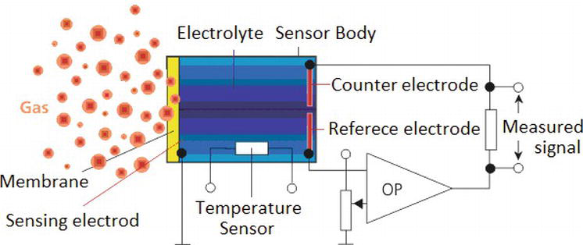
ElectroChemical type Gas Sensor

Slide 14
ElectroChemical type Gas Sensor Advantages:
Small size, low power consumption, good linearity and repeatability, resolution can generally reach 0.1 ppm

Slide 15
ElectroChemical type Gas Sensor Disadvantages:
LifeSpan of ElectroChemical type of CO gas sensor is approximately 5 years
LifeSpan of ElectroChemical type of NO2 gas sensor is approximately 2 years
LifeSpan of ElectroChemical type of SO2 gas sensor is approximately 2 years
Prone to interface , sensitivity is greatly affected by temperature changes
It needs to be detected in an environment with oxygen (1-10% VOL), and liquid electrolytes need to be consumed during use. Easily disturbed by temperature, humidity, pressure, and gases with similar chemical properties. If there is mixed gas on site, it is easy to cause errors.

Slide 16
NDIR Gas Sensors
NDIR (non-dispersive infrared) gas sensors emit infrared light to make the gas molecules vibrate. The working principle is that different gases can absorb different infrared wavelengths. The more gas there is, the less infrared light can pass through. When infrared rays pass through the gas in the measurement area, the infrared rays resonate with the gas molecules and are absorbed by the gas molecules when the molecules vibrate.

Slide 17
NDIR Gas Sensors
This weakens the transmitted infrared rays. Gas molecules vibrate at different frequencies. Some atoms are very small and light, so they vibrate at high frequencies. For example, the methane molecule’s vibration frequency is 333KHz, and the central wavelength is 3.3um. Because the molecular weight is different, the infrared absorption wavelength is also different, as shown in the following figure:

Slide 18
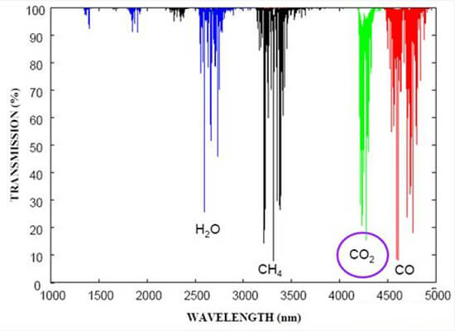
NDIR Gas Sensors

Slide 19
NDIR Gas Sensors Advantages:
Common sensors on the market, such as catalytic combustion (CAT), electrochemical (EC), and semiconductor sensors, cannot measure any gas. For example, CO2 cannot be measured, but NDIR sensors can measure CO2. The most commonly measured gases for NDIR are CH4 and CO2.
Oxygen is not required. The CAT sensor requires oxygen to participate in the oxidation reaction. But NDIR is an optical sensor and doesn’t require oxygen to be involved.

Slide 20
NDIR Gas Sensors Advantages:
The measurement concentration can reach 100%v/v. Because the NDIR sensor signal characteristics are: in a normal environment, the signal strength is the largest; the greater the measured gas concentration, the smaller the signal.
Good stability. NDIR sensor stability basically depends on the light source. As long as a good light source is selected, the long-term stability will be excellent, and it can be achieved without calibration for 2 years.
Low maintenance cost.

Slide 21
NDIR Gas Sensors Disadvantages:
NDIR sensors consume high power. Measuring gas concentrations at the ppm level is expensive. The structure, software and hardware are more complex, and the price is relatively expensive.

Slide 22
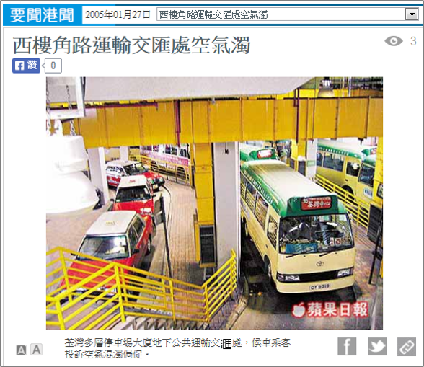
Semi-confined PTI in Hong Kong
Utilize of diesel fuel in the public transport engine
Air quality inside the semi-confined PTI induced a lot of public concern

Slide 23
Local Regulation of Air Quality in Semi-confined PTI
Provision of mechanical ventilation system in a semi-confined PTI is a compulsory requirement in Hong Kong
Air quality inside the semi-confined PTI should meet both the 5-minute and 1-Hour average
Air Pollutant | Maximum Concentration not to be exceeded
 | 1-Hour Average (μg/m³) | 5-Minute Average (μg/m³)
Carbon monoxide | 30,000 | 115,000
Sulphur dioxide | 800 | 1,000
Nitrogen dioxide | 300 | 1,800

Slide 24
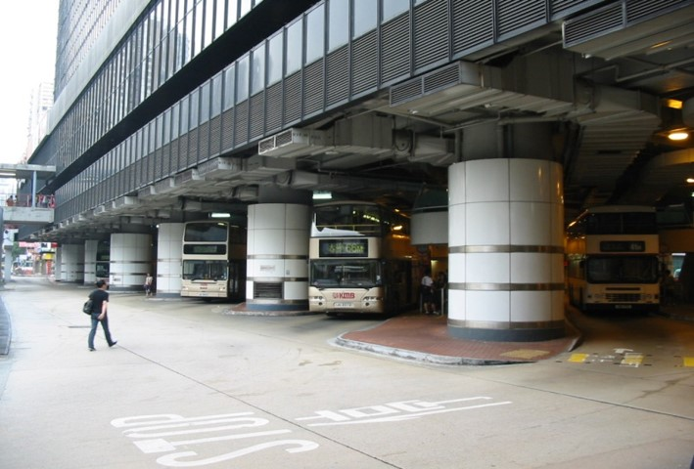


Mixed-mode Ventilation

Slide 25
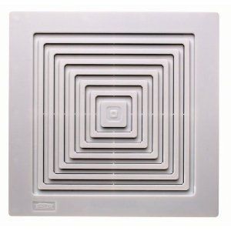
Ventilation of PTI
Natural ventilation: Process by natural means of wind
effect and temperature differences, through intentionally provided openings;
Mechanical ventilation: Process is driven by mechanical fans to provide a system of controlled ventilation.

Slide 26
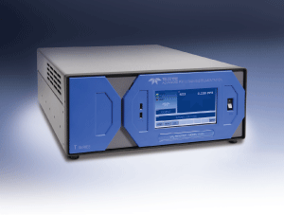
AQM Instrument
T-API T100U SO2 analyser
- Main Features
Ranges: 0-50 ppb to 0-20 ppm user selectable
Dual ranges and auto ranging
Large, vivid, and durable color graphics display with touch screen interface
Ethernet, RS-232, and (optional) USB com ports
Front panel USB connections for peripheral devices and firmware upgrades
8 analog inputs (optional)
Adaptive signal filtering optimizes response time
Temperature & pressure compensation
Comprehensive internal data logging with programmable averaging periods
Ability to log virtually any operating parameter
T-API: Model T100U

Slide 27
Analyzer- Nitrogen dioxide (NO₂)
T-API T200U Main Features
Ranges: 0-5 ppb to 0-2,000 ppb, user selectable
Independent ranges and auto ranging
Large, vivid, and durable color graphics display with touch screen interface
Ethernet, RS-232, and (optional) USB com ports
Front panel USB connections for peripheral devices and firmware upgrades
8 analog inputs (optional)
Adaptive signal filtering optimizes response time
Temperature & pressure compensation
50 ppt lower detectable limit
Catalytic ozone scrubber
Comprehensive internal data logging with programmable averaging periods
Ability to log virtually any operating parameter
T-API: Model T200U

Slide 28
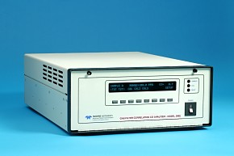
Analyzer - Carbon Monoxide (CO)
T-API 300E Main Features
Ranges, 0-1 ppm to 0-1000 ppm, user selectable
Gas Filter Wheel for CO specific measurement
14 meter path length for sensitivity
Microprocessor controlled for versatility
Multi-tasking software allows viewing of test variables during operation
Continuous self checking with alarms
Bi-directional RS-232 for remote operation
Digital status outputs indicate instrument operating condition
Adaptive signal filtering optimizes response time
GFC wheel guaranteed against leaks for 5 years
Temperature & Pressure compensation
Internal data logging with 1 min to 365 day multiple averages
APIcom remote operation software
T-API: Model 300E

Slide 29
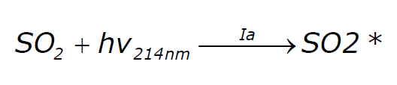
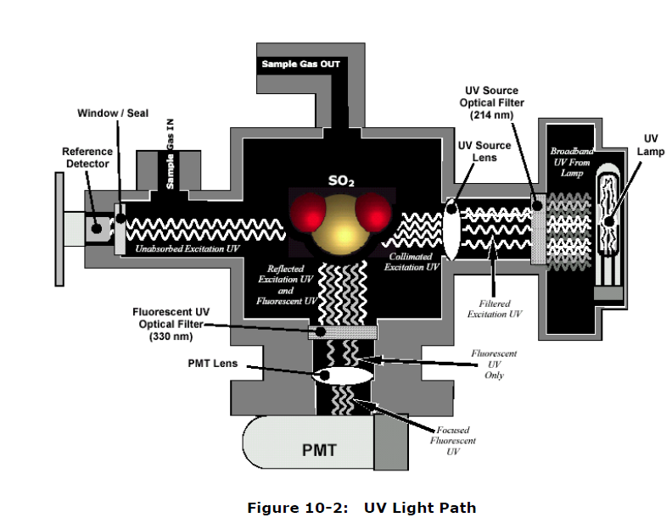

SO₂ Analyzer Theory of Operation: Fluorescence
Dark period every 30 minutes for PMT offset (API)
Illustration is from Teledyne API 200E Operator’s manual

Slide 30
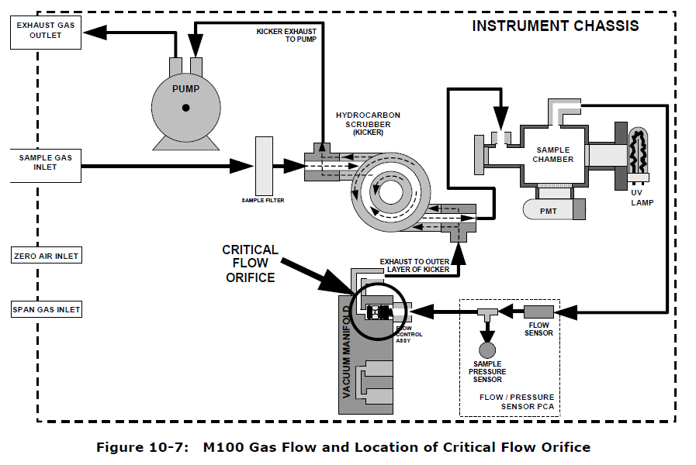
SO₂ Analyzer Theory of Operation: Fluorescence
Illustration is from Teledyne API 200E Operator’s manual

Slide 31



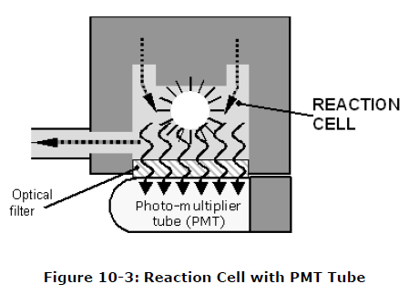

NO_{x} Analyzer Theory of Operation: Chemiluminescence
Sample gas w/NO
O3
Light leaks can impact measurement
PMTs are sensitive and can be damaged by light
Illustration is from Teledyne API 200E Operator’s manual

Slide 32
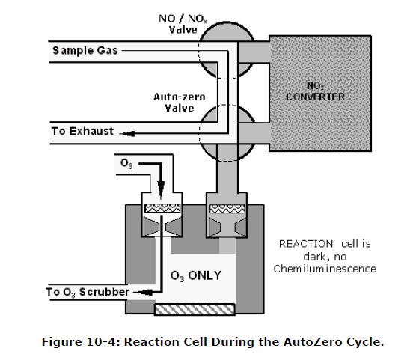
NO_{x} Analyzer Theory of Operation: Chemiluminescence
Illustration is from Teledyne API 200E Operator’s manual

Slide 33
NO_{x} Analyzer Theory of Operation: Chemiluminescence
Dark Cycle
bypasses RX Cell
NOx Cycle goes through converter
Only NO reacts with ozone
MolyCon Molybdenum Converter
NO₂ Converter
Sample Air
NOx = NO + NO₂
NOx – NO = NO₂
NO
NO
Rx Cell
PMT
NOx
NO
NO
NO₂
NO₂ converted to NO
Valves
Excess Ozone
NO Cycle
NO Cycle passes sample air to reaction chamber
Ozone reacts with NO
Only NO reacts – NO₂ isn’t measured NO₂ is calculated: NOx – NO = NO₂
Ozone generator
Dry filtered air
hv in reaction cell is measured by PMT

Slide 34
Gas Phase Titration (GPT) – Creating a NO₂ test atmosphere
CFR Title 40 Part 58 Appendix A
3.2.2.2 (a) NO₂ audit gas for chemiluminescence-type NO₂analyzers must also contain at least 0.08 ppm NO. NO concentrations substantially higher than 0.08 ppm, as may occur when using some gas phase titration (GPT) techniques, may lead to evaluation errors in chemiluminescence analyzers due to inevitable minor NO–NO_{X}channel imbalance. Such errors may be atypical of routine monitoring errors to the extent that such NO concentrations exceed typical ambient NO concentrations at the site. These errors may be minimized by modifying the GPT technique to lower the NO concentrations remaining in the NO₂audit gas to levels closer to typical ambient NO concentrations at the site.
[This is in the Annual Performance Audit Section, but is relevant to GPT]
In the next slide, [No_{rem}] should be at least .080 ppm,
but not be excessively higher than that

Slide 35

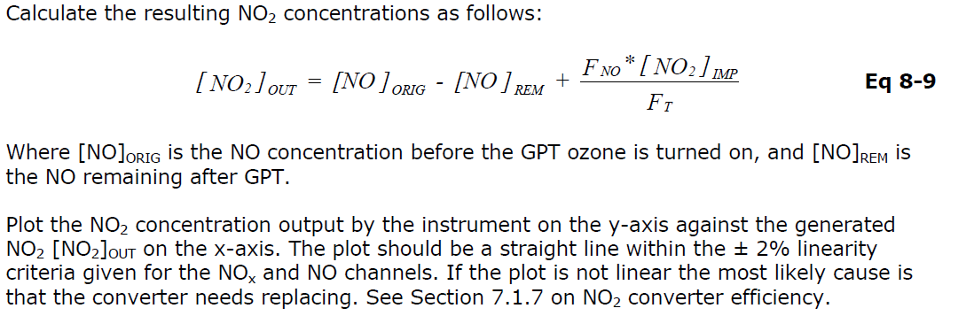
Gas Phase Titration (GPT) – Creating a NO₂ test atmosphere
NO₂ actual = % NO₂ Converted
NO₂ expected

Slide 36
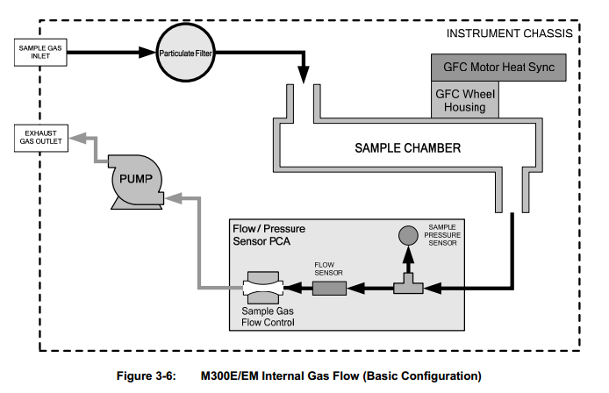
CO Analyzer Theory of Operation: Gas Filter Correlation

Slide 37
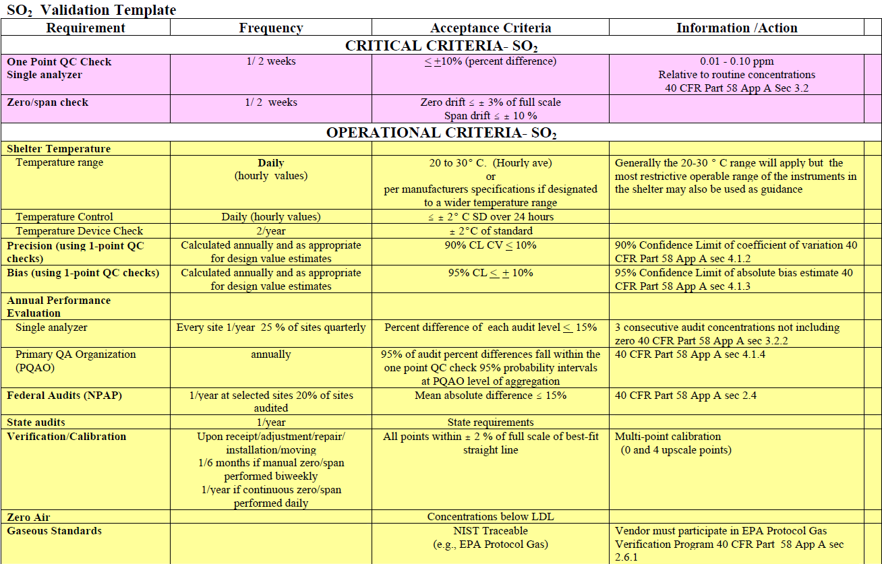

SO2 Analyzer Theory of Operation: Gas Filter Correlation

Slide 38
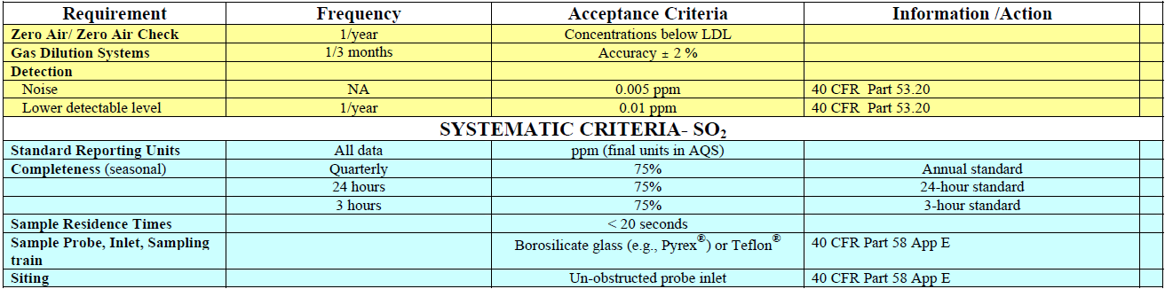
SO2 Analyzer Theory of Operation: Gas Filter Correlation
SO₂ Validation Template continued

Slide 39
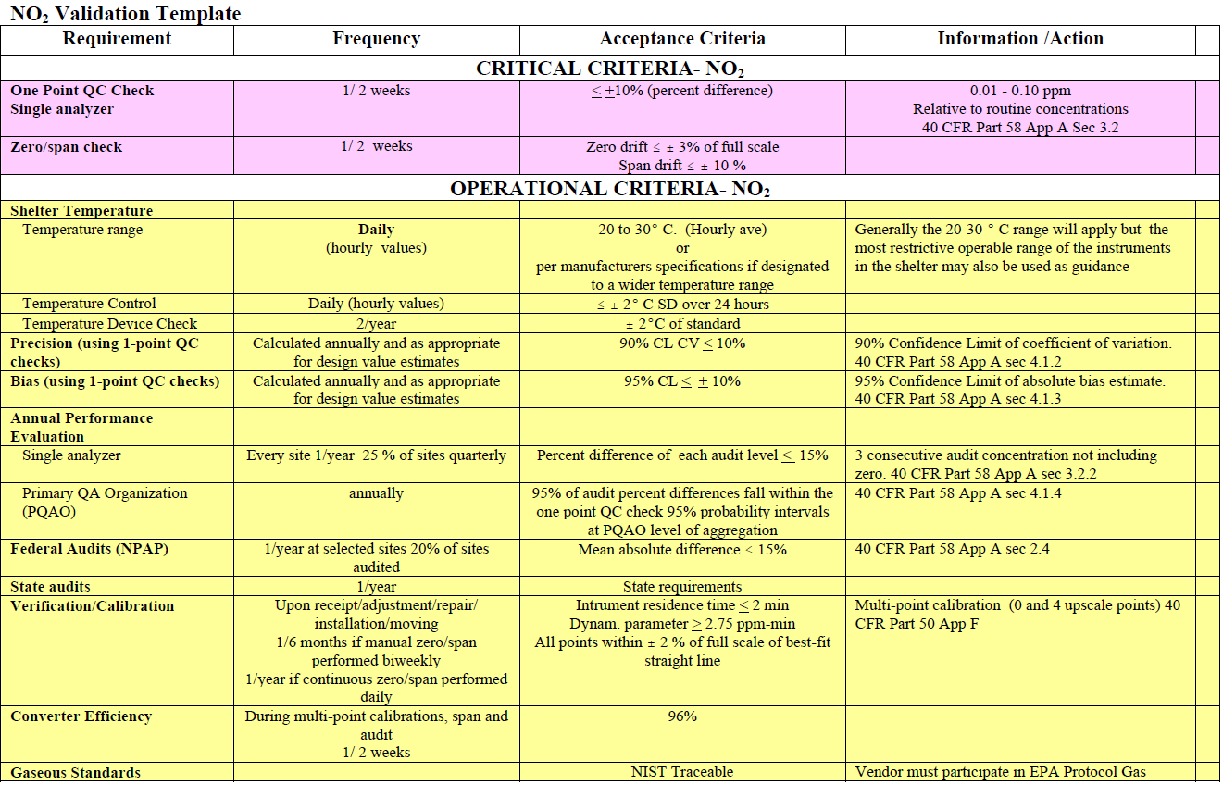
NO2 Analyzer Theory of Operation: Gas Filter Correlation

Slide 40
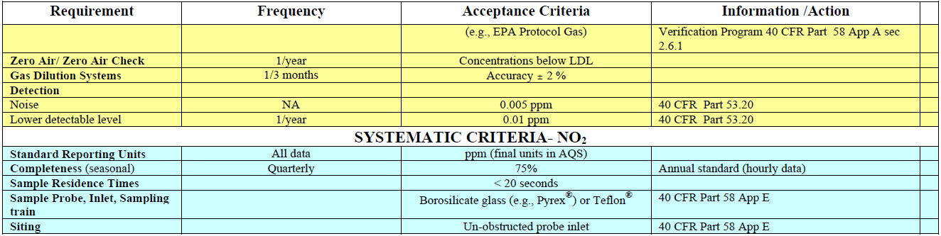
NO2 Analyzer Theory of Operation: Gas Filter Correlation
NO₂ Validation Template continued

Slide 41
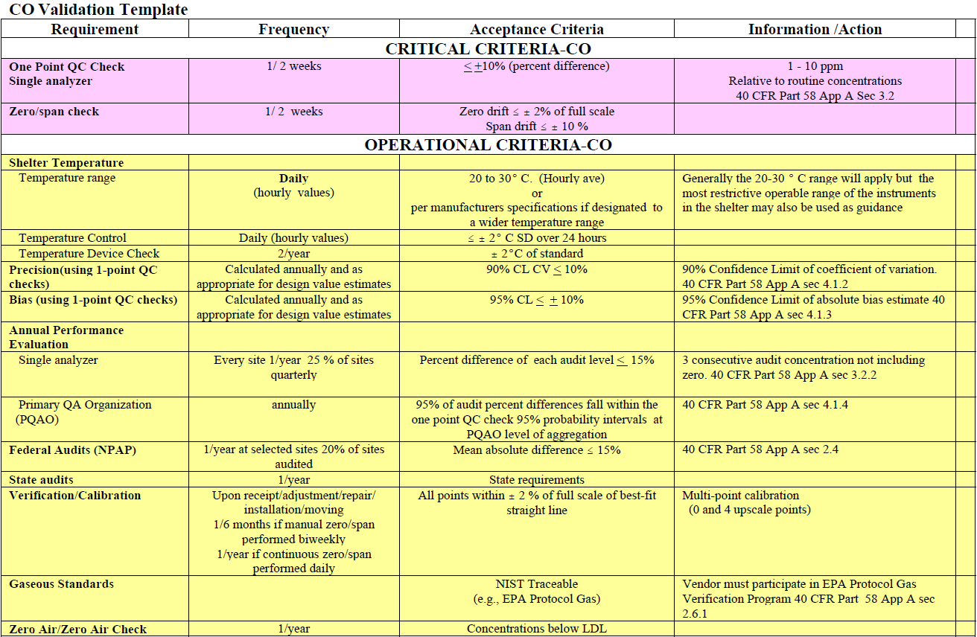
CO Analyzer Theory of Operation: Gas Filter Correlation

Slide 42
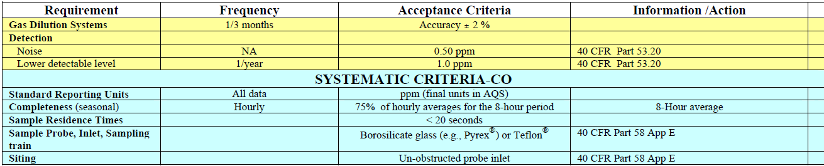
CO Analyzer Theory of Operation: Gas Filter Correlation
CO Validation Template continued

Slide 43


Analyzer Theory of Operation: Gas Filter Correlation
Calibration System Pneumatics
Don’t pressurize analyzers; you must vent. Total flow from calibrator must exceed combined analyzer demand
Wall
Zero Air
Calibration Manifold – may have one on calibrator
Vent
Calibrator
Regulator
(2 stage stainless steel match fittings & purge CGA 660)
Cal gas
must pass through filter
Cal Bottle
Analyzer
Analyzer
Analyzer
EPA Protocol Gas
Most have 2-year
certification
Exhaust manifold
Insect screen

Slide 44
What is Zero Air?
From QA-Handbook – Vol – II (Redbook):
Zero Air Systems: Zero air systems should be able to deliver 10 liters/min of air that is free of ozone, NO, NO2, and SO2 to 0.001 ppm and CO and non-methane hydrocarbons to 0.1 ppm. There are many commercially available systems; however, simple designs can be obtained by using a series of canisters. From 40CFR Part 50 Appendix A-1 (this is not Part 58, Appendix A) SO2 4.1.6.2 Clean zero air, free of contaminants that could cause a detectable response or a change in sensitivity of the analyzer. Since ultraviolet fluorescence analyzers may be sensitive to aromatic hydrocarbons and O2-to-N2ratios, it is important that the clean zero air contains less than 0.1 ppm aromatic hydrocarbons and O2 and N2 percentages approximately the same as in ambient air. A procedure for generating zero air is given in reference 1.

Slide 45
What is Zero Air?
From 40CFR Part 50 Appendix C (this is not Part 58, Appendix A)
CO
3.2 Dilution gas (zero air). Air, free of contaminants which will cause a detectable response on the CO analyzer. The zero air should contain <0.1 ppm CO. A procedure for generating zero air is given in Reference 1.
From 40CFR Part 50 Appendix F (this is not Part 58, Appendix A)
NOx
1.3.2 Zero air. Air, free of contaminants which will cause a detectable response on
the NO/NO_{X}/NO₂analyzer or which might react with either NO, O₃, or NO₂in the gas
phase titration. A procedure for generating zero air is given in reference 13.

Slide 46
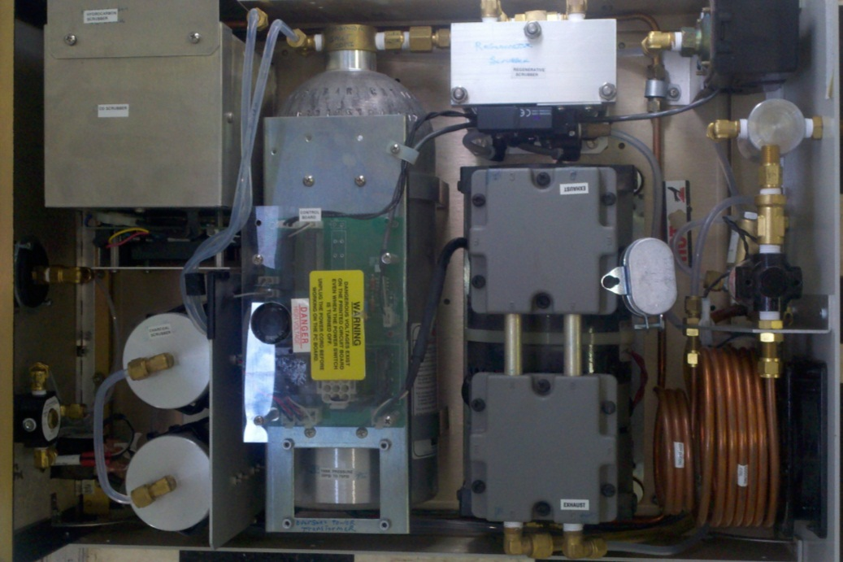
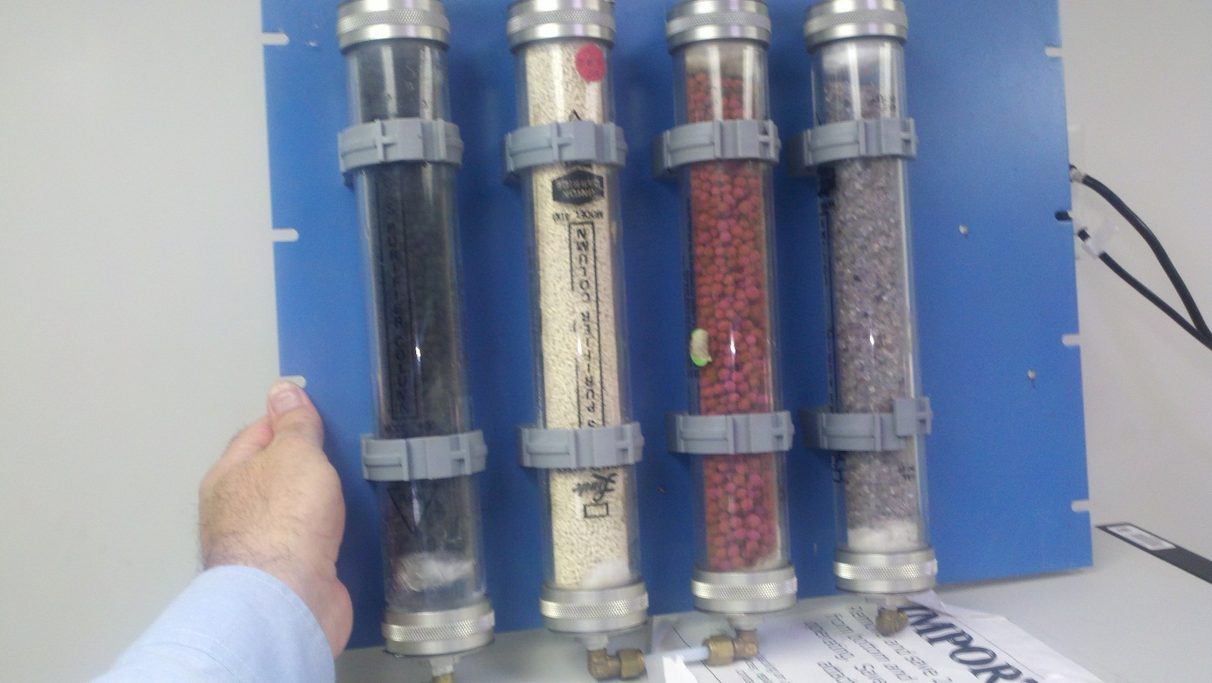
What is Zero Air?
Commercial Zero Air Generator
Series of scrubbers Desiccant, Purafil, Molecular sieve, activated carbon, whatever scrubber media is needed (supply a clean, cooled, dry air flow source that meets pressure needs – always put a 0.1 micron particulate filter downstream of scrubbers)

Slide 47
What is EPA Protocol Gas?
What are Gas Standards?
From QA-Handbook – Vol – II (Redbook):
12.1.2 Gaseous Standards
In general, ambient monitoring instruments should be calibrated by allowing the instrument to sample and
analyze test atmospheres of known concentrations of the appropriate pollutant in air. The following is an
excerpt from 50 CFR Part 58,
Appendix A Section 2.6.1: “Gaseous pollutant concentration standards (permeation devices or
cylinders of compressed gas) used to obtain test concentrations for carbon monoxide (CO), sulfur
dioxide (SO2), nitrogen oxide (NO), and nitrogen dioxide (NO2) must be traceable to either a National
Institute of Standards and Technology (NIST) Traceable Reference Material (NTRM) or a NIST-certified
Gas Manufacturer’s Internal Standard (GMIS), certified in accordance with one of the procedures
given in reference 4 of this appendix. Vendors advertising certification with the
procedures provided in reference 4 of this appendix and distributing gasses as ‘‘EPA Protocol Gas’’
must participate in the EPA Protocol Gas Verification Program or not use ‘‘EPA’’ in any
form of advertising.” "Traceable" is defined in 40 CFR Parts 50 and 58 as meaning that a local standard has
been compared and certified, either directly or via not more than one intermediate standard, to a primary
standard such as a National Institute of Standards and Technology Standard Reference Material (NIST SRM)
or a USEPA/NIST-approved Certified Reference Material (CRM)”. In general, ambient monitoring
instruments should be calibrated by allowing the instrument to sample and analyze test atmospheres of
known concentrations of the appropriate pollutant in air. The following is an excerpt from 50 CFR Part 58,
Appendix A Section 2.6.1: “Gaseous pollutant concentration standards (permeation devices or cylinders of
compressed gas) used to obtain test concentrations for carbon monoxide (CO), sulfur dioxide (SO2),
nitrogen oxide (NO), and nitrogen dioxide (NO2) must be traceable to either a National Institute of
Standards and Technology (NIST) Traceable Reference Material (NTRM) or a NIST-certified Gas
Manufacturer’s Internal Standard (GMIS), certified in accordance with one of the procedures given in
reference 4 of this appendix. Vendors advertising certification with the procedures provided in reference
4 of this appendix and distributing gasses as ‘‘EPA Protocol Gas’’ must participate in the EPA Protocol Gas
Verification Program or not use ‘‘EPA’’ in any form of advertising.”
"Traceable" is defined in 40 CFR Parts 50 and 58 as meaning that a local standard has been compared and
certified, either directly or via not more than one intermediate standard, to a primary standard such as a
National Institute of Standards and Technology Standard Reference Material (NIST SRM) or a USEPA/NIST
approved Certified Reference Material (CRM)”.

Slide 48
What is EPA Protocol Gas?
From 40CFR Part 50 Appendix A-1 (this is not Part 58, Appendix A)
4.1.6.1 SO2 gas concentration transfer standard having a certified SO2 concentration
of not less than 10 ppm, in N2, traceable to a NIST Standard Reference Material (SRM).
From 40CFR Part 50 Appendix C (this is not Part 58, Appendix A)
3.1 CO concentration standard(s). Cylinder(s) of CO in air containing appropriate
concentrations(s) of CO suitable for the selected operating range of the analyzer under
calibration; CO standards for the dilution method may be contained in a nitrogen
matrix if the zero air dilution ratio is not less than 100:1. The assay of the cylinder(s)
must be traceable either to a National Bureau of Standards (NBS) CO in air Standard
Reference Material (SRM) or to an NBS/EPA-approved commercially available Certified
Reference Material (CRM). CRM's are described in Reference 2, and a list of CRM sources
is available from the address shown for Reference 2. A recommended protocol for
certifying CO gas cylinders against either a CO SRM or a CRM is given in Reference 1. CO
gas cylinders should be recertified on a regular basis as determined by the local quality
control program.

Slide 49
What is EPA Protocol Gas?
From 40CFR Part 50 Appendix F (this is not Part 58, Appendix A)
1.3.1 NO concentration standard. Gas cylinder standard containing 50 to 100
ppm NO in N₂with less than 1 ppm NO₂. This standard must be traceable to a
National Bureau of Standards (NBS) NO in N₂Standard Reference Material (SRM
1683 or SRM 1684), an NBS NO₂Standard Reference Material (SRM 1629), or an
NBS/EPA-approved commercially available Certified Reference Material (CRM).
Basically, if you purchase EPA Protocol Gas at the right concentrations things
should be good. BUT, there are factors and calculations that impact what
concentration you can get out of your gas calibrator. Let’s talk more about
generating a test gas atmosphere to better understand this.

Slide 50
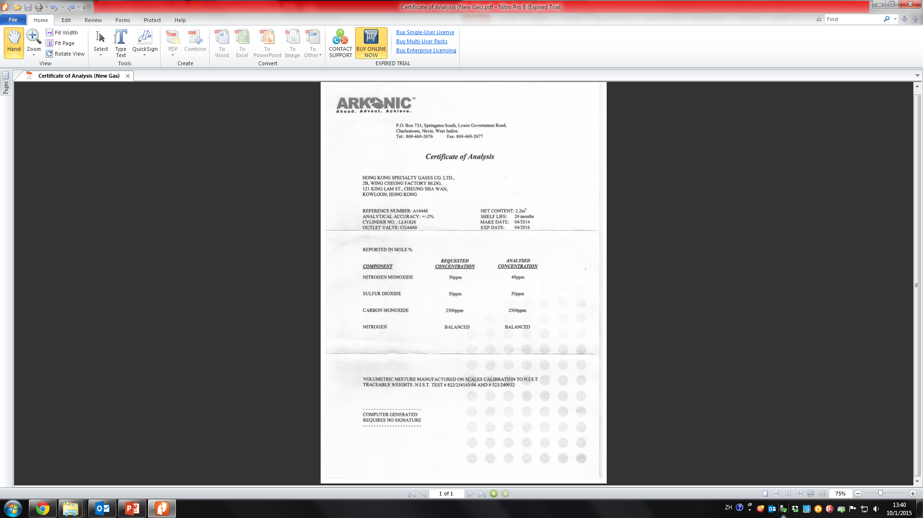
What is EPA Protocol Gas?

Slide 51

Case study in CO analyzers
T-API: Model 300E
TEI: Model 48C-TLE

Slide 52
Responses to Daily Checks
Point | Source Value | TEI Avg | T_API Avg | TEI Std Dev. | T_API Std Dev.
Span | 4500 ppb | 4614 ppb | 4612 ppb | 81 ppb | 155 ppb
Precision | 500 ppb | 514 ppb | 550 ppb | 17 ppb | 30 ppb
Zero | 0 ppb | 1 ppb | -8 ppb | 17 ppb | 33 ppb

Slide 53
Case study in CO analyzers

Slide 54
Case study in CO analyzers

Slide 55
Case study in CO analyzers

Slide 56
Case study in CO analyzers

Slide 57
Case study in CO analyzers

Slide 58
Reference
USEPA., 2013., Quality Assurance Handbook for Air Pollution Measurement Systems., Volume II
CO analyzer model 300E Operation Manual
SO₂ analyzer model T100U Operation Manual
NO_{x} analyzer model T200U Operation Manual
Seinfeld, J.H., Pandis, S.N., 2012. Atmospheric chemistry and physics: from air pollution to climate change. John Wiley & Sons.

Slide 59
PTI AQM Kiosk Setup
Introduction of PTI
Consideration of Location
Proposed by EMSD
Safety Issue

Slide 60
Consideration of Location
No Restricted Airflows
No Physical Adsorption or Absorption of target pollutants
Minimize Chemical Reaction
Avoid Physical Interference
Low Potential for Vandalism
On Ground Level

Slide 61
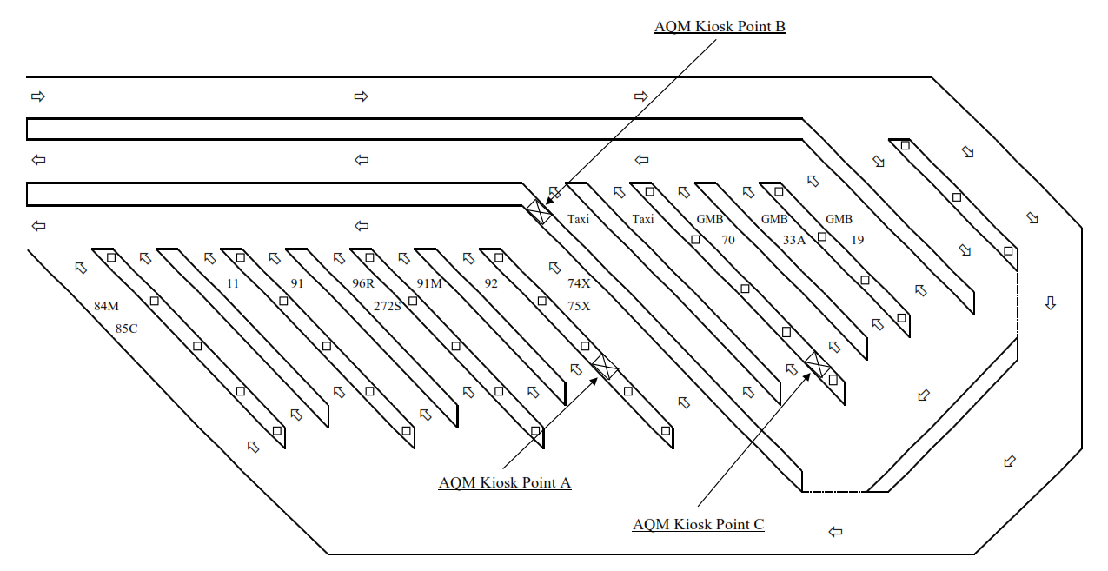
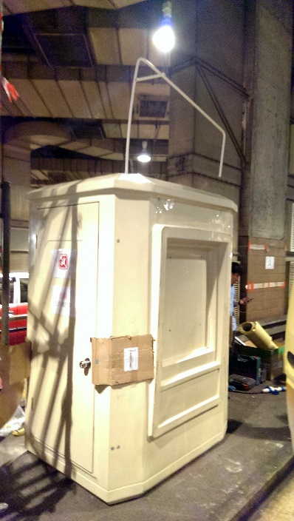
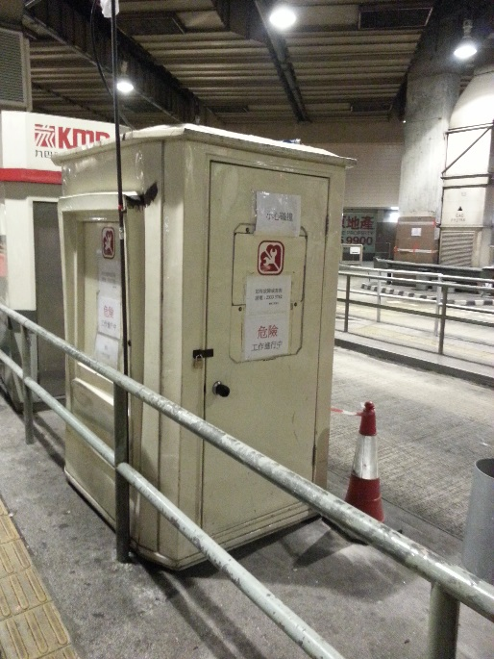
Consideration of Location

Slide 62
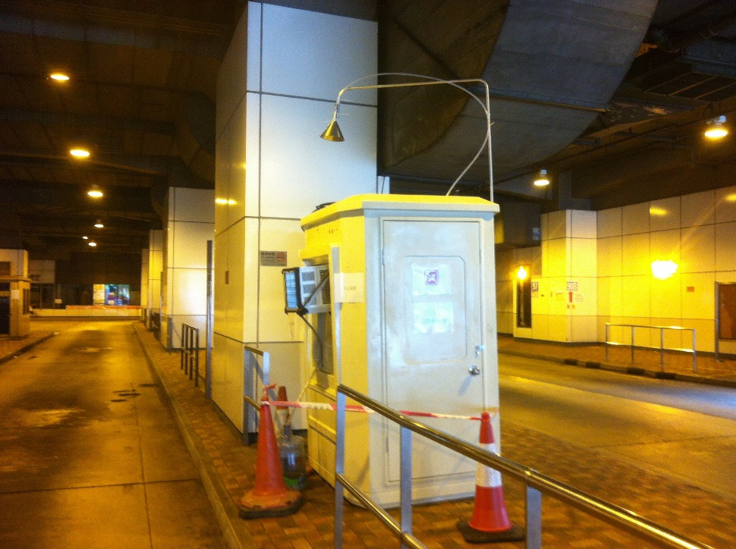
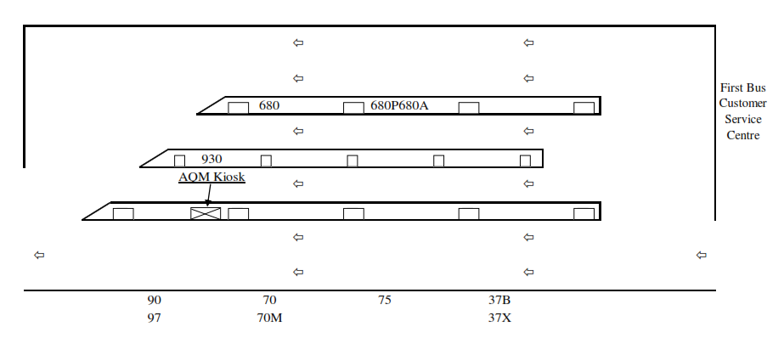
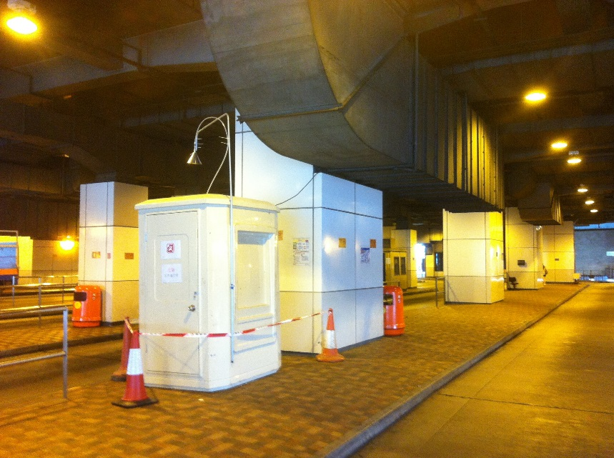
Consideration of Location

Slide 63
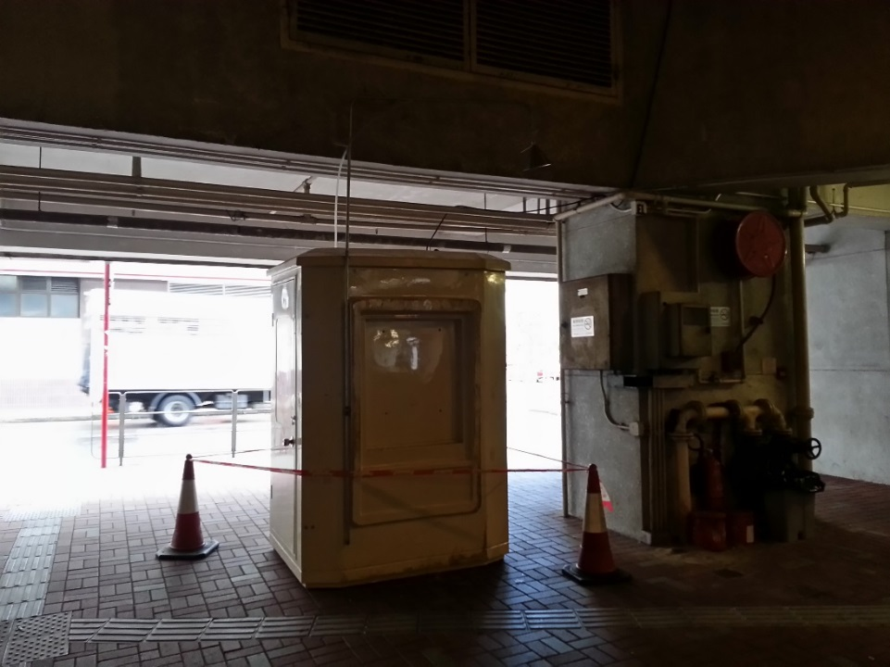
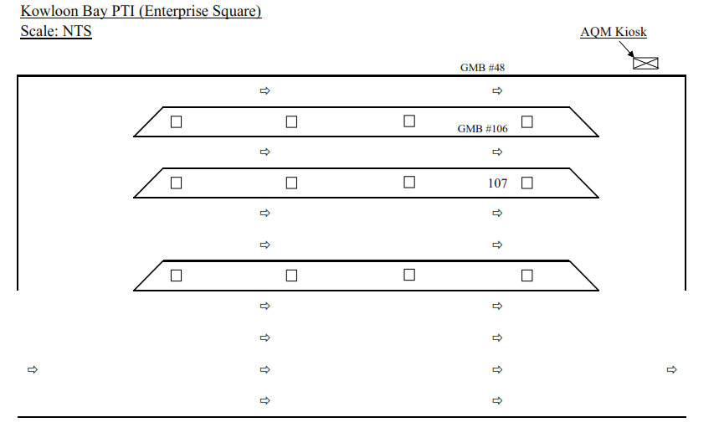
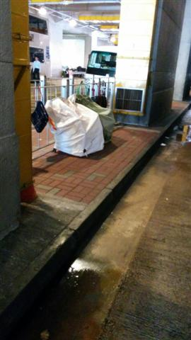
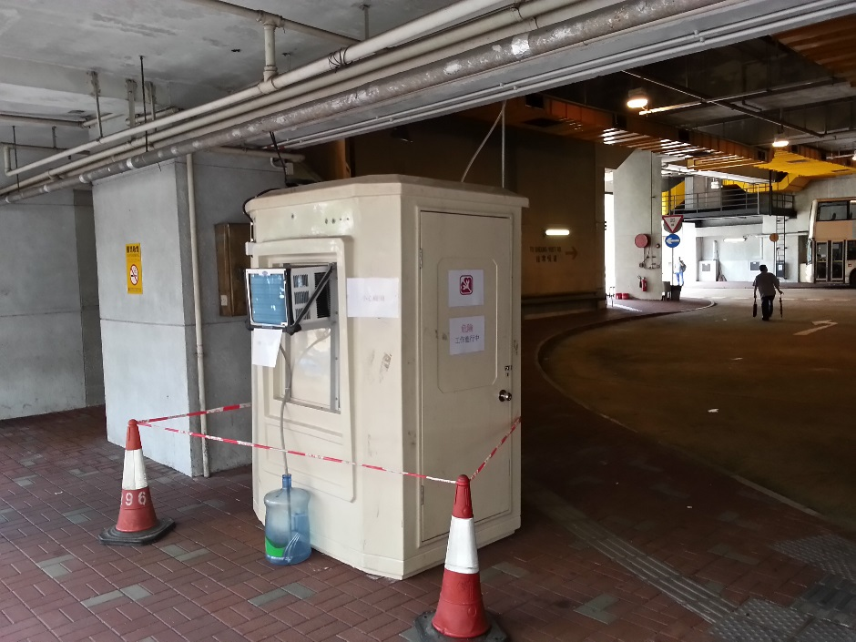
Consideration of Location

Slide 64
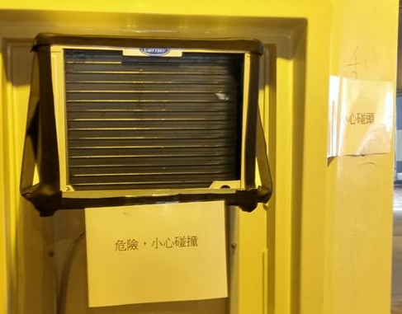
Safety Issue
Safety and Health Hazard
For Workers
For Passerby
Risk Assessment
Safety Measure

Slide 65
Safety and Health Hazard For Workers
Factories and Industrial Undertakings Ordinance, Chapter 59
Working at Working in Height
Occupational Safety and Health Ordinance, Chapter 509
No Smoke and Fire
Lighting
Electricity
Qualified Person
Calibration Gas
Pressure

Slide 66
Safety and Health Hazard For Passerby
Kiosk's
A/C unit
Door
Security
Electricity
As height as possible
Security
Calibration Gas
Pressure
Security

Slide 67
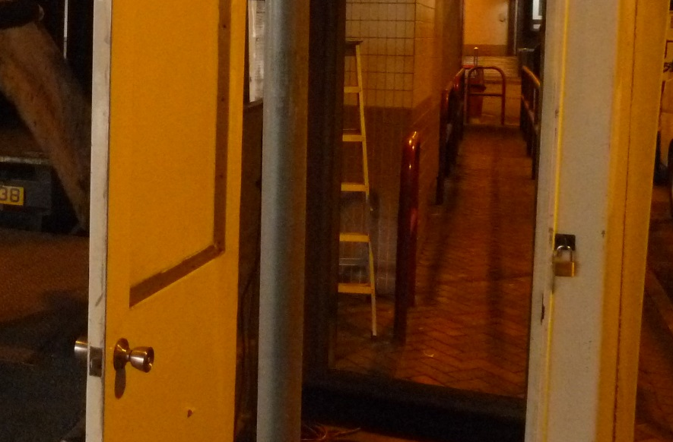
Risk Assessment
Work in Working at Height
Stepladder
Provision of Personal Protective Equipment (PPE)
Insulating gloves
Masks
Safety Shoes
Flashlight
Security
Door with Lock
Calibration Gas
Certificate

Slide 68
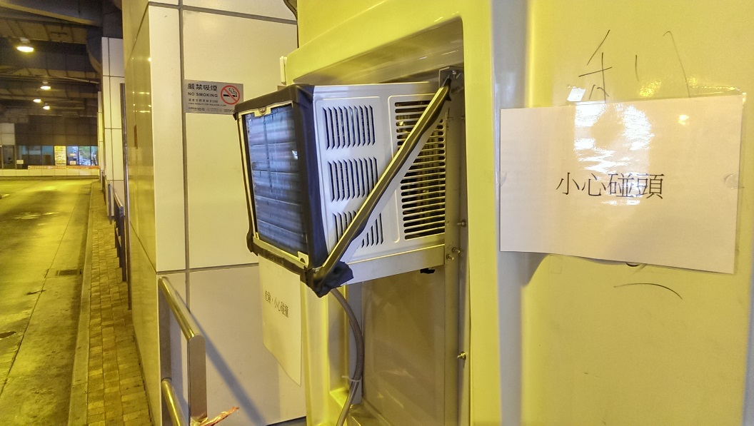
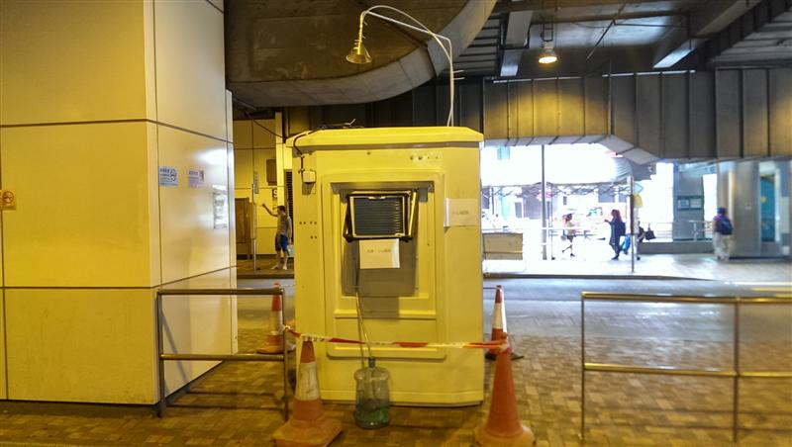

Safety Issue

Slide 69
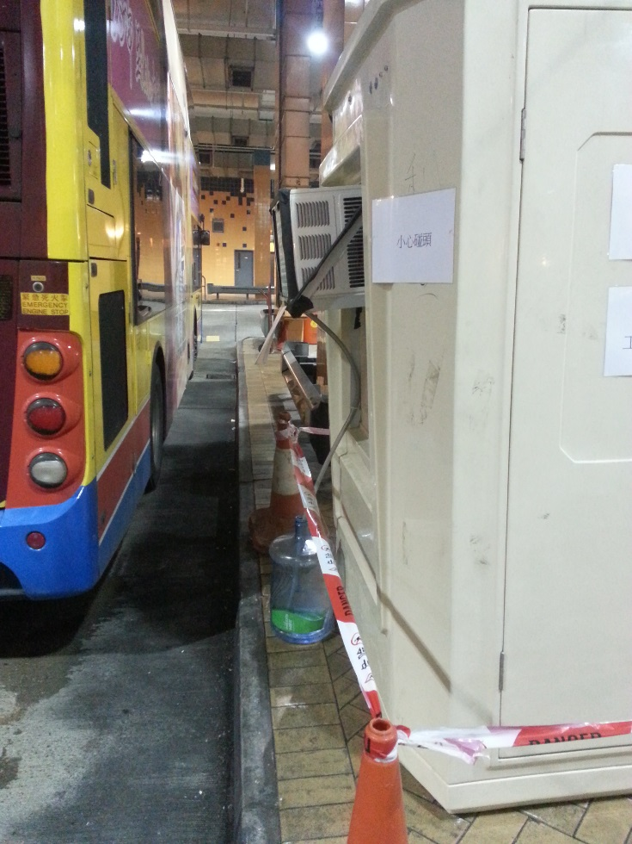
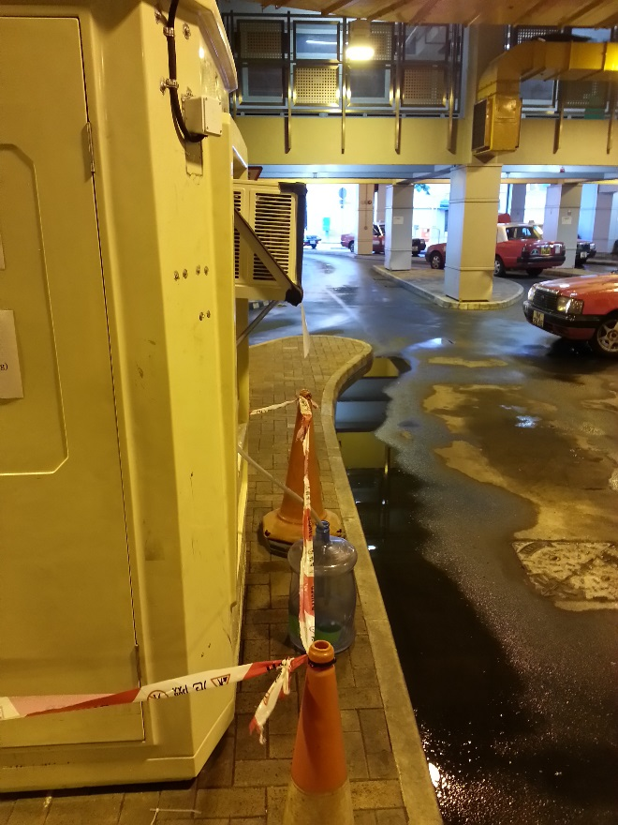

Safety Issue

Slide 70
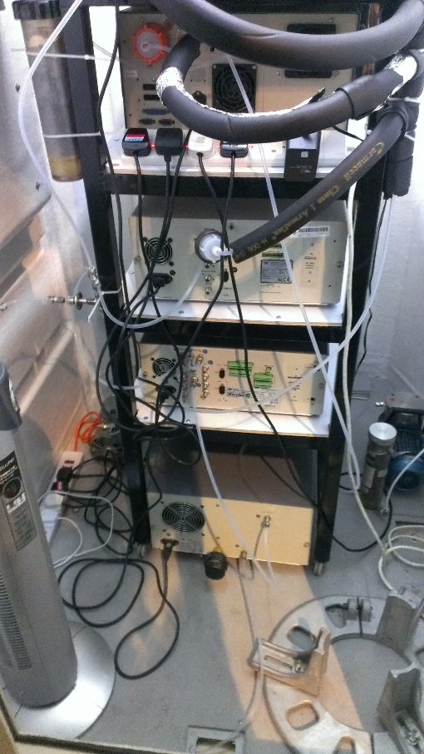
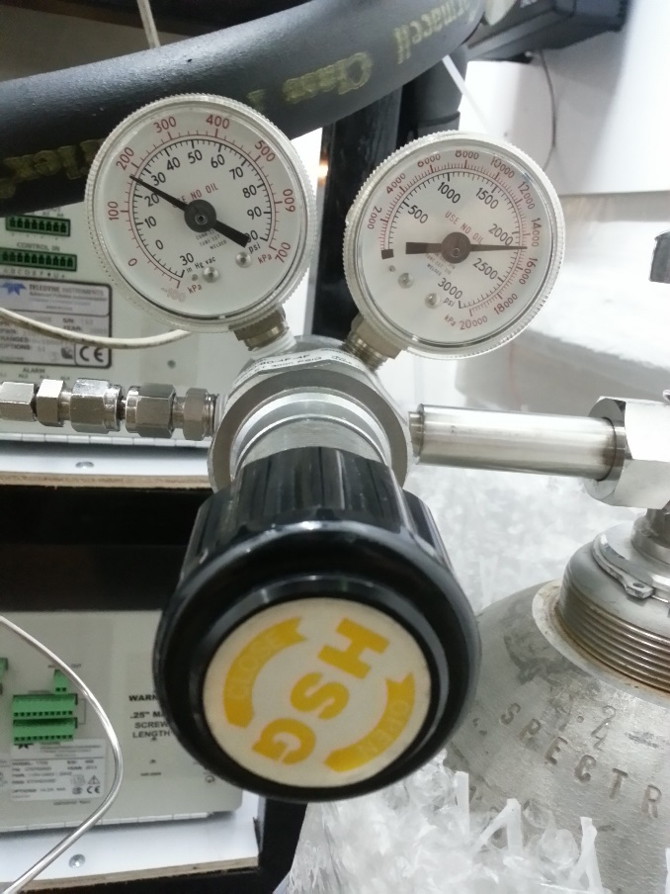
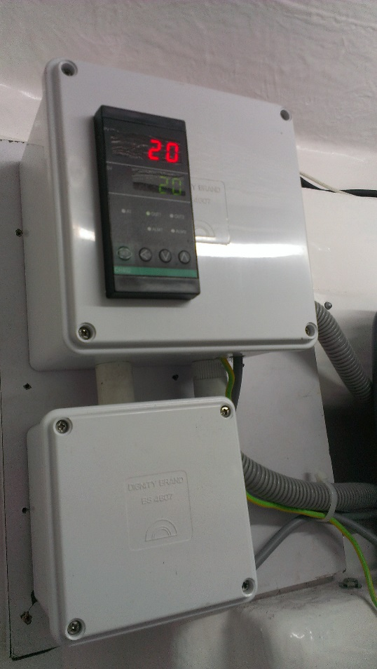
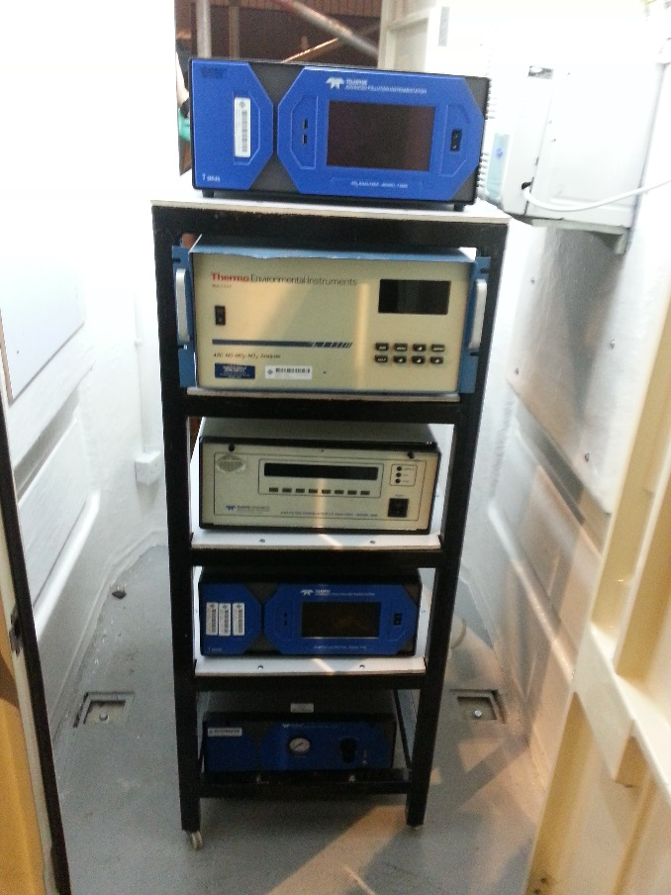
Safety Issue
25 in psi

Slide 71
PTI AQM Kiosk Setup
Procedures
Kiosk Setting Up (Day 1)
Calibration (Day 2)
Data Logging (Day 3)
Zero/Span Check (Day 4)
Kiosk Removal (Day1/Day 4)
Routine Maintenance for Analyzers

Slide 72
PTI AQM Kiosk Setup Process of PTI AQM
Kiosk Setting Up (Day 1)
Calibration (Day 2)
Data Logging (Day 3)
Zero/Span Check (Day 4)
Kiosk Removal (Day1/Day 4)

Slide 73
Procedures – Delivery
Ensure there is no equipment damage before delivering
Put all equipment in original package with sufficient cushioning
Deliver all equipment to the monitoring PTI carefully
Light vehicle for equipment and truck with tail boards for Kiosk
A/C unit and Fluorescent tube must dismantle
Check there is no equipment damage after the delivery and confirm the equipment is operational

Slide 74
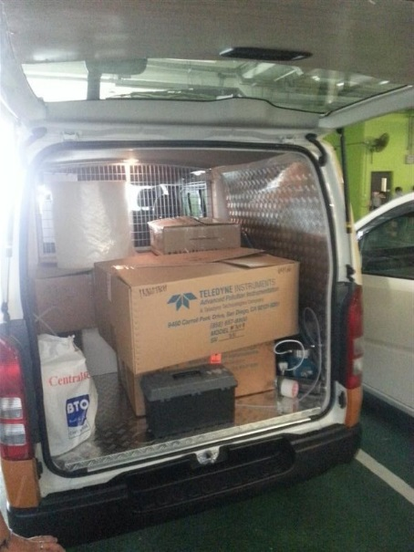
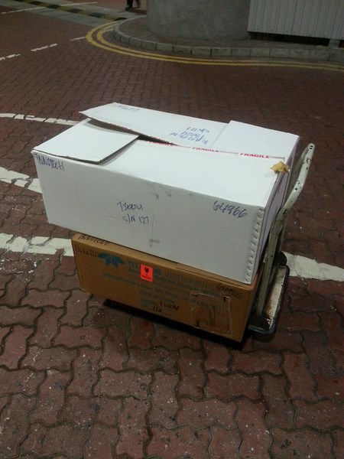
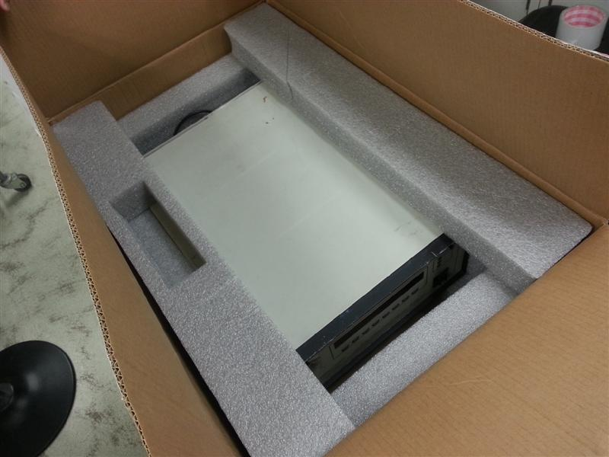
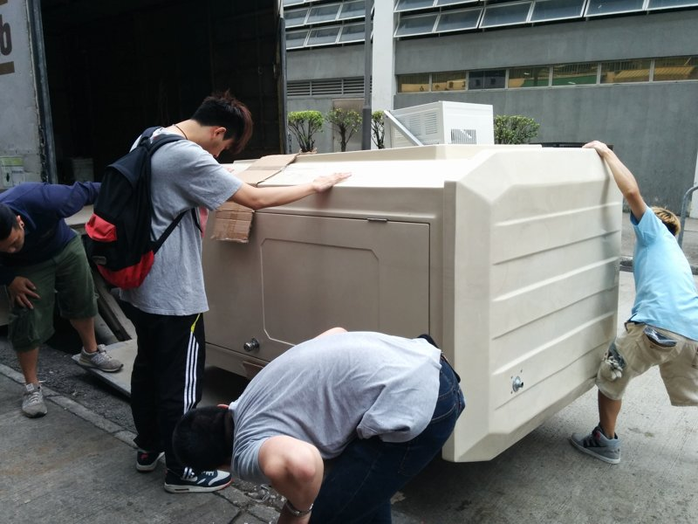
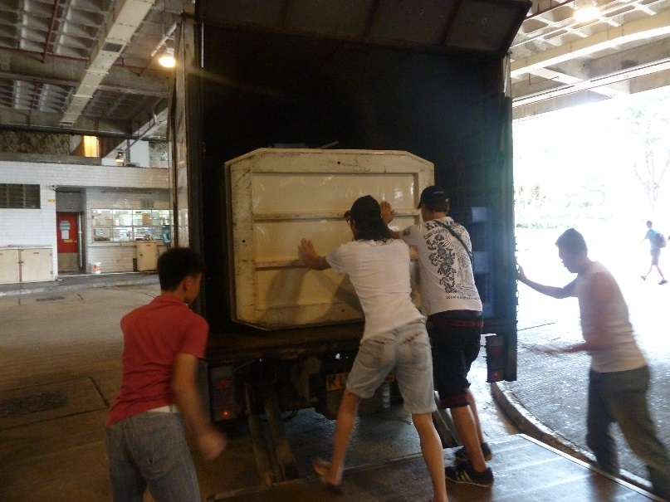
Procedures – Delivery

Slide 75
Procedures – Installation
Install the A/C unit and Fluorescent tube before setting up the Analyzer and Calibrator
Perform an initial power-up test
Connect the pneumatic hoses to the equipment accordingly
Switch on the temperature recorder
Check the set up before turning on the equipment
Turn the equipment on and let the equipment run overnight
Cordon off the work area to enclose kiosk to avoid people walk in near to the kiosk
Fill in the “Measurement Checklist of the PTI Investigation” record sheet

Slide 76
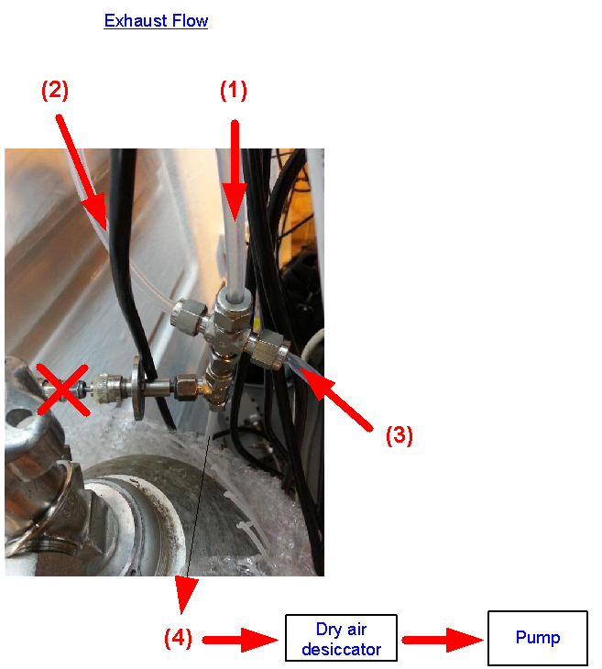

Procedures – Installation
SO₂ analyzer
1 x power cord
1 x exhaust tube (1)
1 x sample tube with filter(a)
1 x usb cable (connect to computer)
NO_{x} analyzer
1 x power cord
1 x larger exhaust tube (connect to large pump)
1 x sample tube (b)
1 x usb cable (connect to computer)
CO analyzer
1 x power cord
1 x exhaust tube(2)
1 x sample tube with filter (c)
1 x RS232 cable (connect to computer)
Calibrator
1 x power cord
1 x exhaust tube (3)
1 x output A tube (d)
1 x diluent in tube (connect to zero air generator output)
1 x cylinder gas tube (connect to zero air generator output)
Zero air generator
1 x power cable
1 x output tube (connect to calibrator diluent in)
1 x drain tube

Slide 77




Procedures – Installation
SO₂ Analyzer
NO₂ Analyzer
CO Analyzer

Slide 78


Procedures – Installation
1m
Teflon tubing (O.D size of 3/8” or 1/2”)
Steel Support
Safety Barrier

Slide 79
Routine Maintenance for Analyzers
Anchor Bolt should be used for reduce the tremors
Ensure the Equipment in well condition
Avoid any undesirable connection
Pump, Receiving Time
Calibration Gas
Temperature : 20 ºC - 30 ºC
Replace the filter paper

Slide 80


Multi-point calibration-CO
Slope = 1.02
R² = 0.9999

Slide 81

Multi-point calibration-SO₂
Slope = 0.98
R² = 0.9999

Slide 82

Multi-point calibration-NO_{x}
Slope = 1.01
R² = 1

Slide 83
Data Review, Verification and Validation
4.1 Data Review Methods
4.1.1 DAS Data Review
Typical review process for the station operators (SO) and data processing team (DP) include:
(SO) Review of zero, span, one point QC verification information, the hourly data, and any flags that could effect data and record any information on the daily summaries that might be vital to proper review of the data.
(SO) Transfer strip charts both analog and digital information, daily summaries, monthly maintenance sheets, graphic displays of meta data and site log notes to the central location for a secondary and more thorough review.
(SO) At the central location, review the data, marking any notations of invalidations and provide electronic strip charts, meta data charts, daily summaries, site notes, and monthly maintenance sheets for ready access by the data processing staff.
(DP) Review zero, span and one point QC verifications, station notes, and monthly maintenance sheets for the month.

Slide 84
Reporting
AQM Report.pdf
Cover Page : AQM Cover
Appendix I : Location Plan
Appendix II: Temperature Chart
Appendix III: Location & Configuration of Intake Probe
Appendix IV: Checklist & Calibration Record
Appendix V: Printout of Measured Data
Appendix VI: Summary of Daily Maximum
Appendix VII: Summary of Pollutant Concentration

Slide 85


Reporting - Cover
AQM Cover
Kiosk Setting Up
Calibration
Data Logging
Zero/Span Check
Kiosk Removal

Slide 86

Reporting - Location Plan
Location Plan
Provided by engineer from EMSD

Slide 87

Reporting - Temperature Chart
Temp Chart
Weekly Temperature Chart
Should be start at Day 1
Must included the day of Data Logging*

Slide 88



Reporting - Configuration of Intake Probe
at least 3 photos of kiosk in different side to locate the monitoring point
3 Photos in one page

Slide 89


Reporting - Checklist & Calibration Record
Checklist
Fresh Air Dust
Exhaust Air Dust
Schedule for Ventilation Fans
Provided by Engineer
Calibration Form
6 to 8 minutes for the Analyzer to stabilise at each concentration level
Not greater that 5% (±2% Preferred)
Calibration Gases Certificate
After installation
After relocation from one to another
Correlation coefficient is less than 0.9975,repeat again

Slide 90
Reporting - Printout of Measured Data
CO Measurement Record
SO₂ Measurement Record
NO₂ Measurement Record
Set 1 : 00:00 – 23:59
Set 2 : 00:00 – 23:59
Set 3 : 00:00 – 03:59

Slide 91
Reporting - Summary of Daily Maximum
Maximum Average

Slide 92

Reporting - Summary of Pollutant Concentration
Pollution Concentration from EPD
Past 24 Hours Pollutant Concentration Summary

Slide 93



Procedures for Calibration and Zero/Span Check
Set up calibration Gas, and set in 25 psi
Full Procedures
Calibration Sheet

Slide 94

Procedures for Data Collection
Connect the USB cable of each Analyzer to the Computer
Open ‘APICom’(software) in Computer
Click ‘CO/NO/SO₂’ to open the Analyzer menu separately
Click ‘iDAS’ to open the internal menu
Click ‘GET DATA’, and enter the time (in minutes) to get data
Wait for the process of getting data
Click the ‘SAVE DATA’ to get the excel file, and save it

Slide 95
End

