Slide 1
Central Control and Monitoring System ( CCMS )

Slide 2
Introduction
As we have entered the new age of information technology, electronically enhanced buildings have gone through more than 20 year of the development history. A modern building is one equipped with the information technology infrastructure that enables it to continuously respond and adapt to changing conditions, allowing for a more efficient use of resources and increasing the comfort and security of its occupants.
Due to hardware and software limitations, older buildings lack the necessary integrations among various control aspects. Nowadays, modern buildings are usually controlled and monitored by a CCMS which is the “brain” of the buildings during their daily operations. The most widely accepted framework for the CCMS in an intelligent building is a two-tier or three-tier distributed architecture. These two tiers include the outstation controllers and the central monitoring computer with data communication wiring connection in between. The controllers are local microprocessor based devices to implement actual control algorithm (e.g. PID algorithm) for the actuators under control. They are usually installed next to the equipment to be controlled. The controllers receive control commands such as set point, on/off instructions from the central control and monitoring computer to carry out the designated functions. This two-tier configuration ensures the building’s functionality even the central control and monitoring computer is temporarily out of service. Additionally, sensors and transducers are installed at various parts of the engineering systems to send the condition signal back to the controller for control and monitoring purpose.
The new trend of Intelligent Buildings is concentrated on both economic and environmental sensitive developments. Flexibility and low energy have become the issues that must be addressed to cope with the fast growing technology and ever changing of the modern world. Besides operational advantages, Intelligent Buildings also project high technology image to the property market. This gives the buildings additional cutting edges in the tight market.

Slide 3
Introduction
The building’s features that can be looked after by the CCMS basically fall into four categories. They are :
Energy efficiency - reduction of energy consumption through effective energy management algorithms,
Life-safety systems – reduction of manpower dependence, access control, smoke detection, fire alarm, intrusion alarm, and emergency control of HVAC and lifts etc,
Telecommunications systems – telephone system, electronic mail system and cablevision etc,
Workplace automation – central data processing, facility management etc.

Slide 4
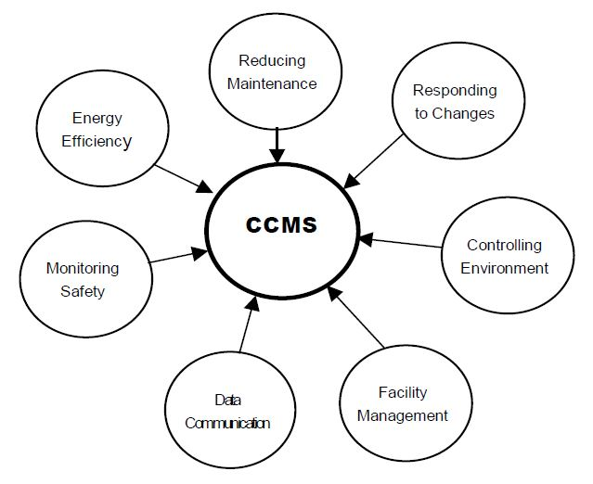
Introduction
The following diagram outlines the features that modern CCMS addresses :
Through the use of CCMS, the building under controlled can be monitored and operated 24 hours a day, 7 days a week. Compared with traditional facility management set up, CCMS provides a systematic tool for building manager to operate the building.
Routine operations can be programmed and operated automatically everyday. Through the use of CCMS, the building under controlled can be monitored and operated 24 hours a day, 7 days a week. Compared with traditional facility management set up, CCMS provides a systematic tool for building manager to operate the building. Routine operations can be programmed and operated automatically everyday.

Slide 5
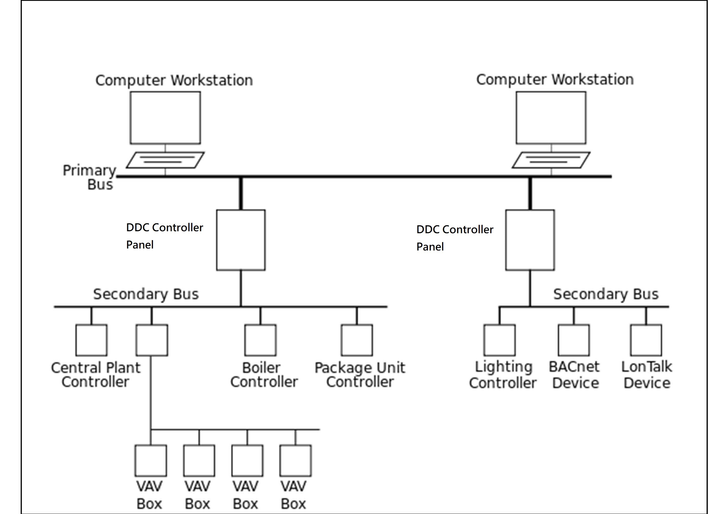
System architecture of CCMS

Slide 6
Network Protocols
TCP/IP – Transfer control protocols/Internet protocol
BACnet – Building automation controller network
Modbus
LonWorks
Numerous protocols available

Slide 7
Network Protocols
BACnet
Created and driven by ASHRAE, BACnet (Building Automation Communications Network) is the most widely used communications protocol in the industry. The two main types of BACnet implementations are BACnet MS/TP and BACnet/IP.
BACnet MS/TP (Master-Slave/Token Passing) : an older implementation in which system integrators run twisted pairs (RS-485 standard) through the building as a separate network. BACnet MS/TP communicates at a low baud rate and cannot handle default settings or changes to the physical network configuration. It must be installed with specific terminating and biasing resistors. Despite its slow speed and limited fault tolerance compared to other communication protocols and implementations, BACnet MS/TP is probably the most common application today.
BACnet/IP : an emerging implementation based on Internet Protocol (IP), which means it can communicate over an Ethernet cable or an IP network. Instead of running standard MS/TP RS-485 twisted pairs, system integrators can plug in a BACnet/IP controller or device just like a computer. These devices have a network jack that accepts an Ethernet cable. The system integrator or IT/OT professional then sets up a network and it works.

Slide 8
Network Protocols
Modbus
Modbus is widely used in industrial environments such as electrical switchgear. Factories use Modbus for programmable logic controllers (PLCs) and data centers use it for power distribution units (PDUs). Modbus is also popular in Europe and Asia Pacific.
Like BACnet, Modbus offers different implementations. Remote Terminal Unit (RTU) uses a twisted pair serial bus, while Transmission Control Protocol (TCP) is implemented using Ethernet compatibility.
Unlike BACnet, Modbus does not provide network discoverability. The integrator needs a Modbus register (essentially a blueprint or road map of the communication points in the building) as well as data point address numbers. The integrator manually enters these address numbers and then configures each address number to read the correct value. While it requires more upfront work to set up than BACnet, Modbus works very well once you're up and running.

Slide 9
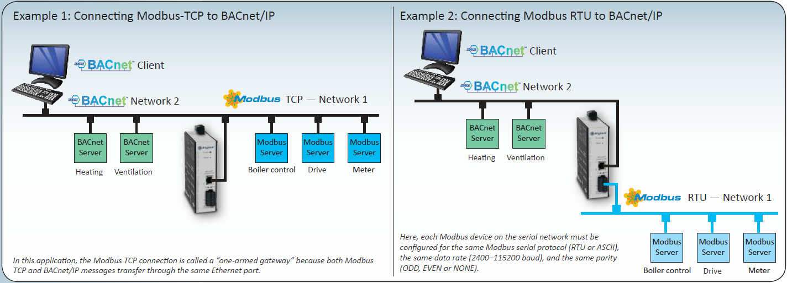
Network Protocols
BACnet & Modbus Communication
BACnet to Modbus gateway

Slide 10
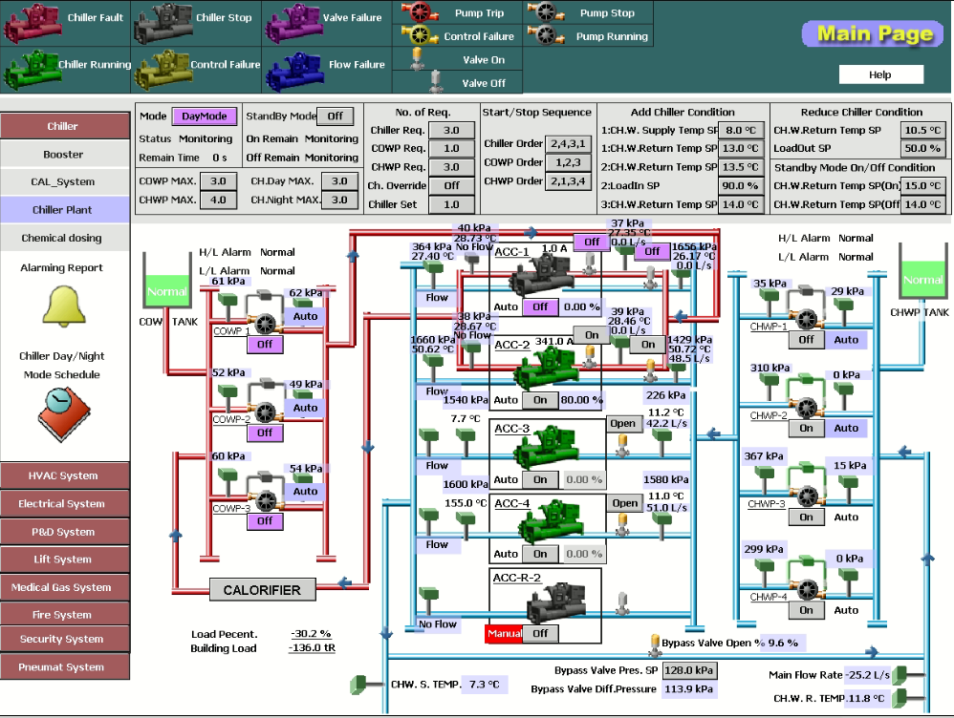
CCMS Application : Chiller Plant

Slide 11
CCMS Application : Chiller Plant
ACC CHILLER PROGRAM FLOW CHART

Slide 12
CCMS supervision and O&M work sharing
With yourself :
Understand all the works you are responsible
With contractors :
Keep good communication
Works distribution & inspection
With shift duty staffs :
Keep good communication
Explain patiently for system operation
Kindly assistance

Slide 13
CCMS supervision and O&M work sharing
With EMA staffs :
Keep good communication
Explain patiently for system operation and maintenance contract content (eg.Equipment list)
Kindly assistance
Solve each other's problems
With electronic staffs :
Keep good communication
Explain patiently for system operation (if any)
Assistance

Slide 14
Thank you

