Slide 1
PA system aeNISK22 YEN KING CHUN

Slide 2
Part One
Understanding the PA
Characteristic Client PA
Input ( Microphone )
Mixing
Amplifies
Output (Speaker)
Chime system
Timer
Battery

Slide 3
PA System basic diagram
Input ( Microphone )
Mixing
Amplifies
Output (Speaker)

Slide 4
Microphone type
Dynamic Microphones
Condenser Microphone
Input
Mixing
Amplifies
Output

Slide 5
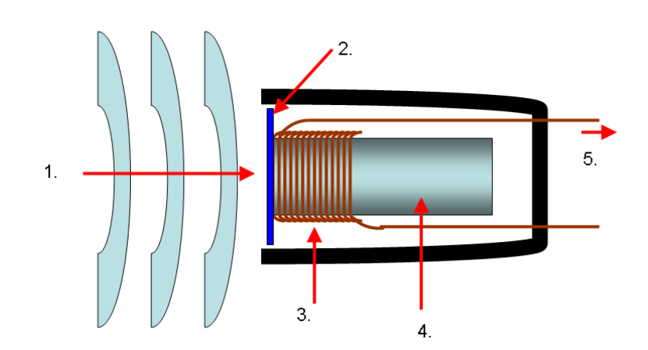
Principle (a dynamic microphone)
The principle of a dynamic microphone is to drive the diaphragm and coil through air vibration, converting the sound received by the microphone into electronic signals for transmission.
It have a magnet design (heavy).The high and low frequency response is poor.
The coil produces an induced current

Slide 6
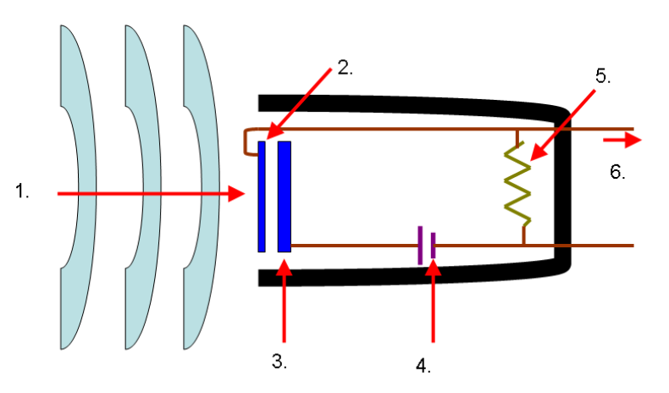
Principle (a Condenser microphones)
Capacitor microphones do not have coils or magnets. When sound enters the microphone, it vibrates the two parallel metal plates in front of the microphone. The vibrating membrane vibrates with the sound, while the metal plate in the back is fixed. The capacitor formed by the distance between the two generates a voltage difference due to vibration, which is converted into different signals to produce sound.
The biggest difference between capacitor microphones and other microphones is that they need to be powered.
The capacitor produces a voltage difference due to vibration

Slide 7
Microphone type
Input
Dynamic Microphones
for use in noisy environments (lower sensitivity)
Condenser Microphone
Ability to capture clearer sound details (higher sensitivity)
Usage: studio recording, podcasting, detail capture.
Usage: Live performances, speeches.
No additional power supply required
Requires power
Mixing
Amplifies
Output

Slide 8
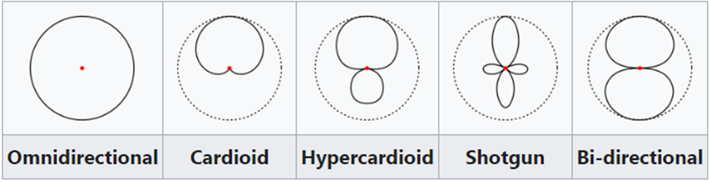
directivity
Front
Omnidirectional
Cardioid
Usage: Studio, vocal and instrument recording.
Hypercardioid
Usage: Live performance, stage.
Features: More focused on the front, with a small amount of sound pickup from the rear.
Features: Highly focused, suitable for long-distance pickup, but limited side and rear pickup.
Picks up front and rear sounds, rejects side noise, suitable for conversation between two people.
Shotgun
Bi-directional
Usage：Conversation recording
Usage: film shooting, outdoor recording.
Features: Effectively reduce rear noise and focus on front sound.
Usage: Choir, lavalier microphone.
Features: Pick up sound evenly from all directions. Cardioid

Slide 9
Mixer
Digital Mixer
Built-in effects, equalizer, and dynamics processing eliminate
Each function has physical knobs and faders that are easy to understand and operate.
Settings can be saved and recalled for quick switching
Analog Mixer
Input
Mixing
Amplifies
Output

Slide 10
Mixer (Input)
Input jack (Jack) ------ Connect various audio devices
Preamplifier ------ Preliminarily amplifies the audio signal from the input device
Equalizer ------ Adjusts the frequency response of an audio signal to enhance or attenuate specific frequencies
Dynamic processing area ------Control the dynamic range of the signal
Routing area ------ distribute audio signals to different outputs or other processing channels
Input fader ------Control the volume of each input signal

Slide 11
amplifies type
CLASS A Amplifier
the most common type of amplifier topology
s a solution to the efficiency and heating problems associated with the previous class A amplifier.
CLASS C Amplifier
as the greatest efficiency but the poorest linearity of the classes of amplifiers mentioned here.
CLASS AB Amplifier
a combination of the “Class A” and the “Class B” type amplifiers we have looked at above.
CLASS B Amplifier
over the full 360 degrees of the input cycle.
Then the output transistor of a class-A topology never turns “OFF”
uses two complimentary transistors either bipolar of FET for each half of the waveform
so that each transistor device amplifies only half of the output waveform
the output signals amplitude and phase are linearly related to the input signals amplitude and phase.
Input
Mixing
Amplifies
Output

Slide 12
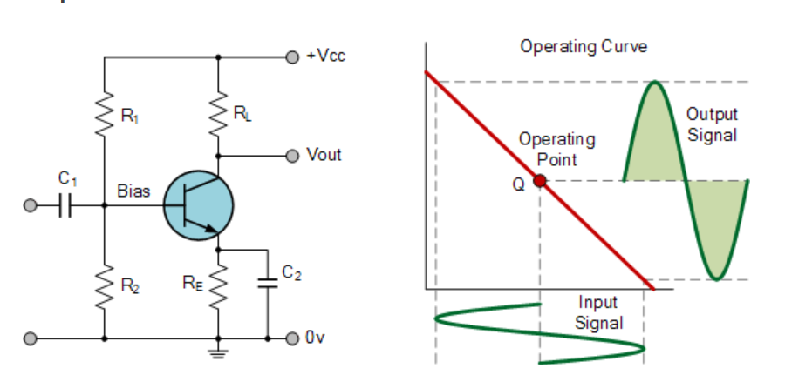
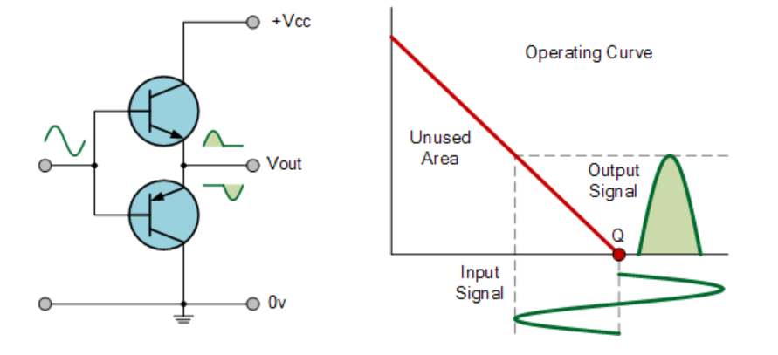
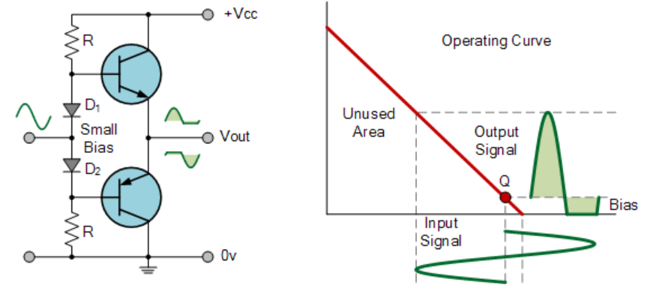
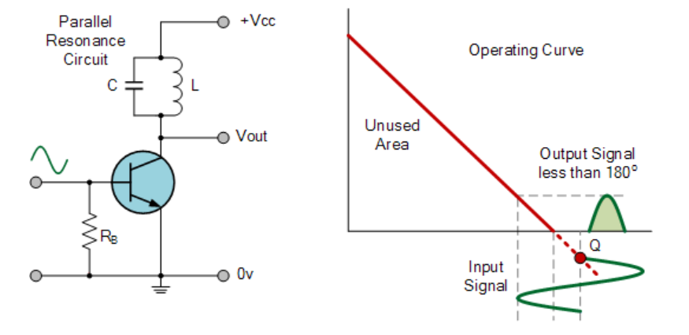
Class A Class B
Class AB Class C

Slide 13
Speaker
Speaker
for use in noisy environments (lower sensitivity)
Usage: Live performances, speeches.
No additional power supply required
Input
Mixing
Amplifies
Output

Slide 14
Client PA
Speaker
for use in noisy environments (lower sensitivity)
Usage: Live performances, speeches.
No additional power supply required
Input
Mixing
Amplifies
Output

Slide 15
Characteristic of Client PA
Chime system
Timer
Battery

Slide 16
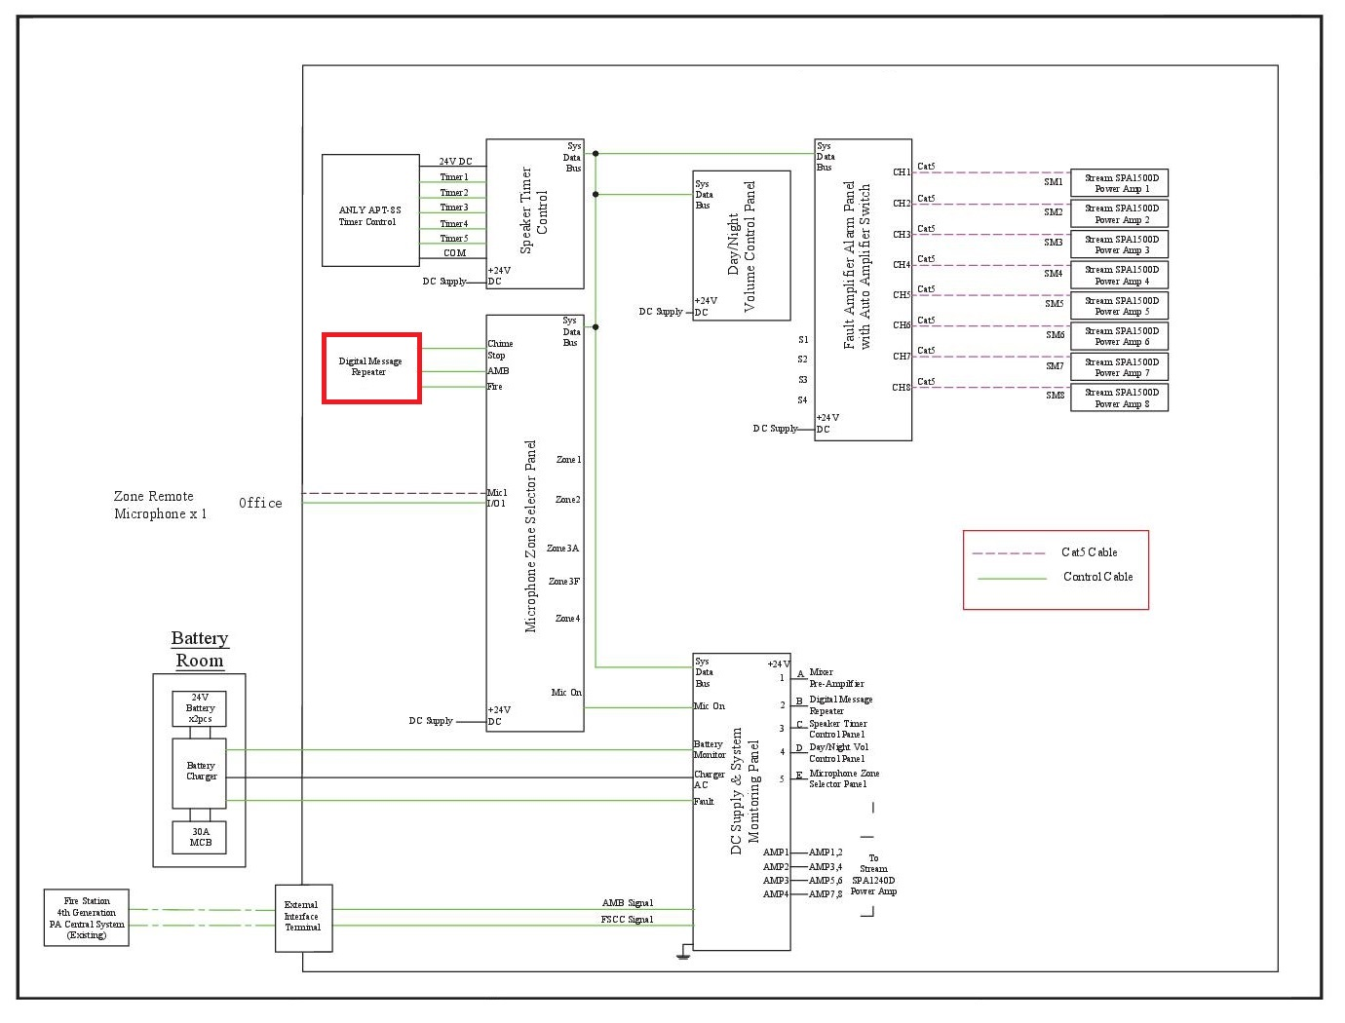
Characteristic of Client PA
Chime system
Timer
Battery

Slide 17
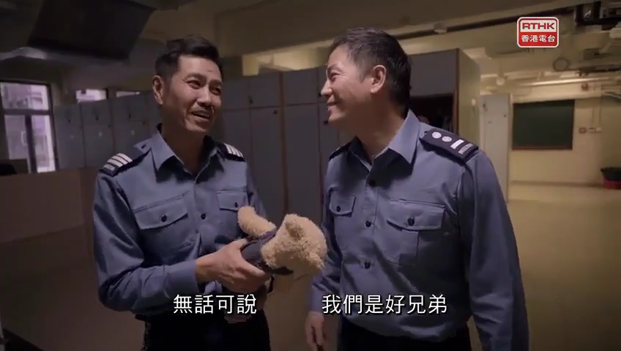
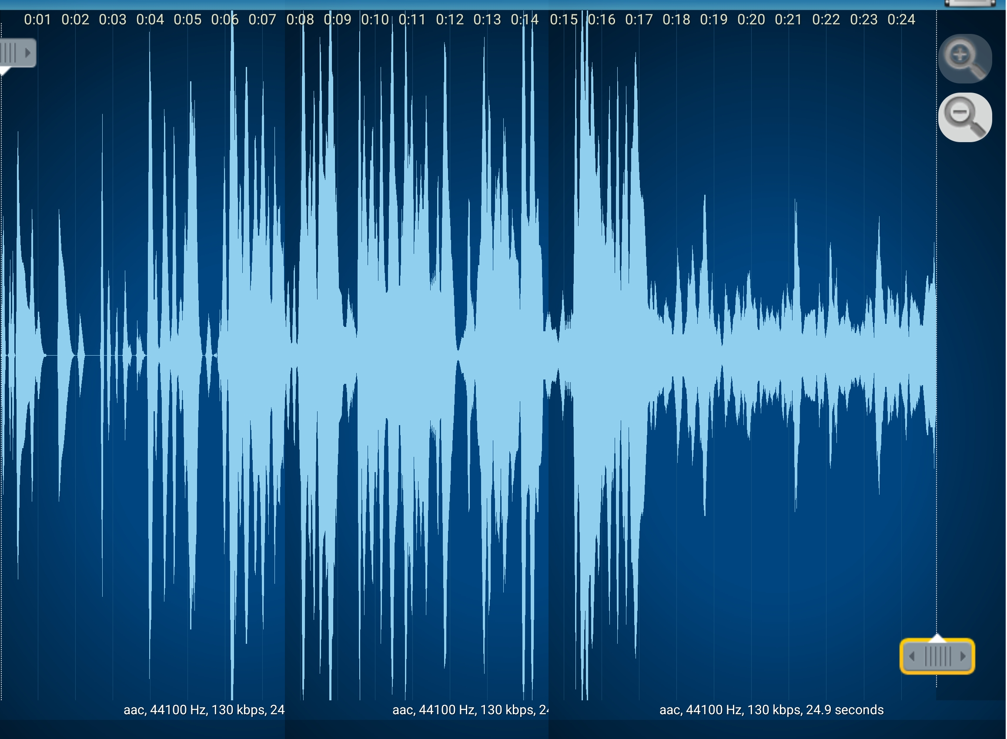

Slide 18
RCS9500 – TETRA Radio Dispatch System

Slide 19
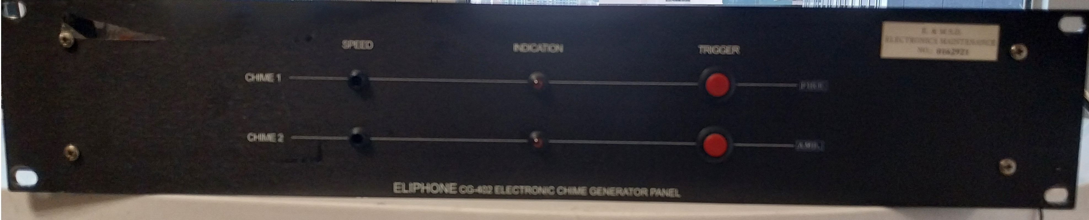
Chime generator

Slide 20
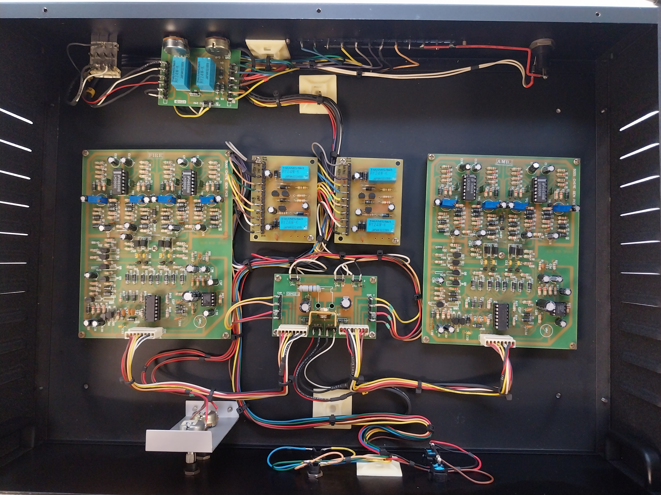

Slide 21
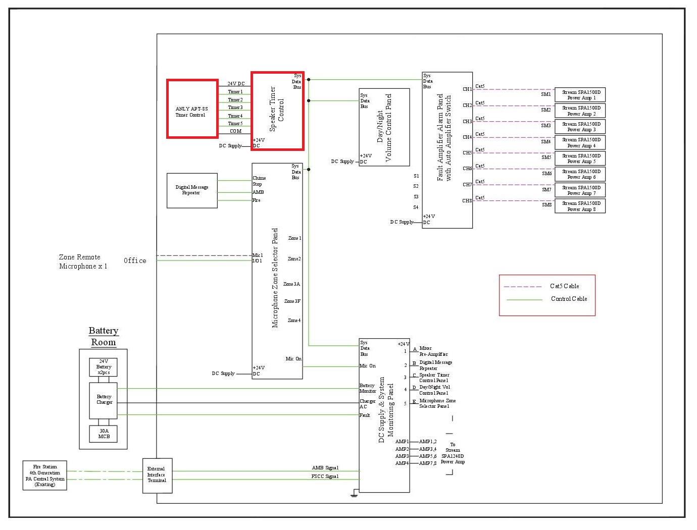
Characteristic of Client PA
Chime system
Timer
Battery

Slide 22
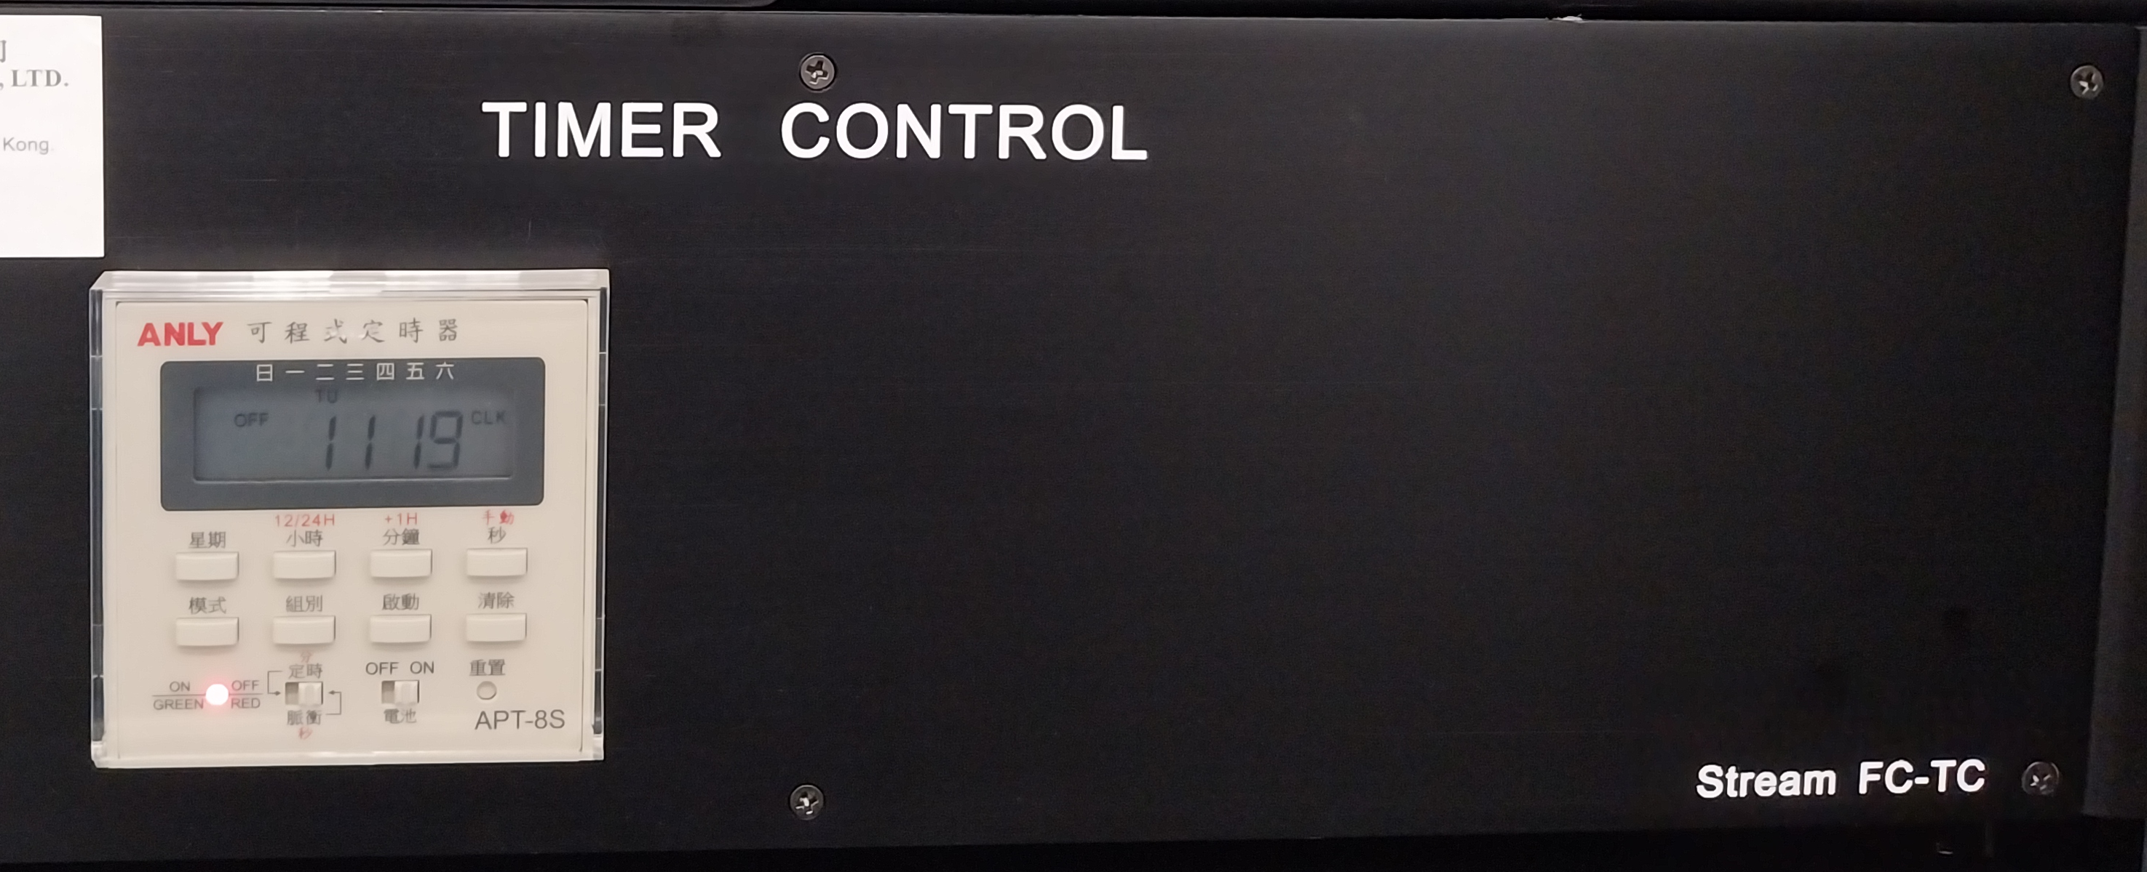
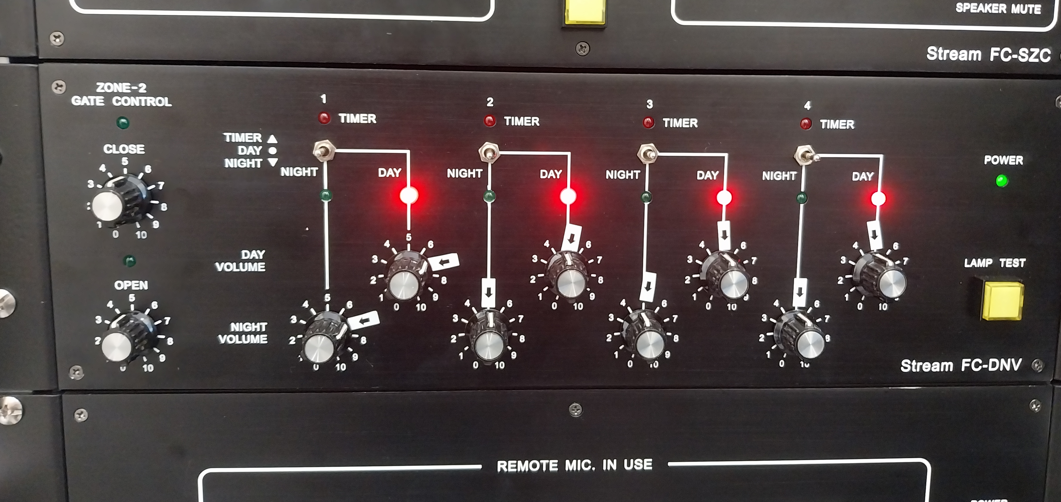
Timer

Slide 23
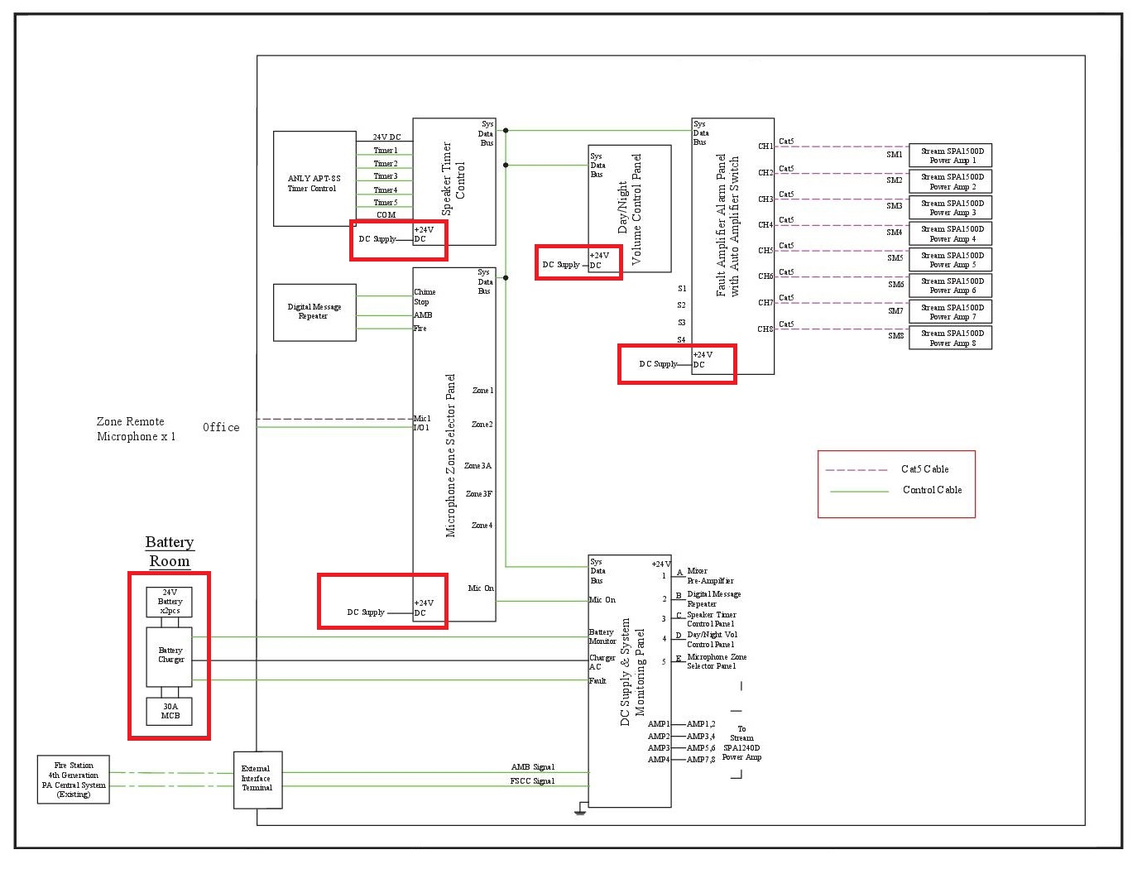
Characteristic of Client PA
Chime system
Timer
Battery

Slide 24
END

