Slide 1



Radio
By AEnI/GF/3
Johnson Lo

Slide 2
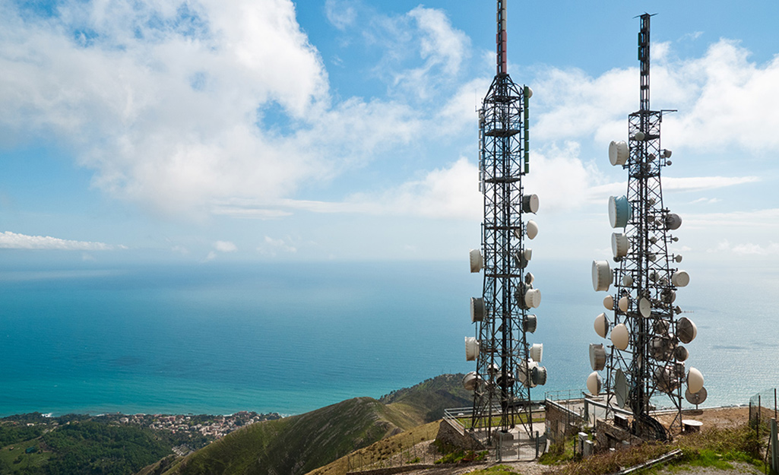
1.RF theory
2. Antenna
3. RF measurement
4. Radio System
5. Current Development
6. Training Trend

Slide 3
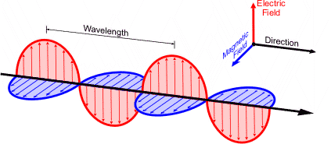
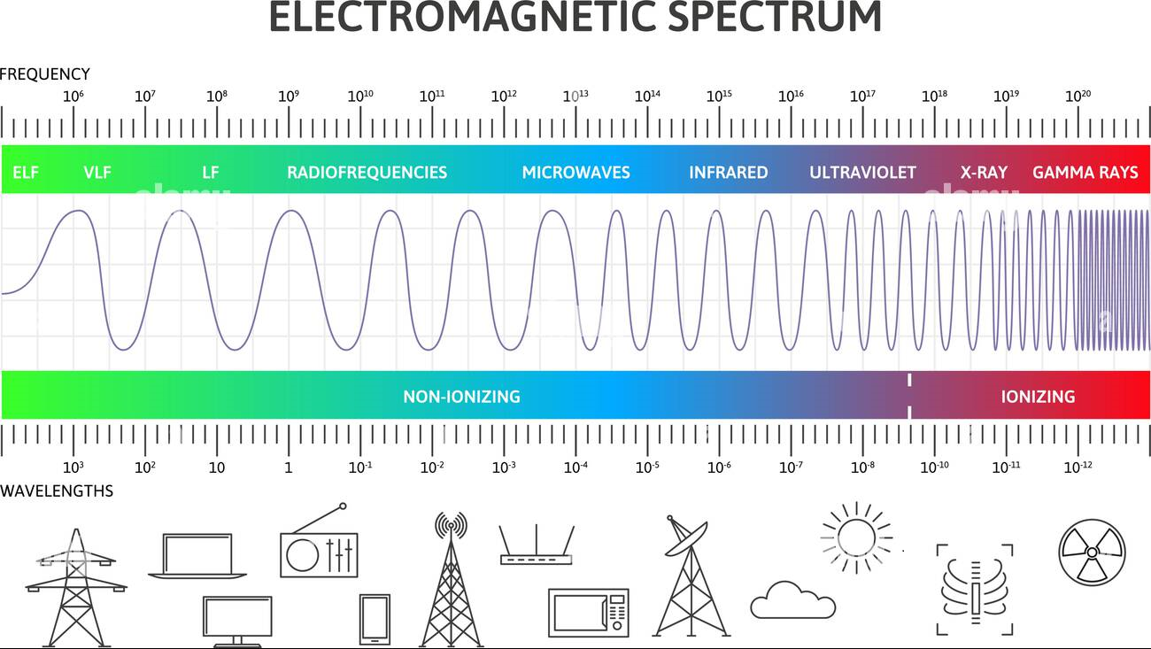

RF Theory
Radio Frequency (RF)
Radio wave is kind of Electromagnetic wave
Different wavelength/frequency have
different usage
$$c=f\text{λ}$$

Slide 4
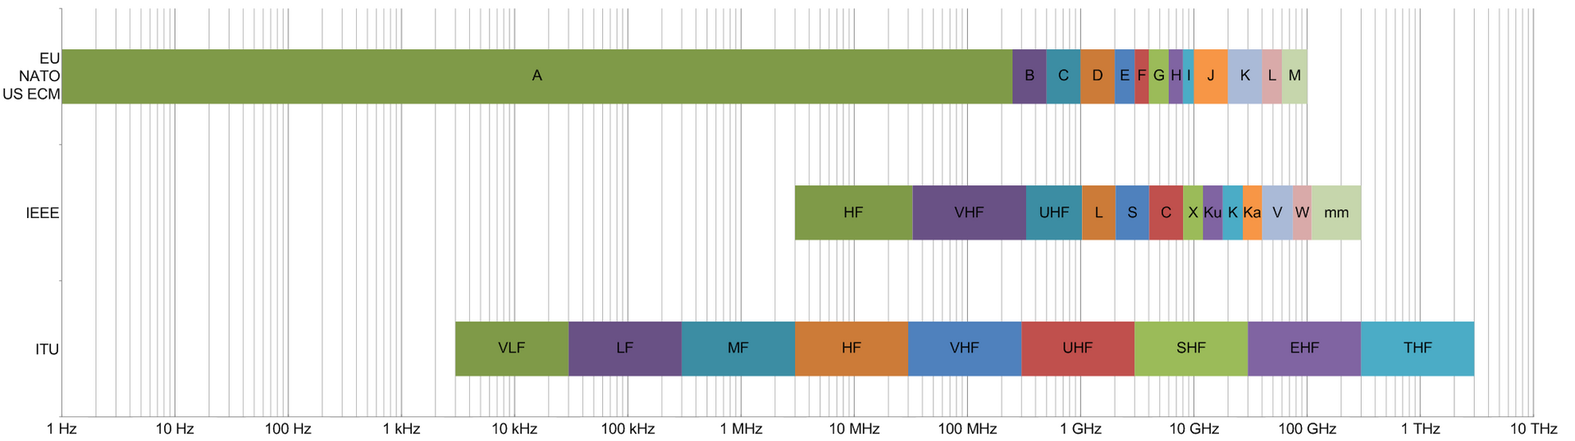
RF Theory
Frequency bands
ITU bands
IEEE bands
Band name | Abbreviation | Frequency and wavelength
Extremely low frequency | ELF | 3–30 Hz
 |  | 100,000–10,000 km
Super low frequency | SLF | 30–300 Hz
 |  | 10,000–1,000 km
Ultra low frequency | ULF | 300–3,000 Hz
 |  | 1,000–100 km
Very low frequency | VLF | 3–30 kHz
 |  | 100–10 km
Low frequency | LF | 30–300 kHz
 |  | 10–1 km
Medium frequency | MF | 300–3,000 kHz
 |  | 1,000–100 m
High frequency | HF | 3–30 MHz
 |  | 100–10 m
Very high frequency | VHF | 30–300 MHz
 |  | 10–1 m
Ultra high frequency | UHF | 300–3,000 MHz
 |  | 100–10 cm
Super high frequency | SHF | 3–30 GHz
 |  | 10–1 cm
Extremely high frequency | EHF | 30–300 GHz
 |  | 10–1 mm
Terahertz or tremendously high frequency | THF | 300–3,000 GHz
 |  | 1–0.1 mm
Band designation | Frequency range | Explanation of meaning of letters
HF | 0.003 to 0.03 GHz | High frequency
VHF | 0.03 to 0.3 GHz | Very high frequency
UHF | 0.3 to 1 GHz | Ultra-high frequency
L | 1 to 2 GHz | Long wave
S | 2 to 4 GHz | Short wave
C | 4 to 8 GHz | Compromise between S and X
X | 8 to 12 GHz | Used in World War II for fire control, X for cross (as in crosshair). Exotic.
K_{u} | 12 to 18 GHz | Kurz-under
K | 18 to 27 GHz | German: Kurz (short)
Ka | 27 to 40 GHz | Kurz-above
V | 40 to 75 GHz
W | 75 to 110 GHz | W follows V in the alphabet[
mm or G | 110 to 300 GHz[ | Millimeter[

Slide 5
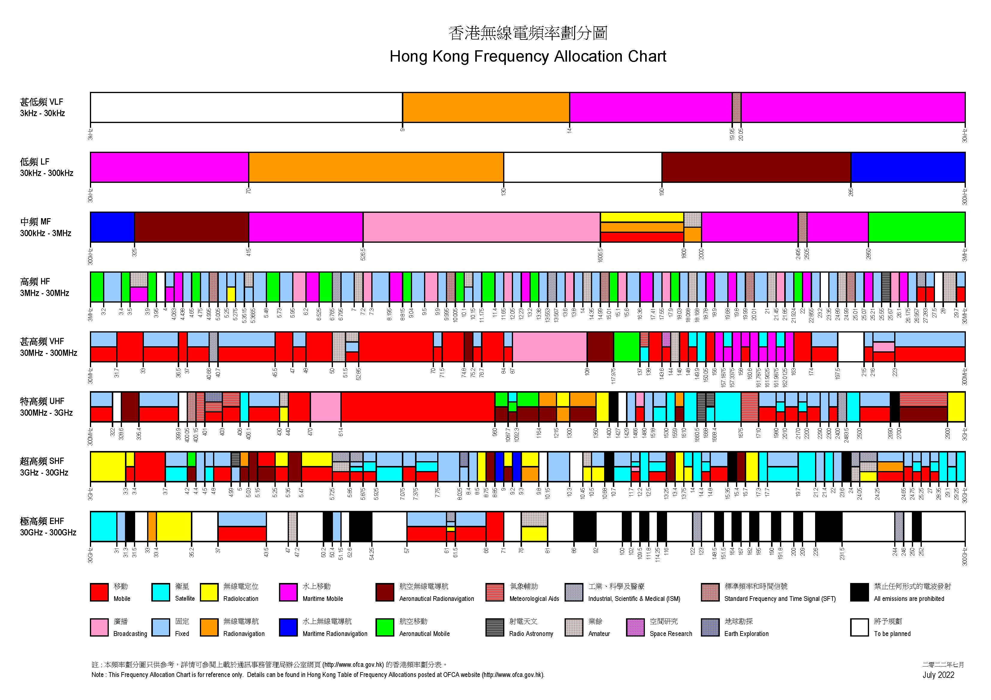
RF Theory
Hong Kong Frequency Allocation

Slide 6
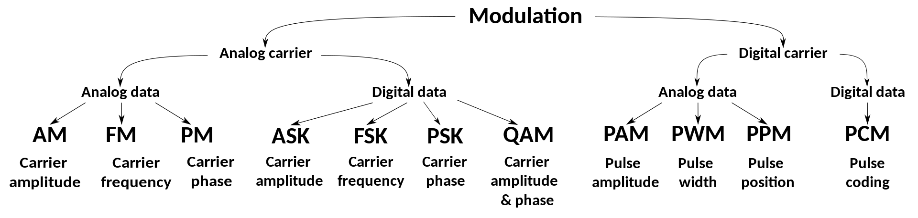
RF Theory
Modulation (Analogues and Digital)
Analogues Mobile Radio (Voice):
  AM
  SSB
  FM
  PM
  …
Digital Mobile Radio:
  Project 25 a.k.a. "P25" or "APCO-25"
  TETRA (trunking)
  TETRAPOL
  NXDN/dPMR
  DMR
  D-STAR
  …
Analogues Mobile Radio (Data):
  ASK
  FSK
    BFSK
    GFSK
  PSK
  …

Slide 7
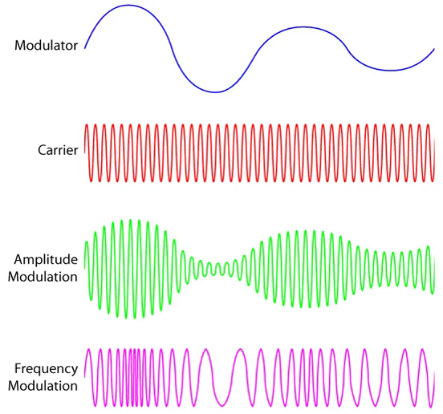
RF Theory
Modulation (Analogues)

Slide 8
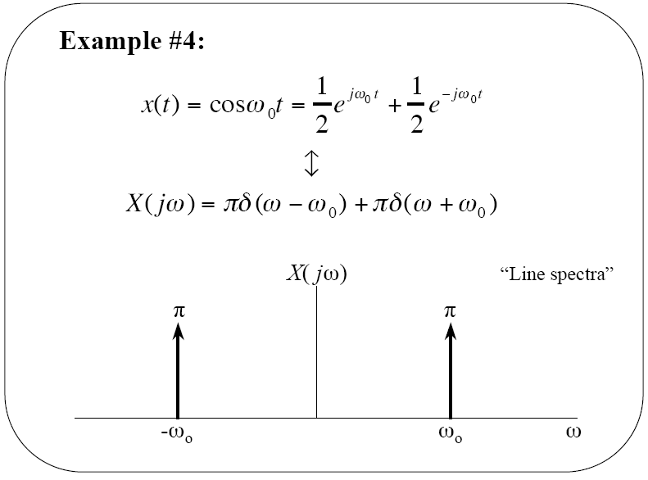
RF Theory
Fourier Transform
Fourier Transform pair
(synthesis)
(analysis)
Convolution in the time domain:
Multiplication in the time domain:

Slide 9
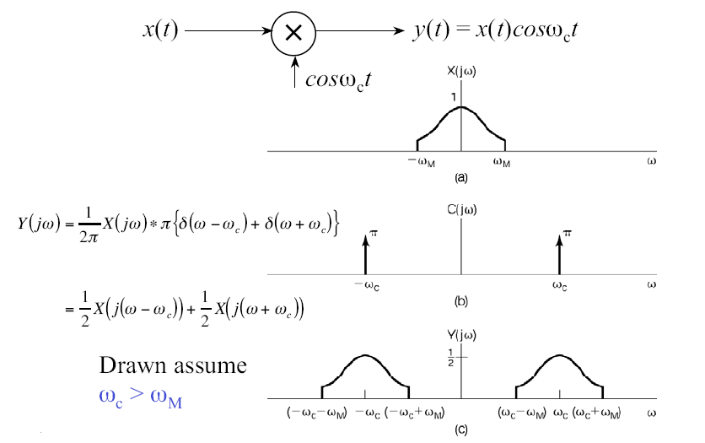
RF Theory
Modulation (AM)

Slide 10
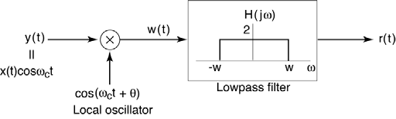
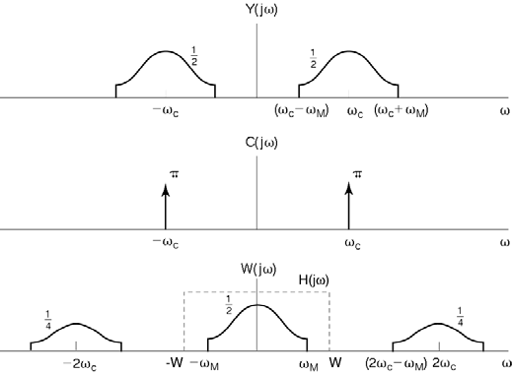
RF Theory
Demodulation (AM)
Assumptions:
θ = 0 (for now),
Local oscillator is synchronized with the carrier.
In practice, synchronization is achieved using a phase-locked loop (PLL).

Slide 11
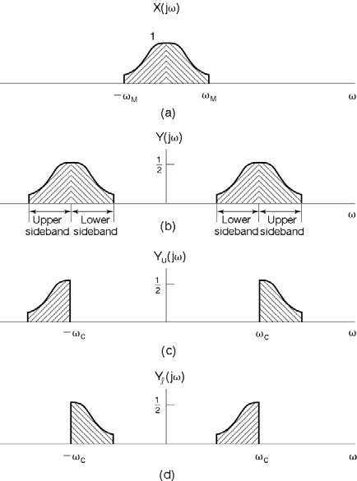
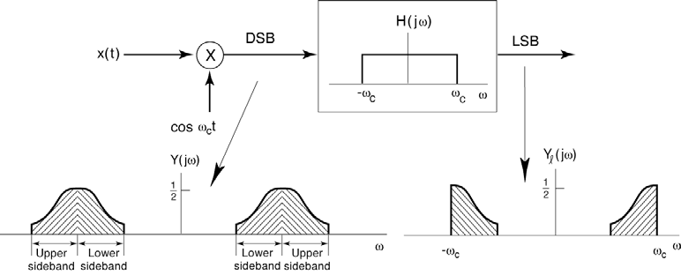
RF Theory
Modulation (SSB)
Since x(t) and y(t) are real, from conjugate symmetry, both lower sideband (LSB) and upper sideband (USB) signals carry exactly the same information.
Double-sideband (DSB) occupies 2M bandwidth in ω > 0, even though all the information is contained in M.
Single-sideband (SSB) occupies M bandwidth in ω > 0.
Of course, SSB requires slightly more complicated hardware, so it was originally only used in applications where bandwidth was very limited (e.g., transcontinental telephone lines).
.

Slide 12
RF Theory
Demodulation (SSB)

Slide 13
Fourier transform.
x(t) = sin(ωmt) y(t) = cos(ωct + mx(t)) = cos(ωct + msin(ωmt)) =
cos(ωct) cos(msin(ωmt)))−sin(ωct) sin(msin(ωmt)))
RF Theory
|Y (jω)|
m = 50
Modulation (FM)
y(t) = cos(ωct + mx(t)) = cos(ωct + m sin(ωmt)) = cos(ωct) cos(m sin(ωmt))) − sin(ωct)sin(m sin(ωmt)))
ωc
ωc
100ωm
Fourier transform of first part.
x(t) = sin(ωmt) y(t) = cos(ωct + mx(t)) = cos(ωct + m sin(ωmt)) = cos(ωct) cos(m sin(ωmt))) − sin(ωct)sin(m sin(ωmt)))
Fourier transform of second part.
x(t) = sin(ωmt) y(t) = cos(ωct + mx(t)) = cos(ωct + msin(ωmt)) = cos(ωct) cos(msin(ωmt)))−sin(ωct) sin(msin(ωmt)))
|Ya(jω)|
m = 50
|Y_{b}(jω)|
m = 50
ωc
ωc
ωc
ωc
100ωm
100ωm

Slide 14
RF Theory
Bandwidth (Analogues)
Name | Peak Frequency Deviation | Bandwidth | Channel Spacing
Narrowband | 2.5 kHz | 11 to 12.5 kHz | 12.5 kHz
Wideband (US Amateur Standard) | 5.0 kHz | 13 to 16 kHz | 15 to 25 kHz
FM Broadcast | 75 kHz | 180 to 200 kHz | 200 kHz
Extended SSB modes | Bandwidth | Frequency response
eSSB (Narrow-1a) | 3 kHz | 100 Hz ~ 3.10 kHz
eSSB (Narrow-1b) | 3 kHz | 50 Hz ~ 3.05 kHz
eSSB (Narrow-2) | 3.5 kHz | 50 Hz ~ 3.55 kHz
eSSB (Medium-1) | 4 kHz | 50 Hz ~ 4.05 kHz
eSSB (Medium-2) | 4.5 kHz | 50 Hz ~ 4.55 kHz
eSSB (Wide-1) | 5 kHz | 50 Hz ~ 5.05 kHz
eSSB (Wide-2) | 6 kHz | 50 Hz ~ 6.05 kHz

Slide 15

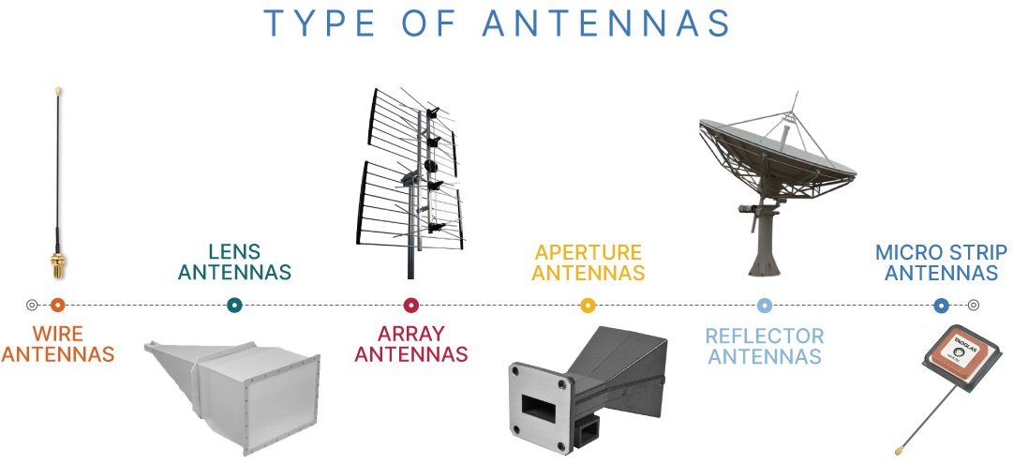
Antenna
Types of antenna

Slide 16
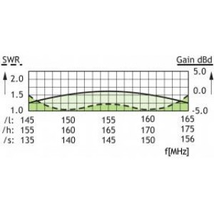
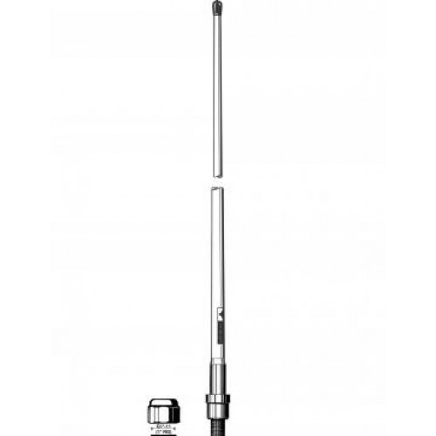
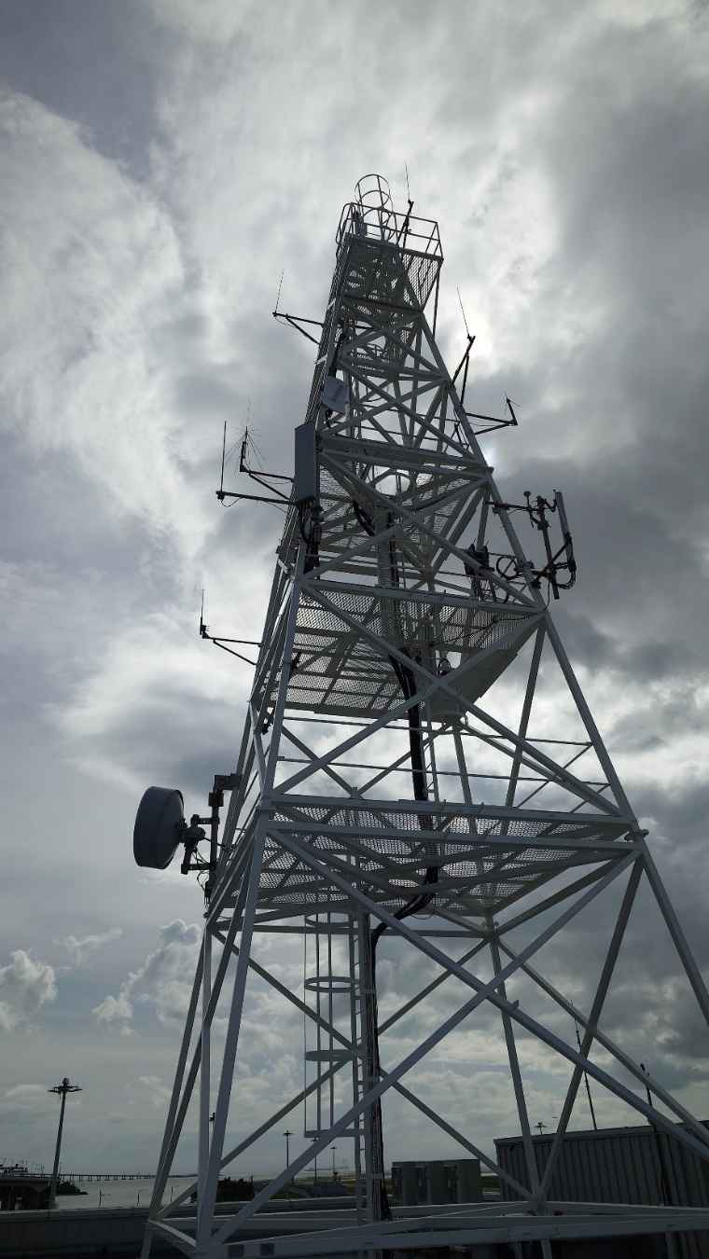
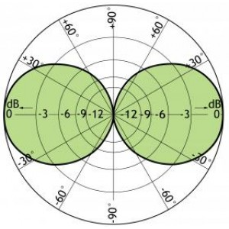
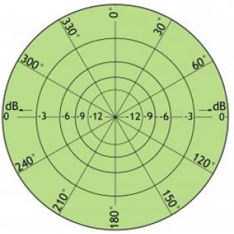
Antenna
Dipole

Slide 17
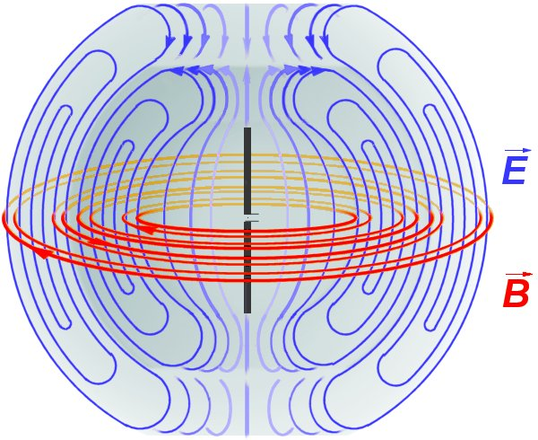
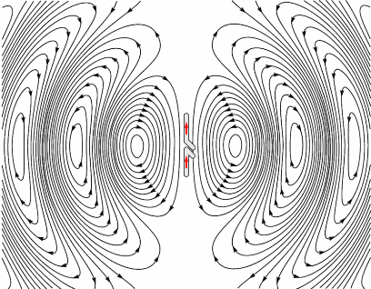
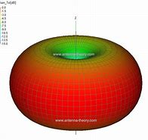
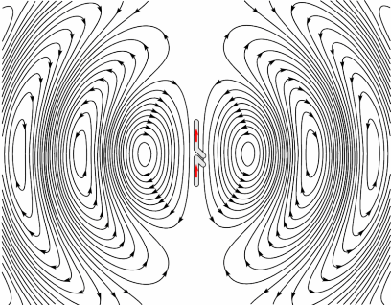
Antenna
Radiation Pattern

Slide 18
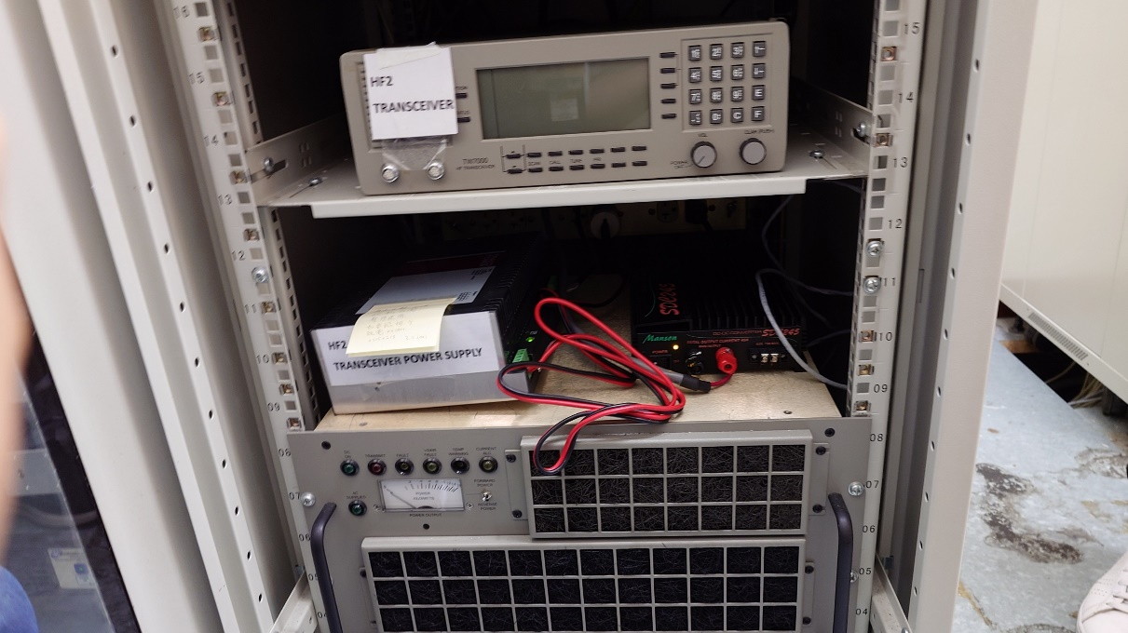
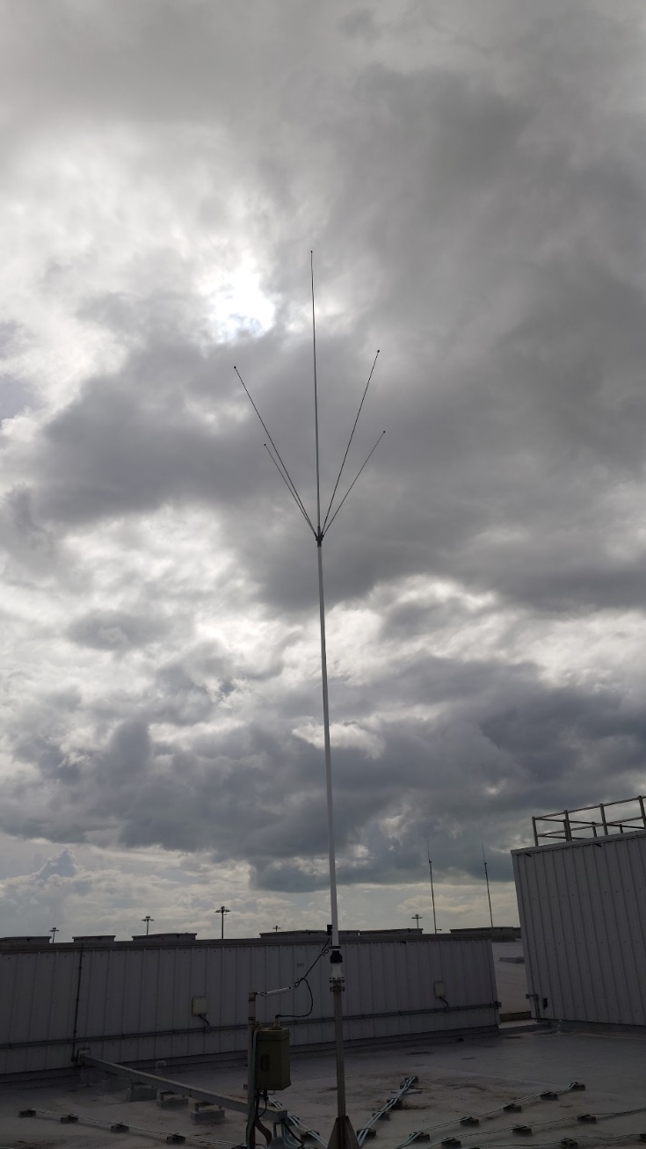
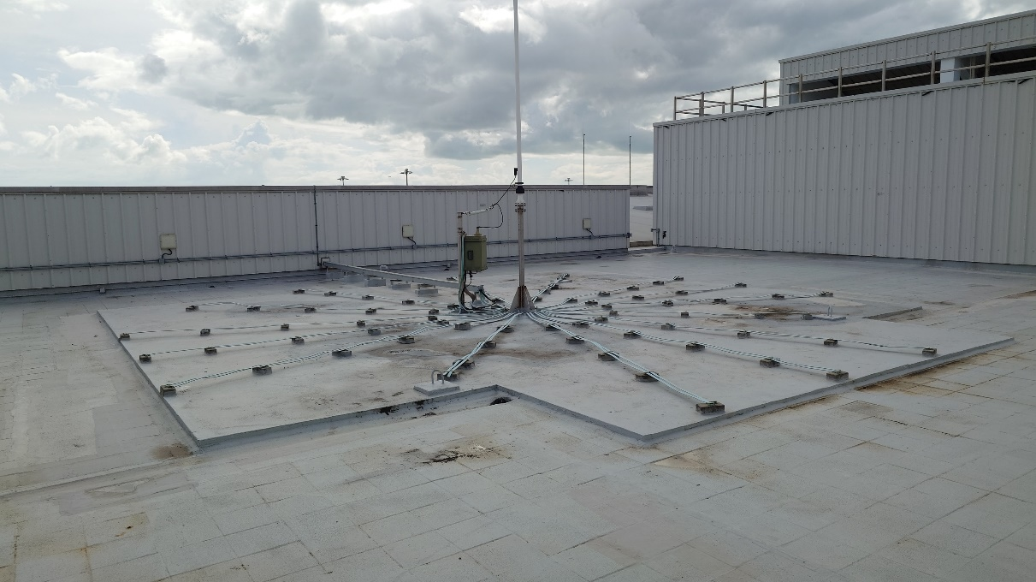
Antenna
Monopole

Slide 19
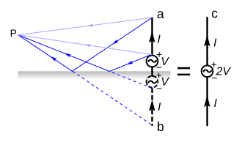
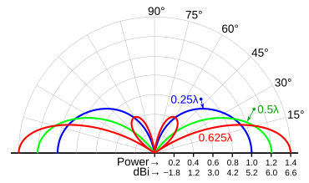
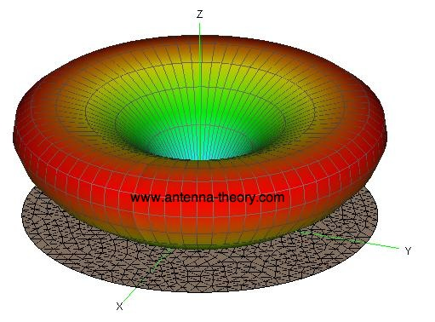
Antenna
Radiation Pattern

Slide 20
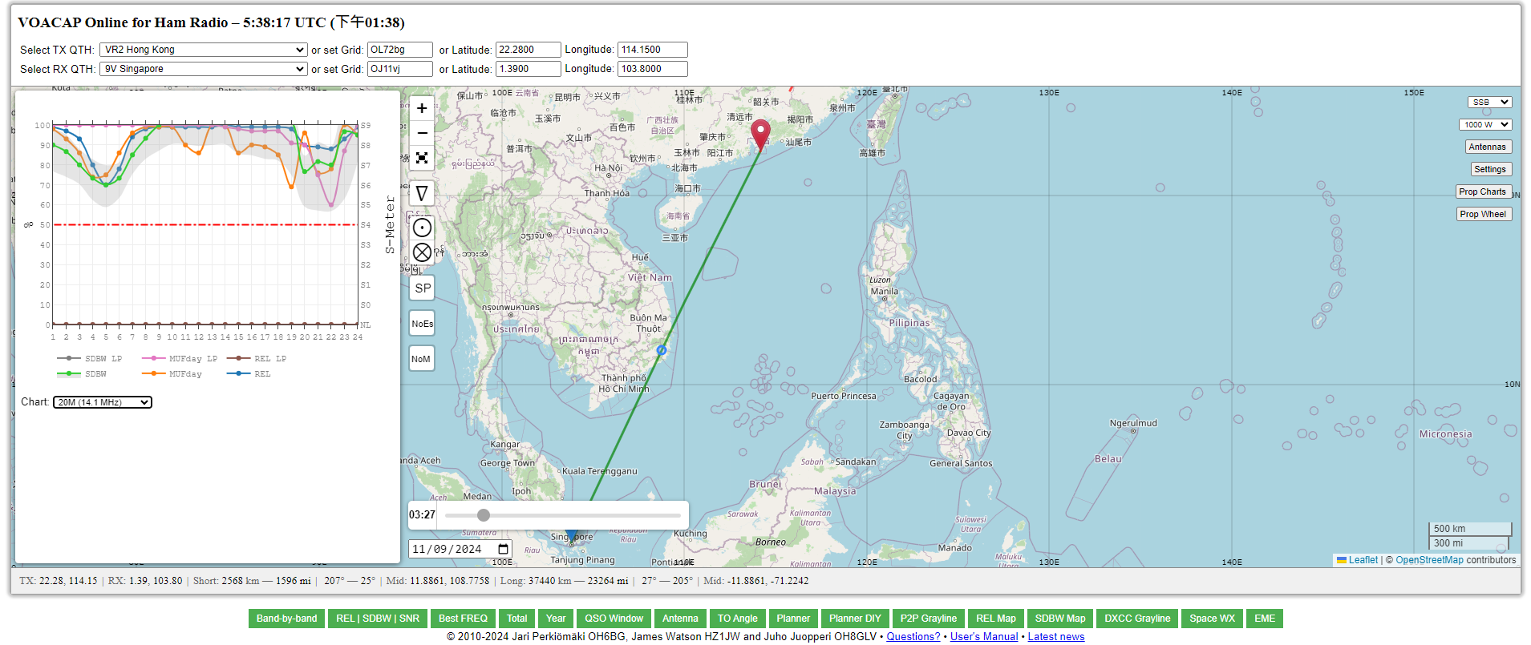
Antenna
Reception simulation

Slide 21
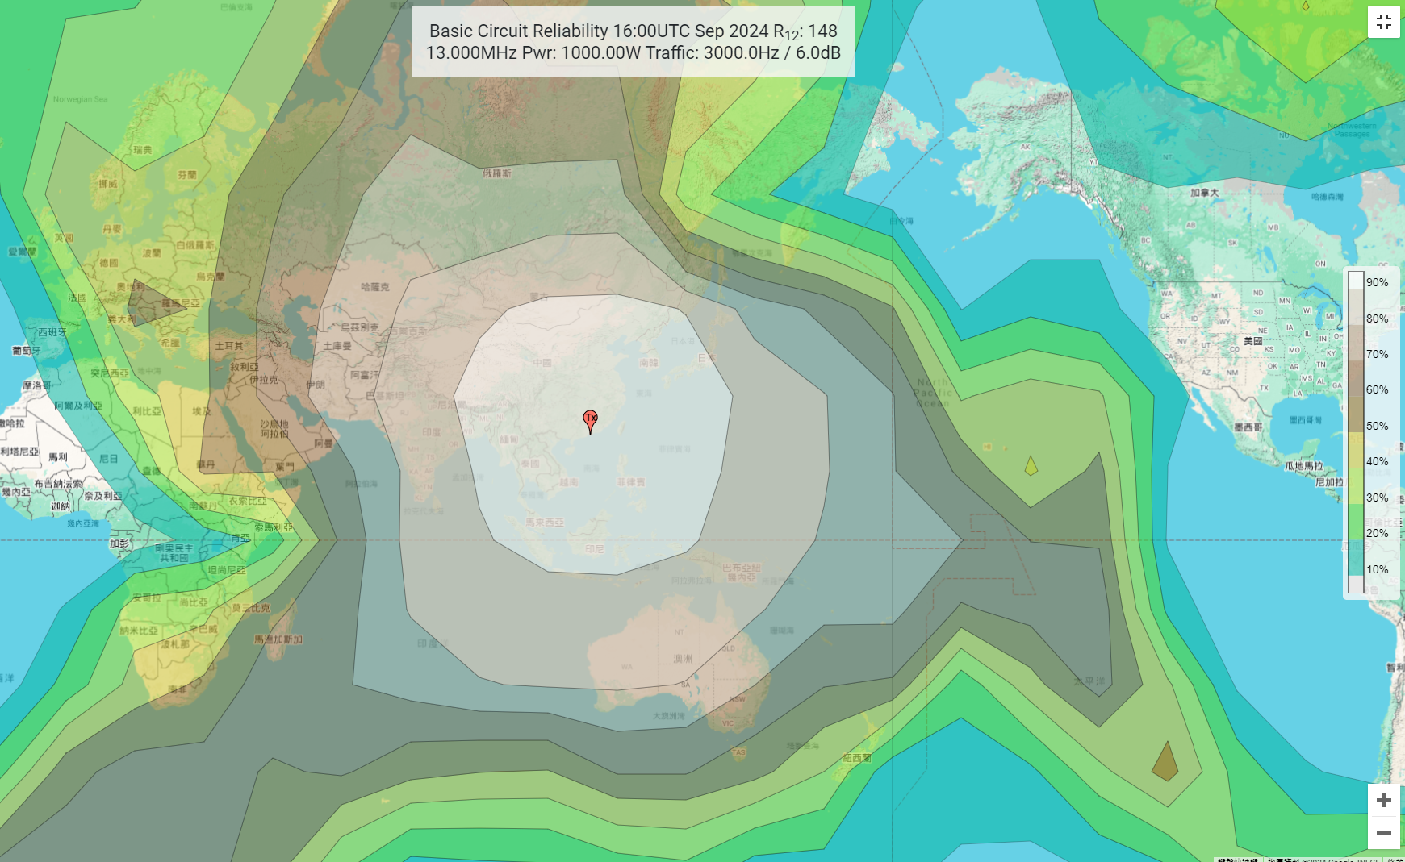
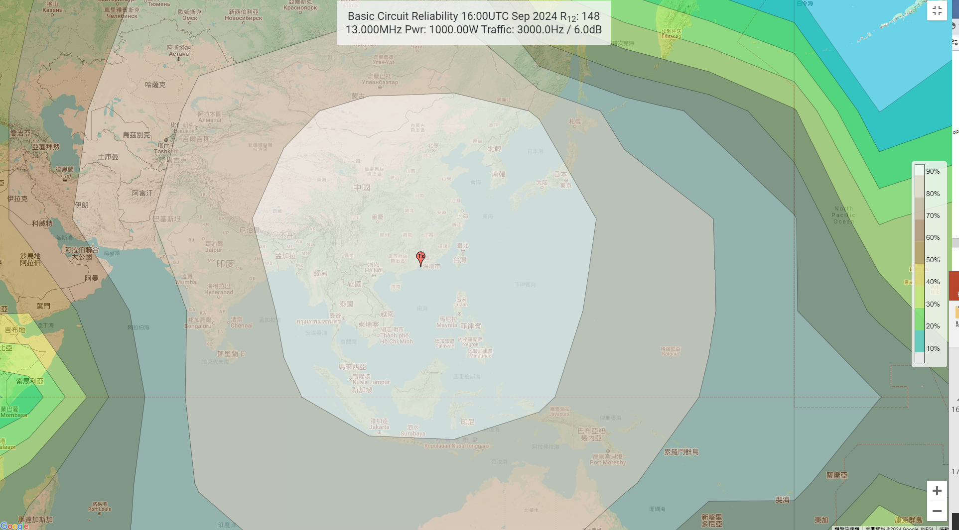
Antenna
HF converage

Slide 22
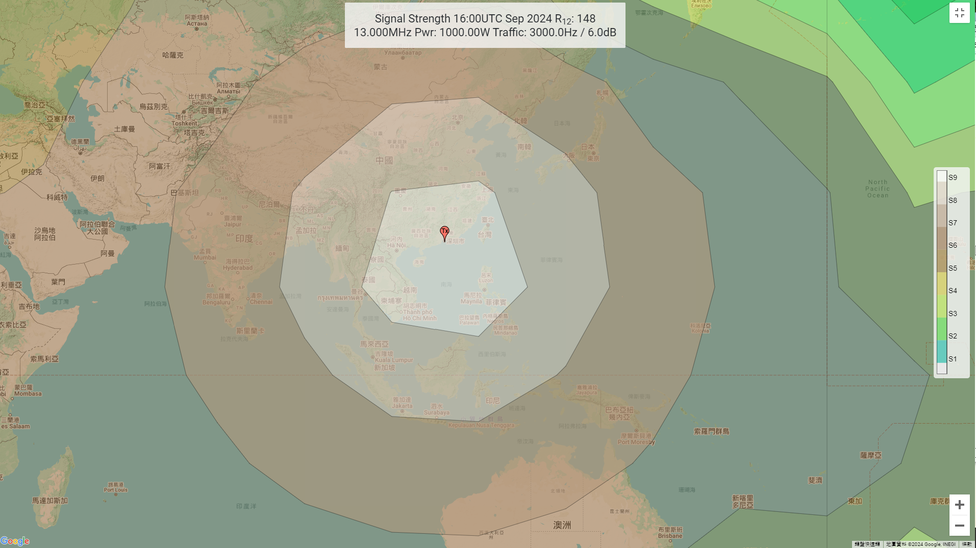
Antenna
HF signal strength
S-reading | HF |  | Signal Generator emf
 | μV (rms, Relative to 50Ω) | dBm | dB above 1uV
S9+10 dB | 160.0 | -63 | 44
S9 | 50.2 | -73 | 34
S8 | 25.1 | -79 | 28
S7 | 12.6 | -85 | 22
S6 | 6.3 | -91 | 16
S5 | 3.2 | -97 | 10
S4 | 1.6 | -103 | 4
S3 | 0.8 | -109 | -2
S2 | 0.4 | -115 | -8
S1 | 0.2 | -121 | -14

Slide 23
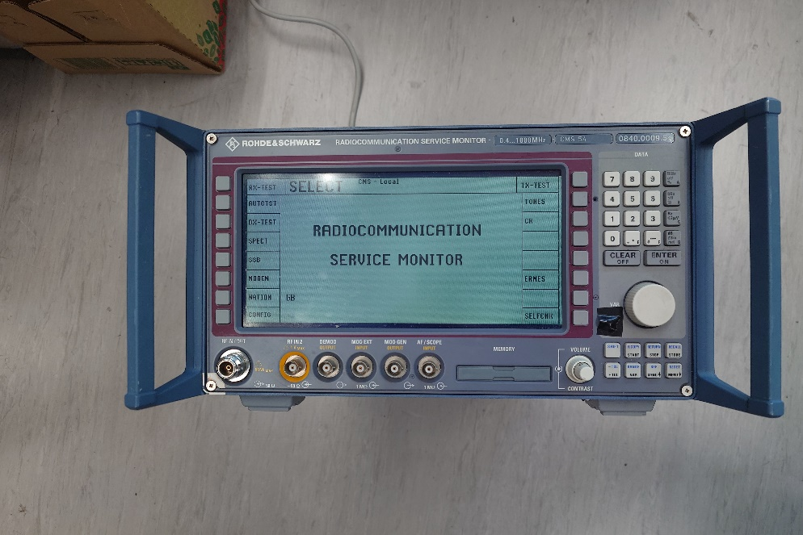
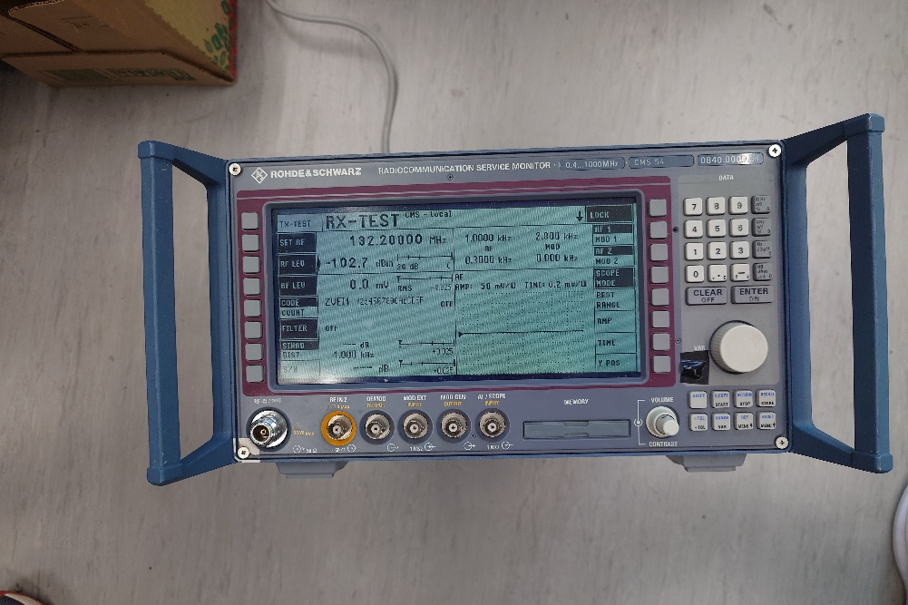
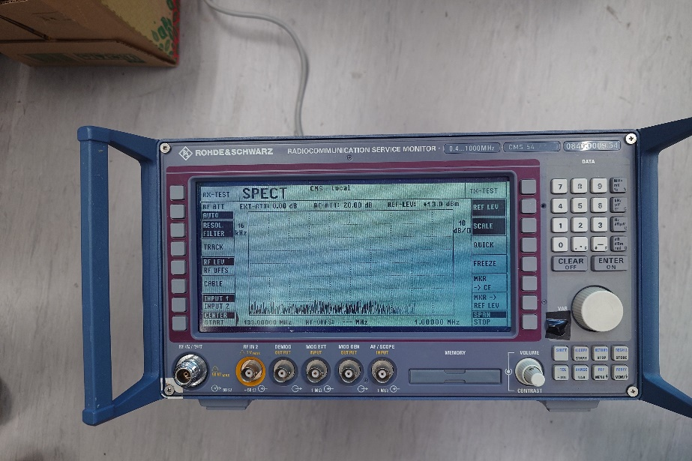
RF measurement
Measuring Equipment (Comm set)

Slide 24
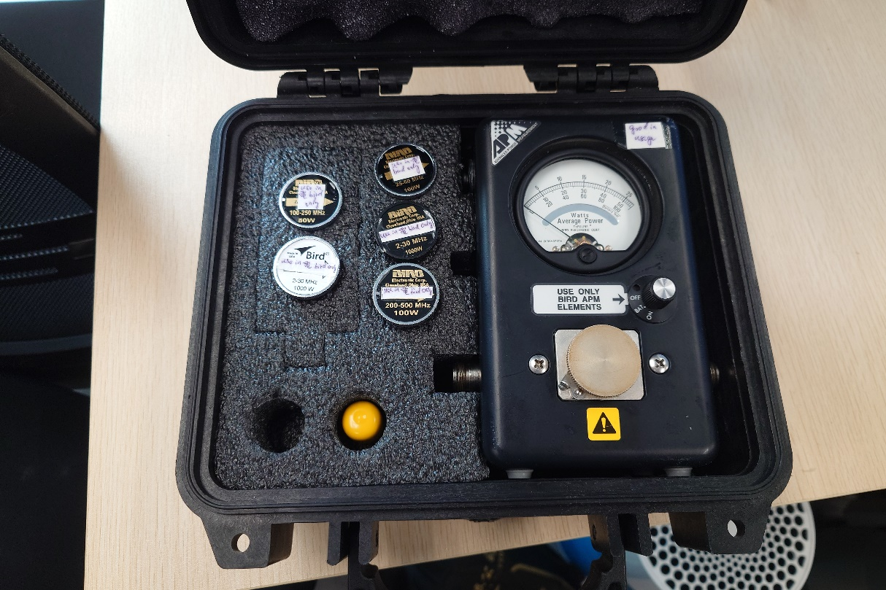
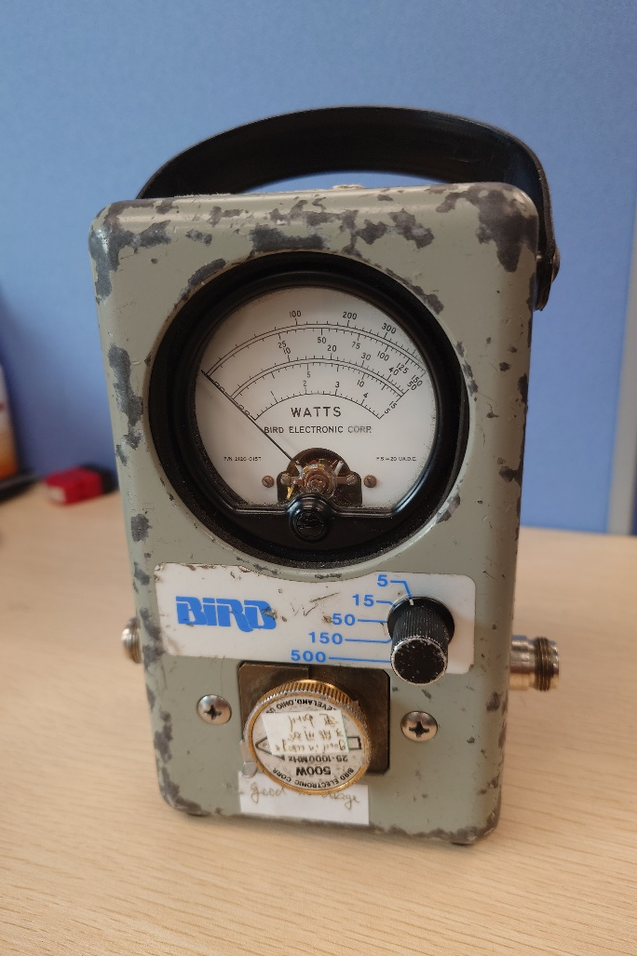
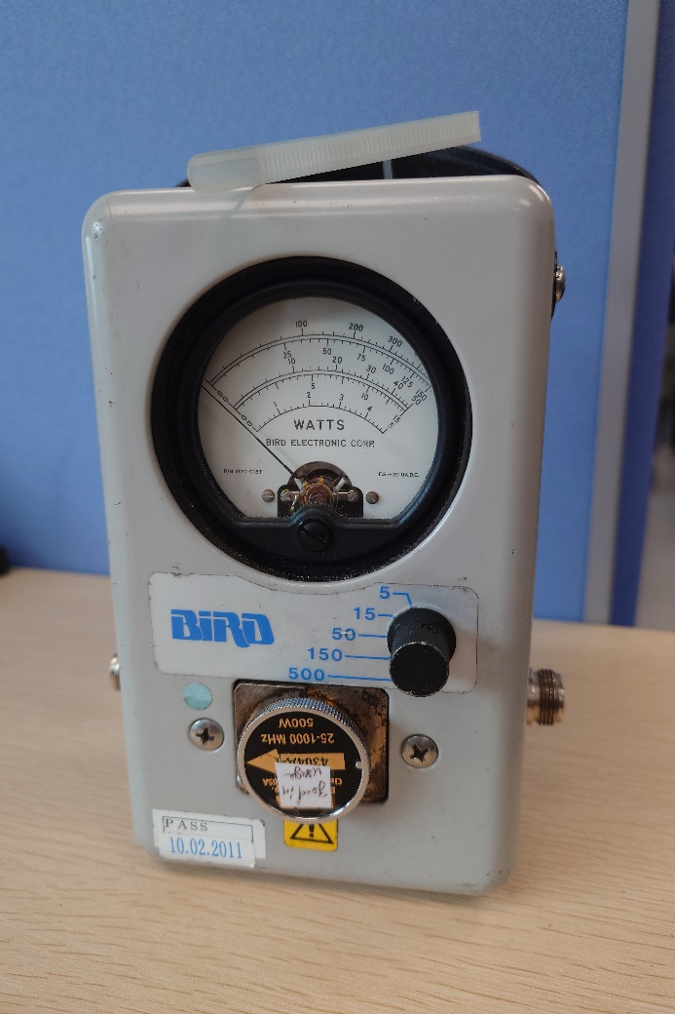
RF measurement
Power Meter (existing)

Slide 25
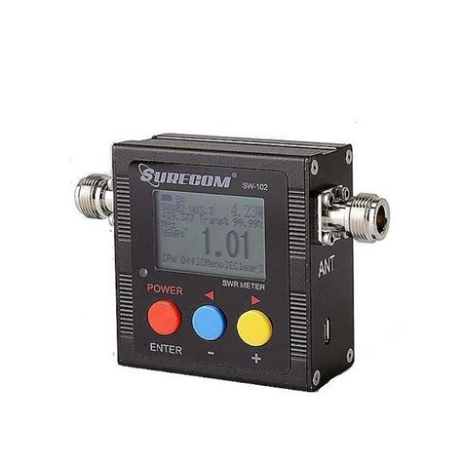
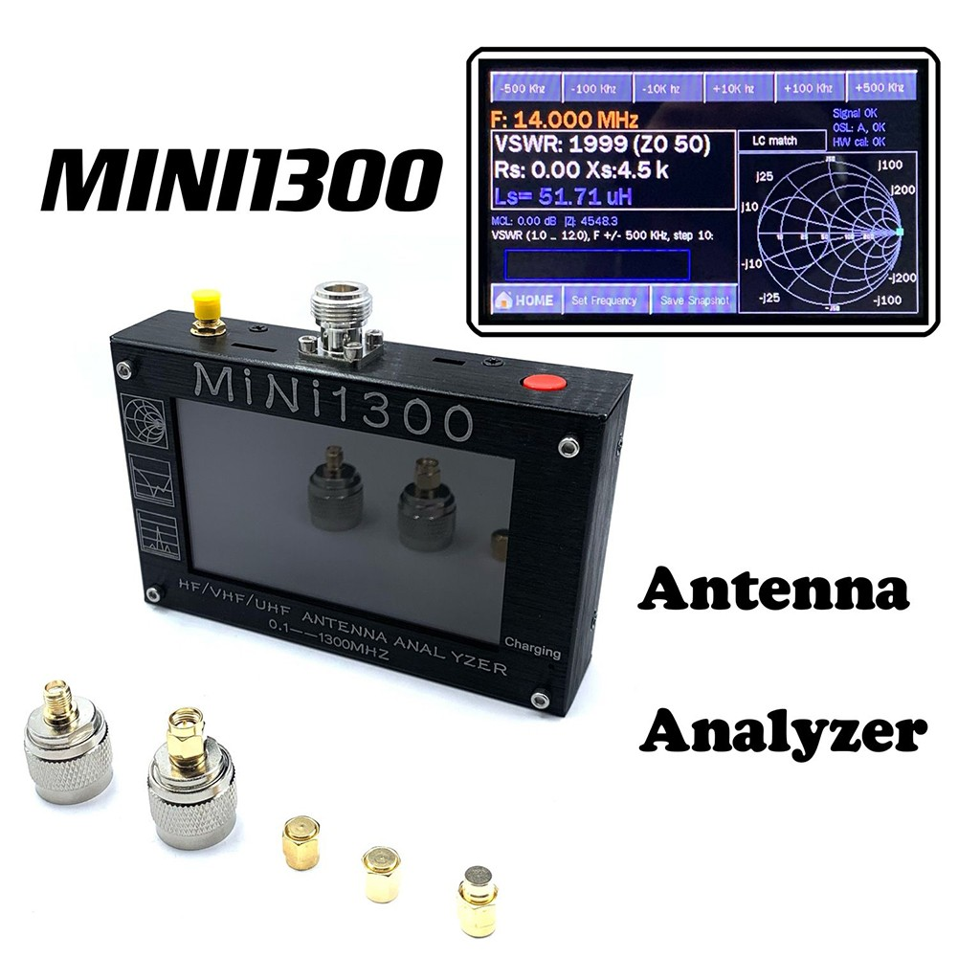
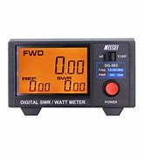
RF measurement
Power Meter (proposed)

Slide 26
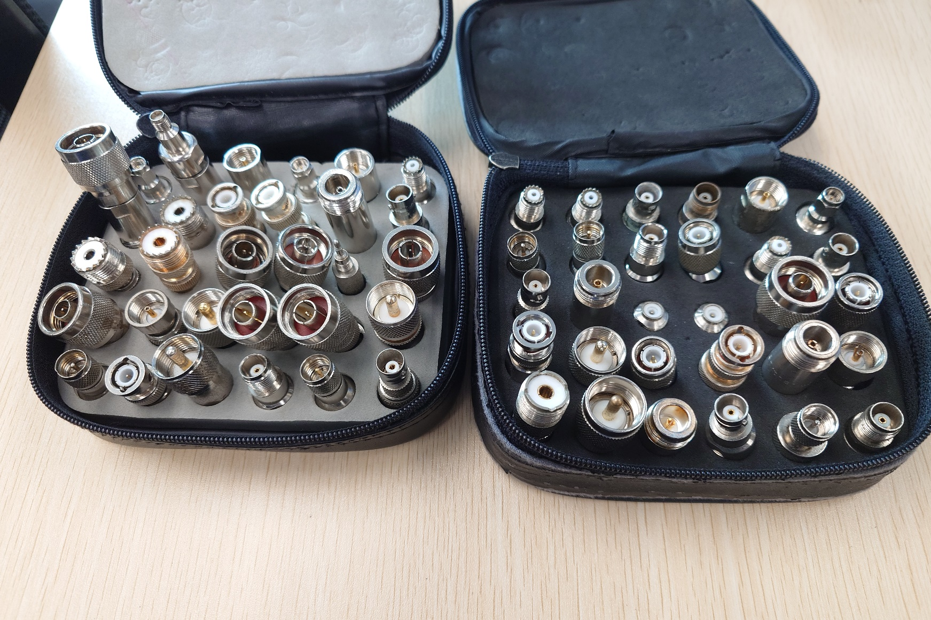
RF measurement
Convertor for different connectors

Slide 27
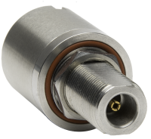
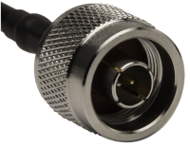
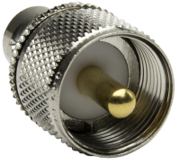
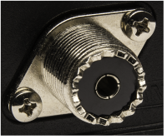
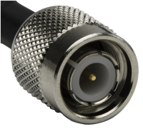
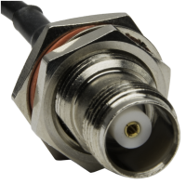
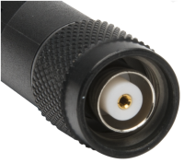







RF connector type
RF measurement
Type N
UHF (PL259)
TNC
Reverse Polarity TNC (RPTCN)
BNC
SMA
Reverse Polarity SMA (RPSMA)

Slide 28





RF measurement
Parameters of RF measurement
Transmission Power
VSWR
SNR
ACPR

Slide 29
RF measurement
Measurement of SSB device

Slide 30
RF measurement
Different Mode of SSD device
Mode | Description
USB | USB voice: Standard voice grade IF filter and voice AGC time constants
LSB | LSB voice: Standard voice grade IF filter and voice AGC time constants
USB DATA | FSK AGC time constants, optional USB wideband data filter, 300-3000 Hz BW
LSB DATA | FSK AGC time constants, optional LSB wideband data filter, 300-3000 Hz BW
USB AME | Same as USB mode with addition of the carrier in transmit mode at a level of -6 dB relative to PEP
LSB AME | Same as LSB mode with addition of the carrier in transmit mode at a level of -6 dB relative to PEP
USB PCS | Same as USB mode with addition of the carrier in transmit mode at a level of -16 dB relative to PEP

Slide 31



Radio System
Radio System of GFS

Slide 32

Radio System
Radio System of GFS

Slide 33

Radio System
Radio System of GFS

Slide 34
Radio System
Radio Channels of GFS
GFS - Channels of the Existing Radio ACOM Console System
Channels |  | Remarks
Radio 1 | TC 131.3
Radio 2 | HQ 131.2 | Maintenance by EMSD
Radio 3 | HQ 132.2 | Maintenance by EMSD
Radio 4 | Police (TRS)
Radio 5 | SUS 131.2
Radio 6 | Hill 275 131.2
Radio 7 | HQ 48.2 | Maintenance by EMSD
Radio 8 | TMS 48.2
Radio 9 | APRON | Maintenance by EMSD
Radio 10 | UHF HQ | Maintenance by EMSD
Radio 11 | TMS 132.2
Radio 12 | HF #1 | Maintenance by EMSD
Radio 13 | HF #2 | Maintenance by EMSD
Radio 14 | Pol Tetra
Radio 15 | Police CC3

Slide 35










Radio System
Radio of GFS
AM Modulation
100W
277.1MHz
AM Modulation
50W
131.3MHz, 131.2MHz, 132.2MHz
FM Modulation
30W
403 to 470MHz
Old Motorola MTR2000 was replace by XiR M6660
FM Modulation
100W
48.2MHz
AM SSB Modulation
1000W
2MHz to 25MHz
SELCAL Coder (Selective calling), Generated by ACOM

Slide 36


Radio System
New ACCC system of GFS

Slide 37


Radio System
New ACCC system of GFS

Slide 38


Radio System
New ACCC system control panel

Slide 39



Radio System
Problems of New ACCC System of GFS

Slide 40



Current Development
SDR
Software-Defined Radio
A software-defined radio (SDR) system is a radio communication system which uses software for the modulation and demodulation of radio signals.

Slide 41


Current Development
Different between Radio and SDR

Slide 42

Current Development
Normal components

Slide 43


Current Development
Software Interface

Slide 44


Current Development
General Setup

Slide 45

Current Development
Decoding Digital Radio
Decoding Digital Voice (P25, DMR, NXDN, D-STAR)
A program called “digital speech decoder” (DSD) can be used as a radio scanner to easily and cheaply listen to unencrypted digital radio voice conversations.

Slide 46


Current Development
DSD interface

Slide 47

Current Development
Virtual Audio Cable (VAC

Slide 48



Training Trend
Different types of programming tools

Slide 49


Training Trend
Interface with USRP

Slide 50

Training Trend
Program interface

Slide 51

Training Trend
Spectrum and waterfall diagram

Slide 52

Training Trend
QPSK

Slide 53

Training Trend
SSB simulation

Slide 54
Training Trend
End of Presentation
Thank you
Question?

