Slide 1

Smart Prison Systems
Li Chiu Keung Kenny (AEnl/S/HK4)
Tang Lik Yan Nicole (AEnl/S/HK3)

Slide 2
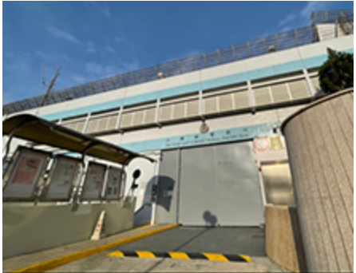
Smart Prison Systems
CSD has been proactively developing since 2018
Innovative technologies have been applied
  To modernize correctional facilities
  To enhance management efficiency, the level of security of correctional institutions and the effectiveness of rehabilitation programs
The first-generation Smart Prison –
Tai Tam Gap Correctional Institution (TGCI)

Slide 3
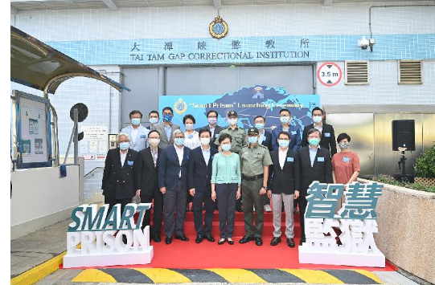

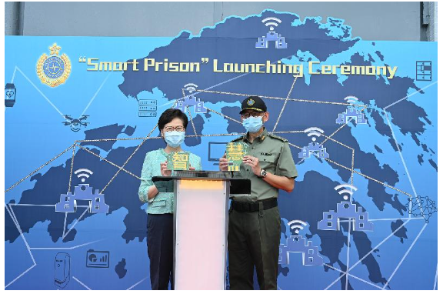
Smart Prison Systems

Slide 4

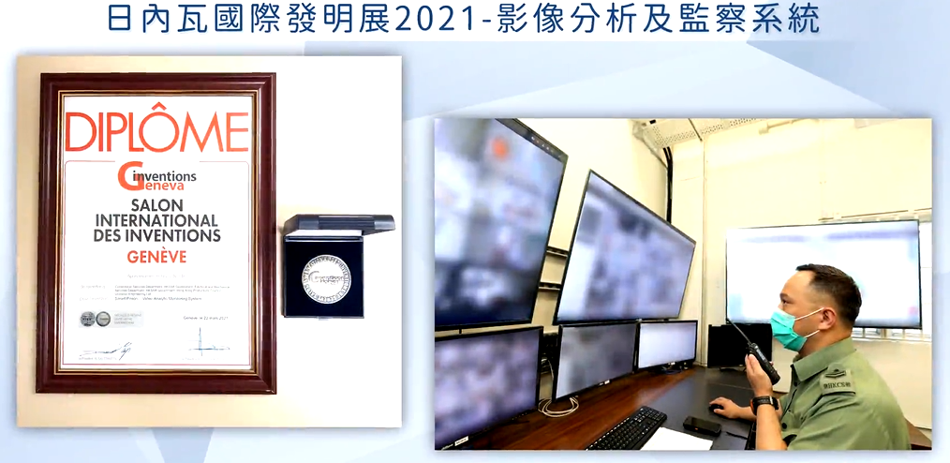
Smart Prison Systems

Slide 5
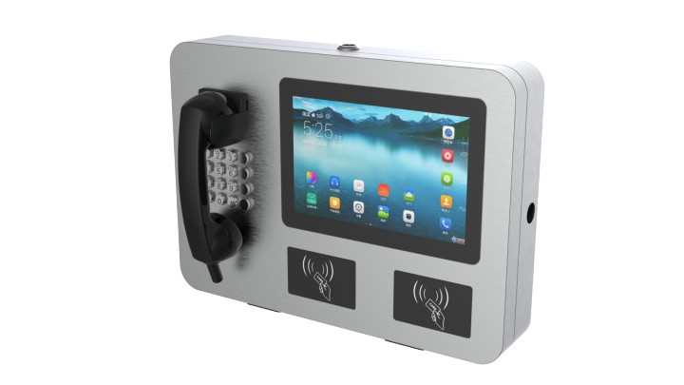
Smart Prison Systems
Integrated Intelligent Communication System (IICS)
在囚人士綜合智能通訊系統
Movement and Location Monitoring System (MLMS)
移動及位置監測系統
Video Analytic Monitoring System (VAMS)
影像分析及監察系統

Slide 6
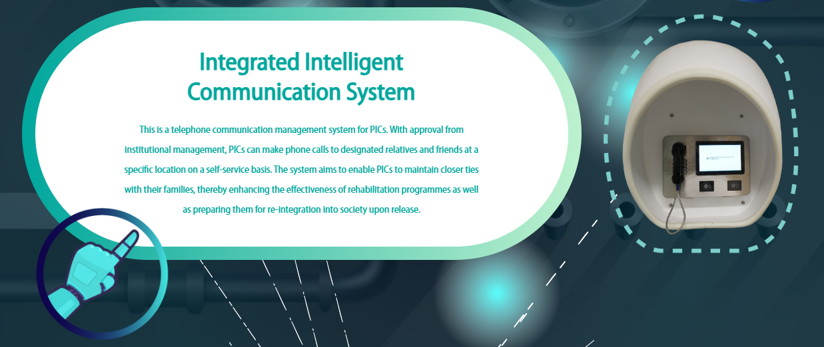

Slide 7
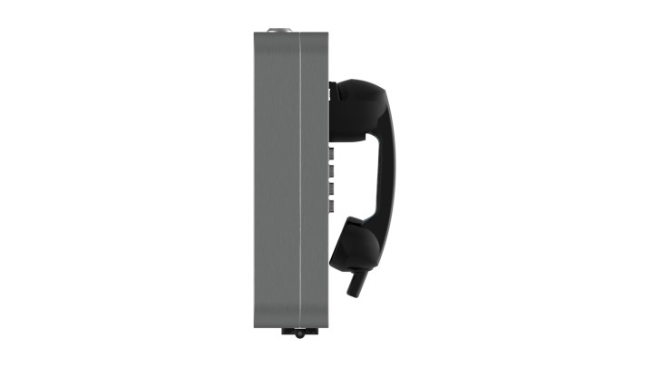
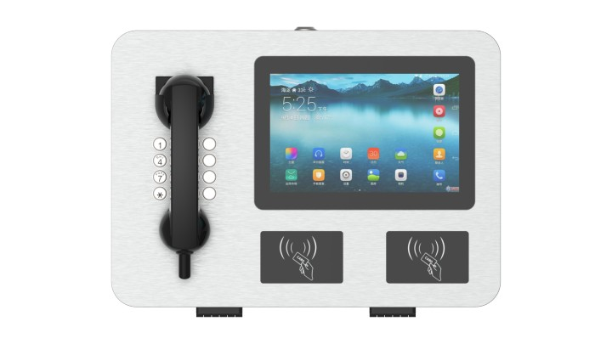
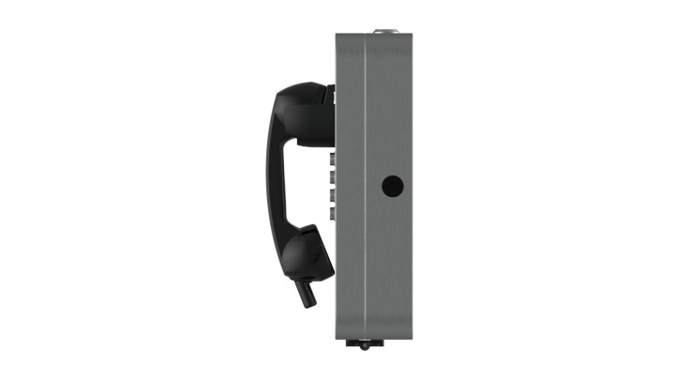
Phone Kiosk

Slide 8
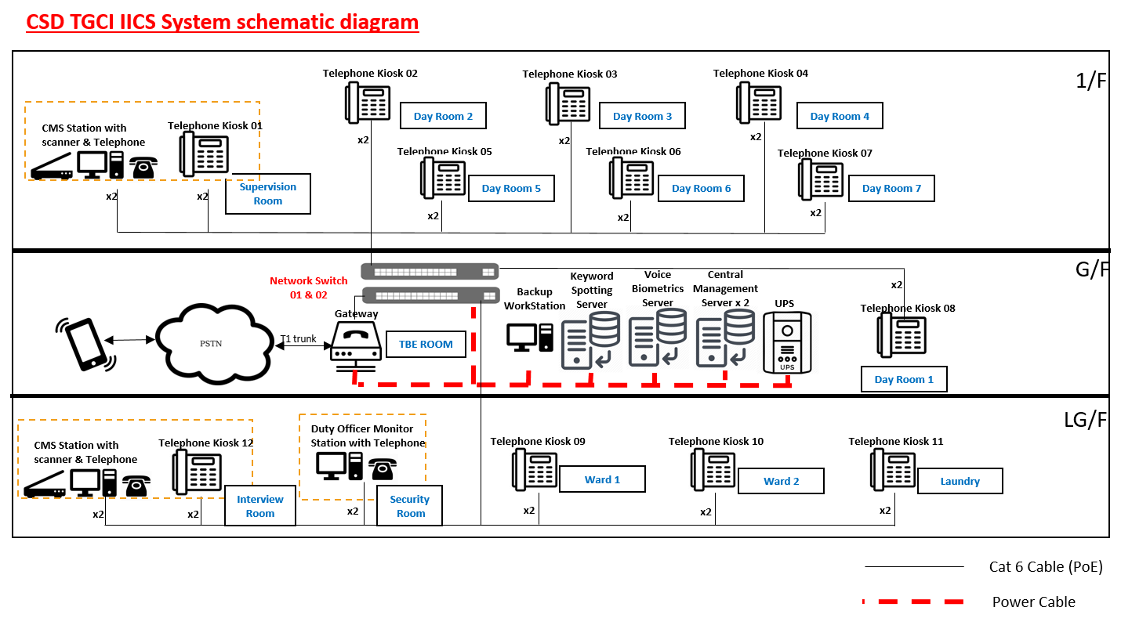

Slide 9
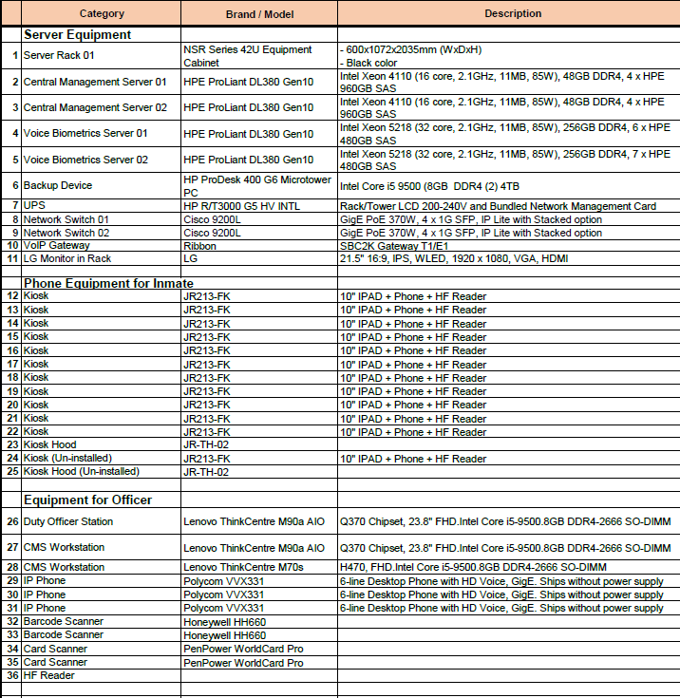

Slide 10
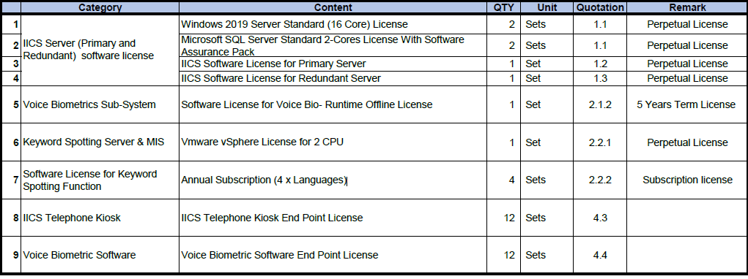
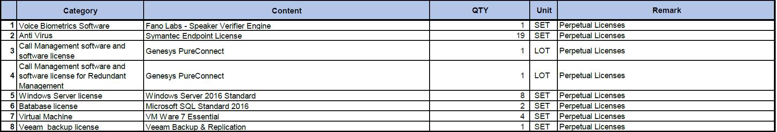

Slide 11
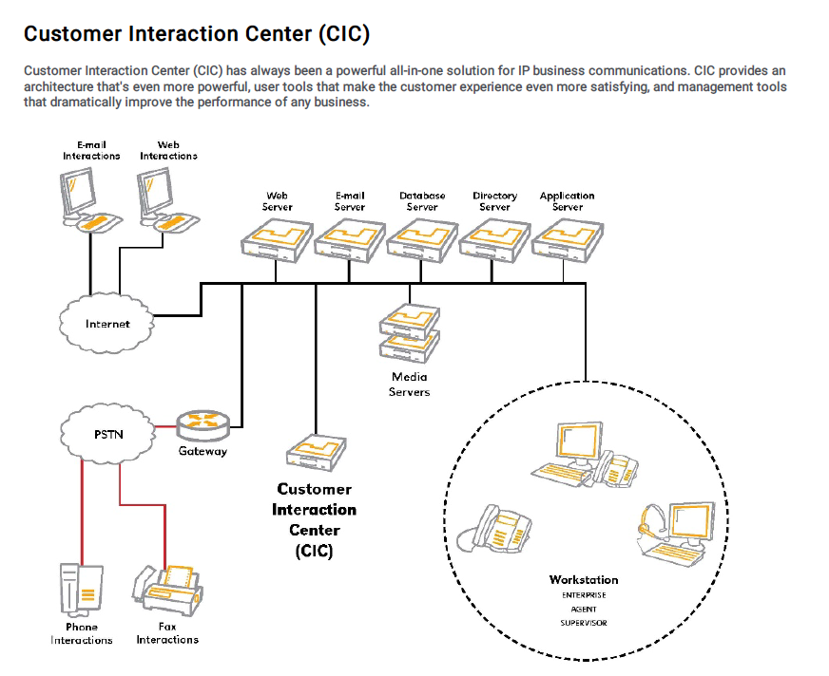

Slide 12
Objectives of
Integrated Intelligent Communication System (IICS)
Allow Inmates to dial to their Relatives /Friends in a Self Service manner
The Whole Process will be in a controlled mechanism including:
Authenticate the Inmate ID by using new technologies – Voice Biometrics
Security Control on Calling–out Numbers
Realtime Silent Monitor the behavior of the inmate throughout the conversation
Reports and Statics for further analysis

Slide 13
Integrated Intelligent Communication System (IICS)
Deployment of IICS system to TGCI
Support of RFID reader ( UHF and HF ) for registration and verification on IICS
Voice Biometrics
Speaker Change Detection
Keyword Spotting

Slide 14

Voice Biometrics

Slide 15
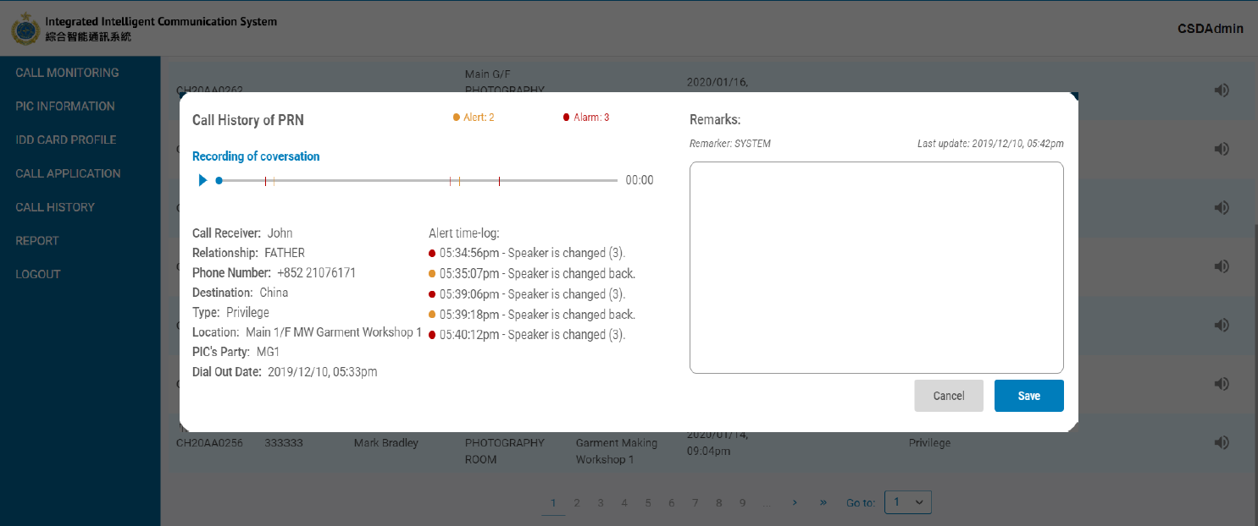
Speaker Change Detection

Slide 16
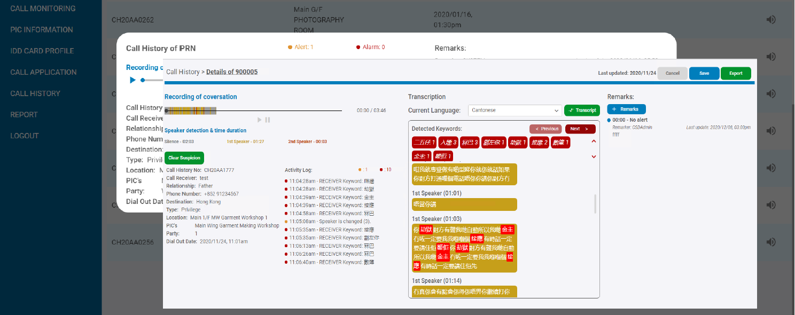
Keyword Spotting

Slide 17
System scope
Cabling services
Voice recording from each workshop to evaluate voice pin model
Keyword Spotting, supports 4 languages: English, Cantonese, Mandarin, Thai
Keyword Spotting, 1 language to be selected by CSD for further tuning to achieve 80% accuracy
  At least 100 hours live data audio sample for the selected language
  Further tuning will take ~2-3 months

Slide 18
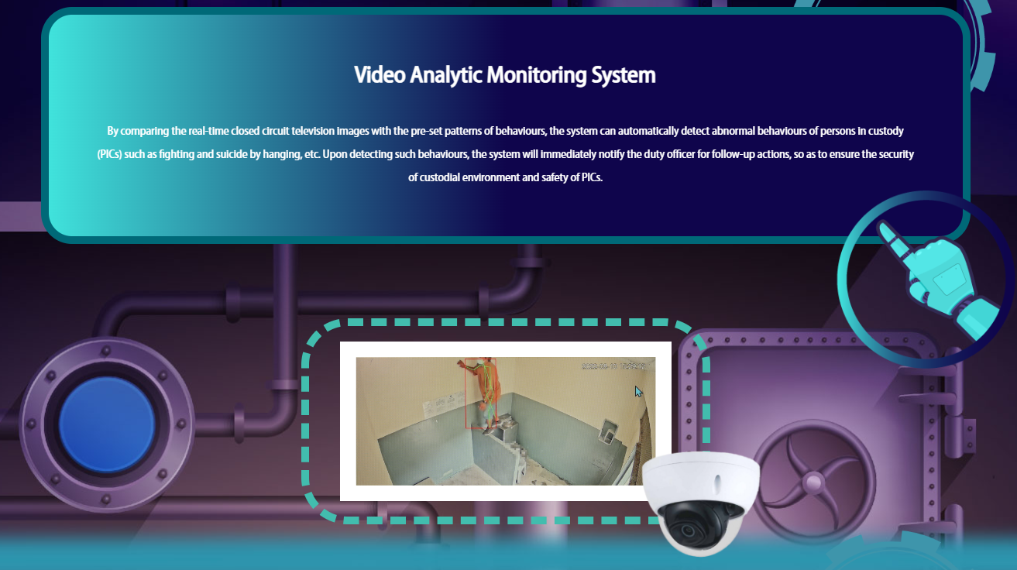

Slide 19
Objectives of
Video Analytic Monitoring System (VAMS)
Support officers in monitoring primarily prison holding areas e.g. dormitories and day rooms
Detect abnormal behavior of inmates in the prison
All cameras are monitored by logging into the video analytics module via displays at workstations and in designated control rooms.
Primarily designed to analyze abnormal behavior of inmates in designated camera coverage areas or zones

Slide 20
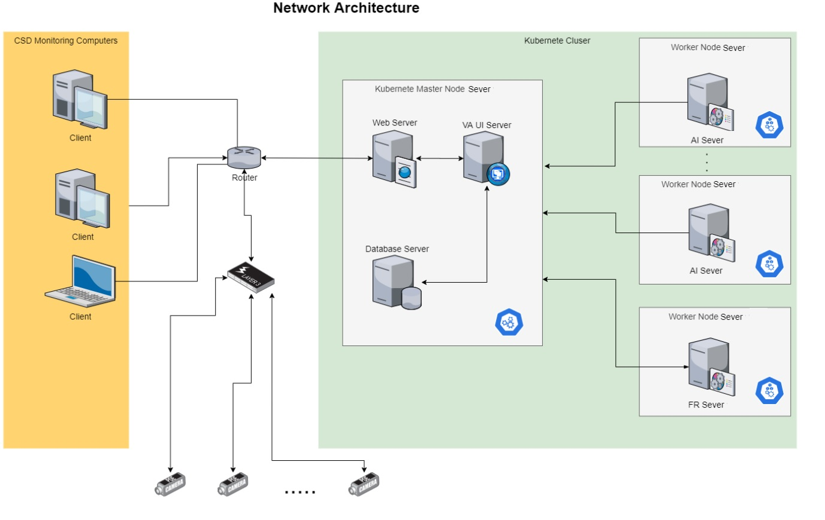

Slide 21
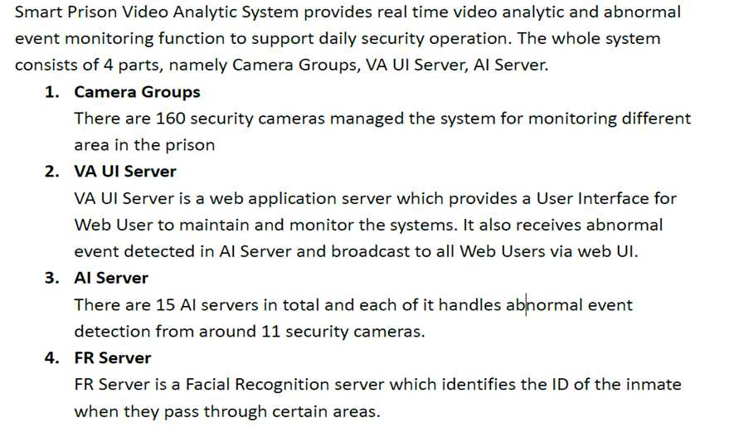
Background and System Architecture

Slide 22
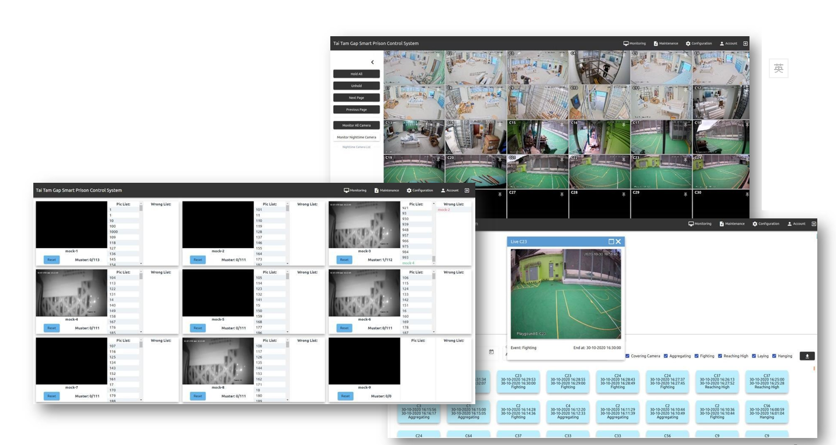

Slide 23
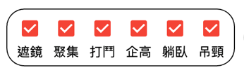
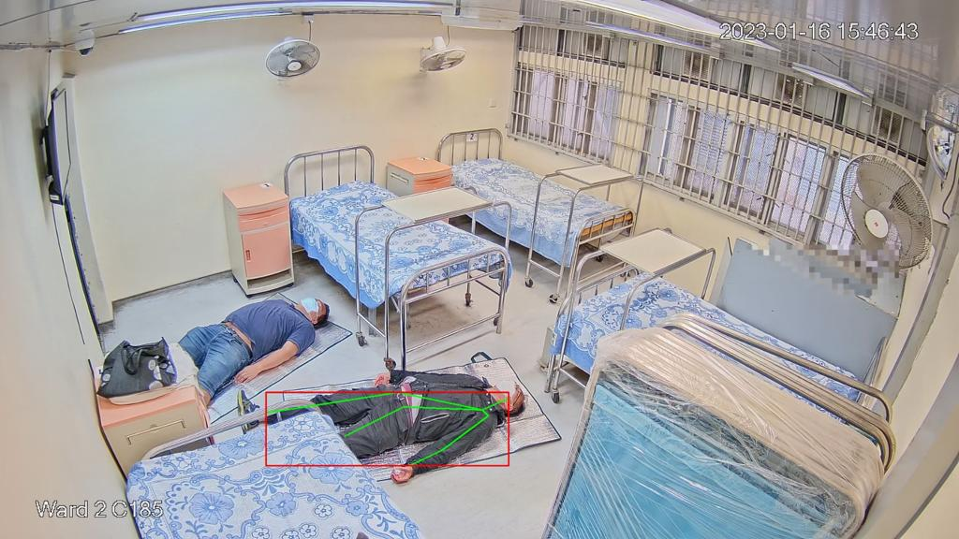
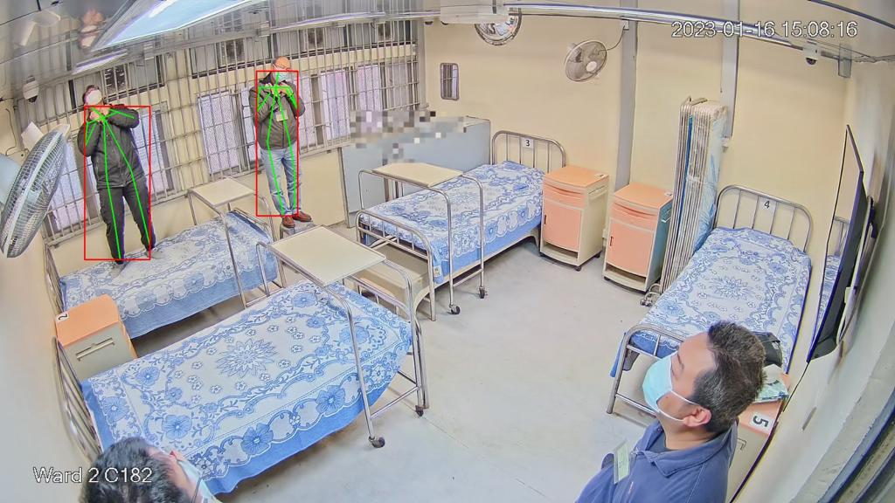
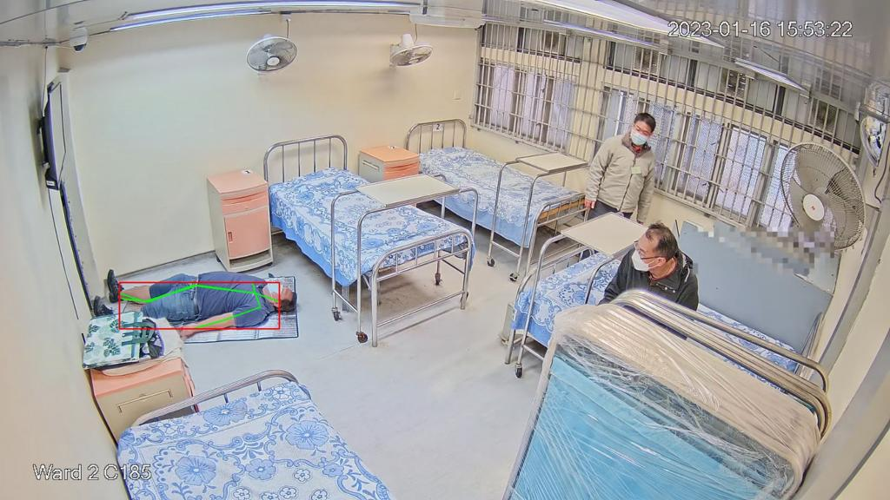

Slide 24
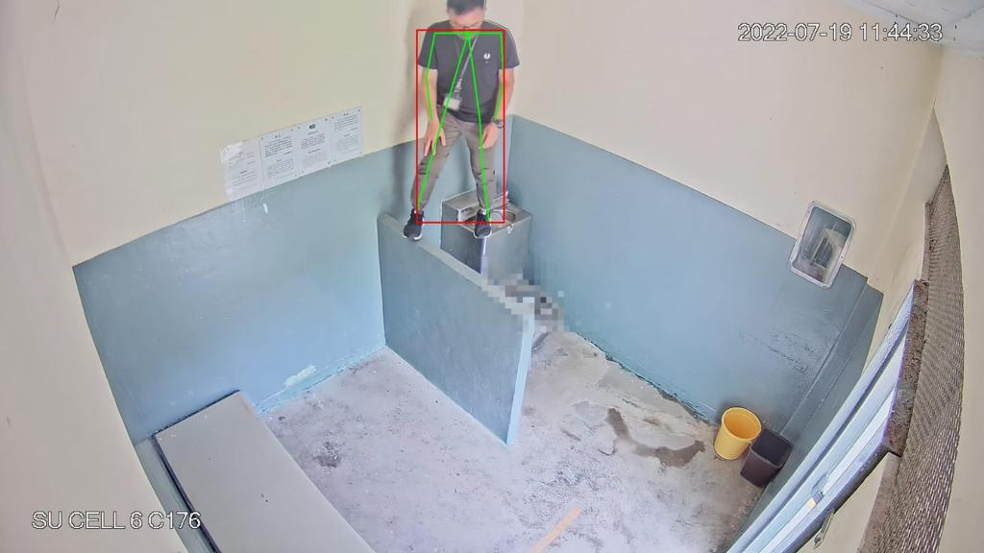
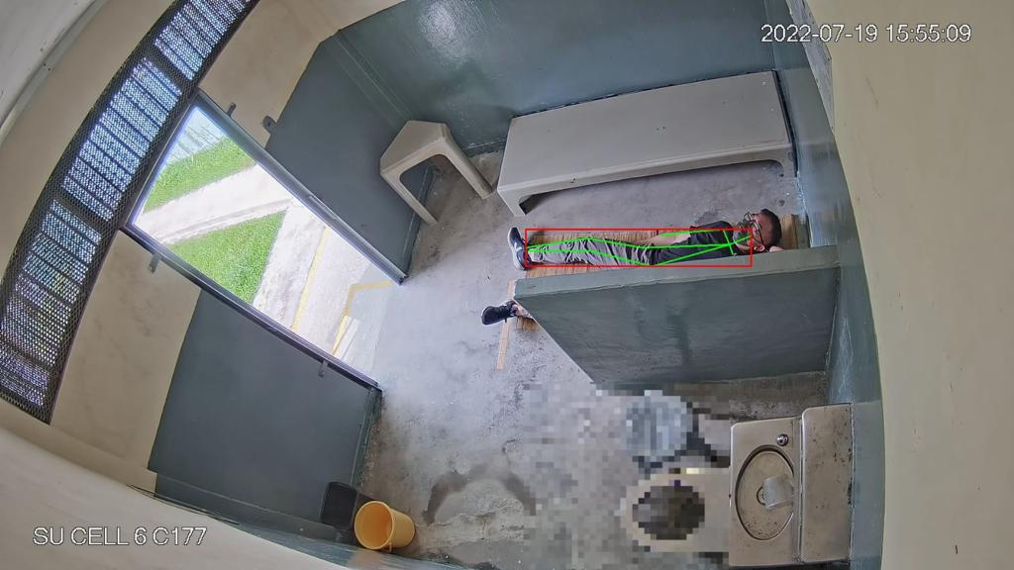
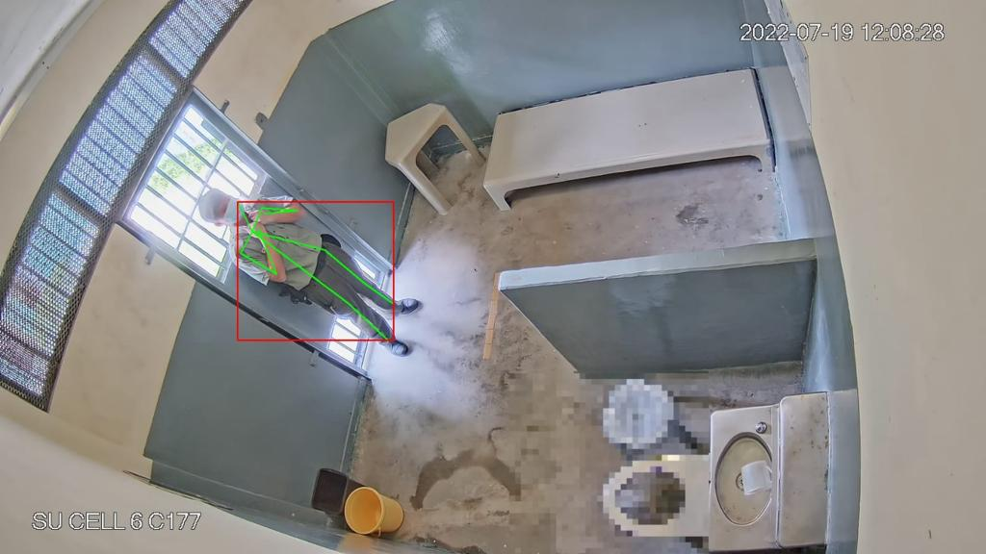

Slide 25
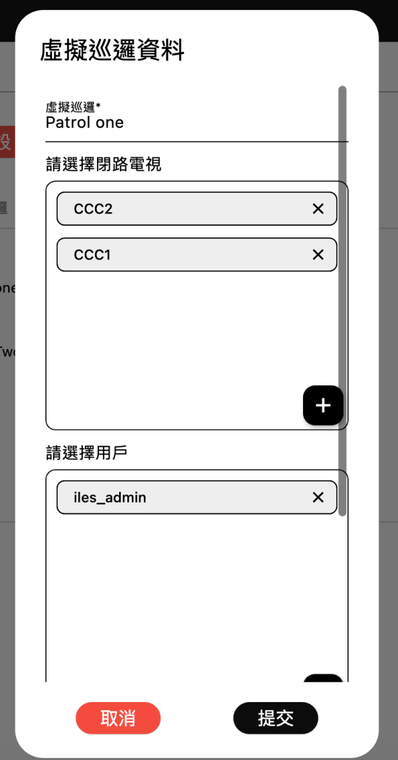
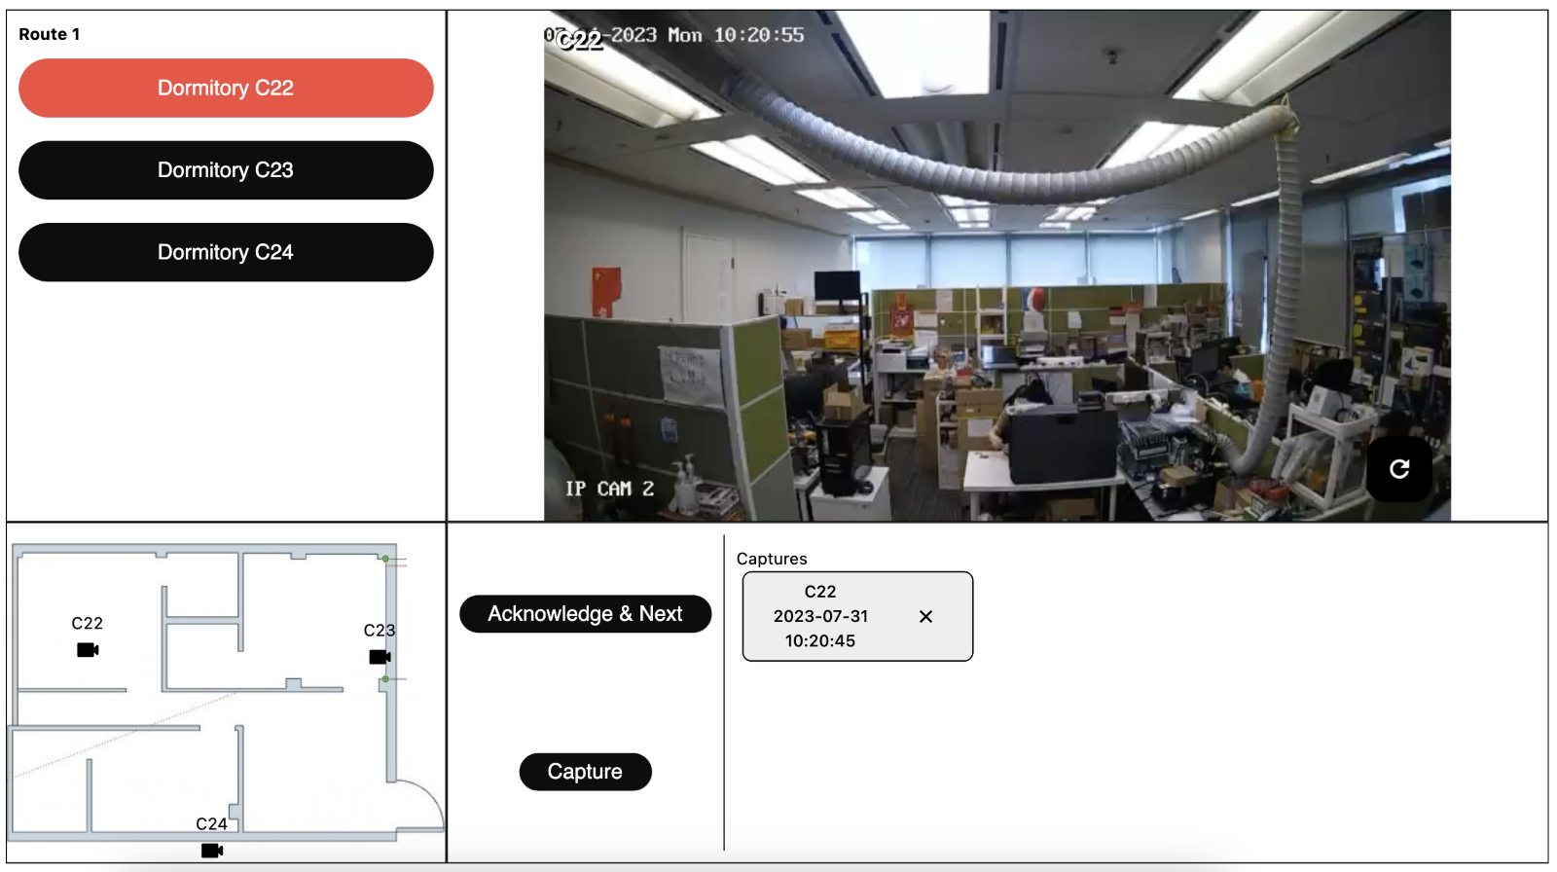

Slide 26
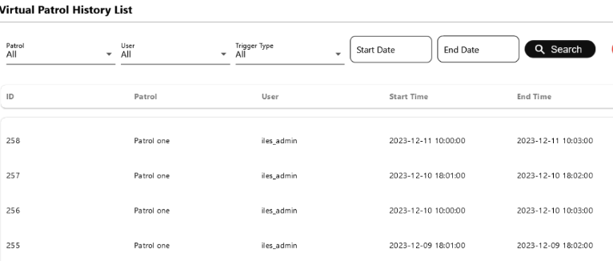
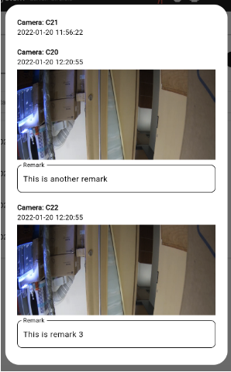

Slide 27
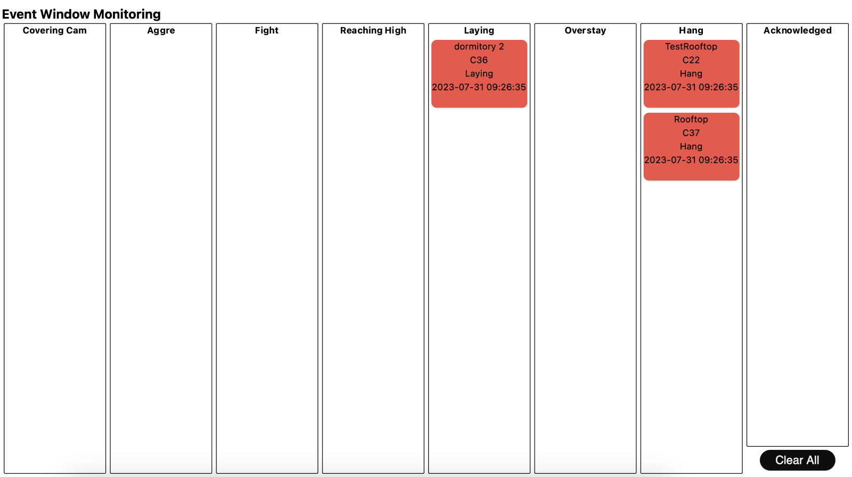

Slide 28
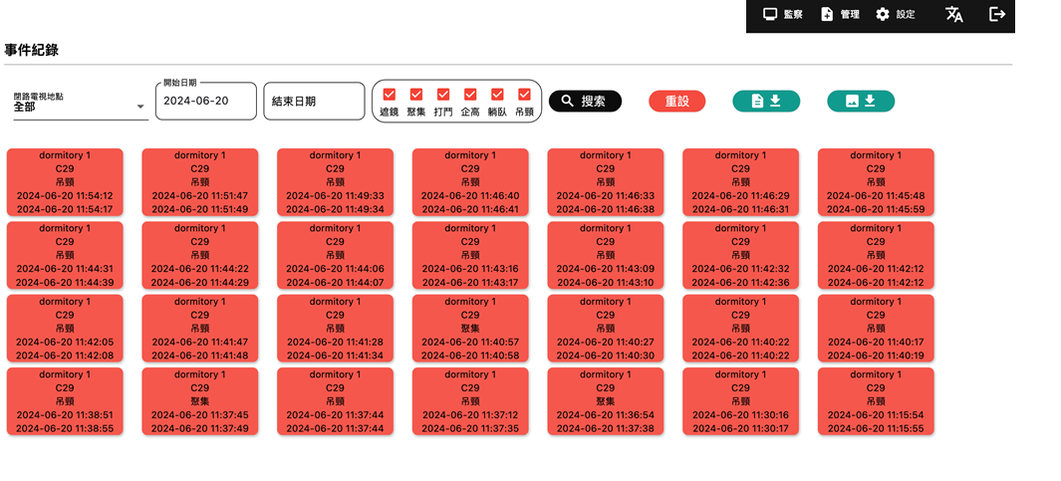

Slide 29
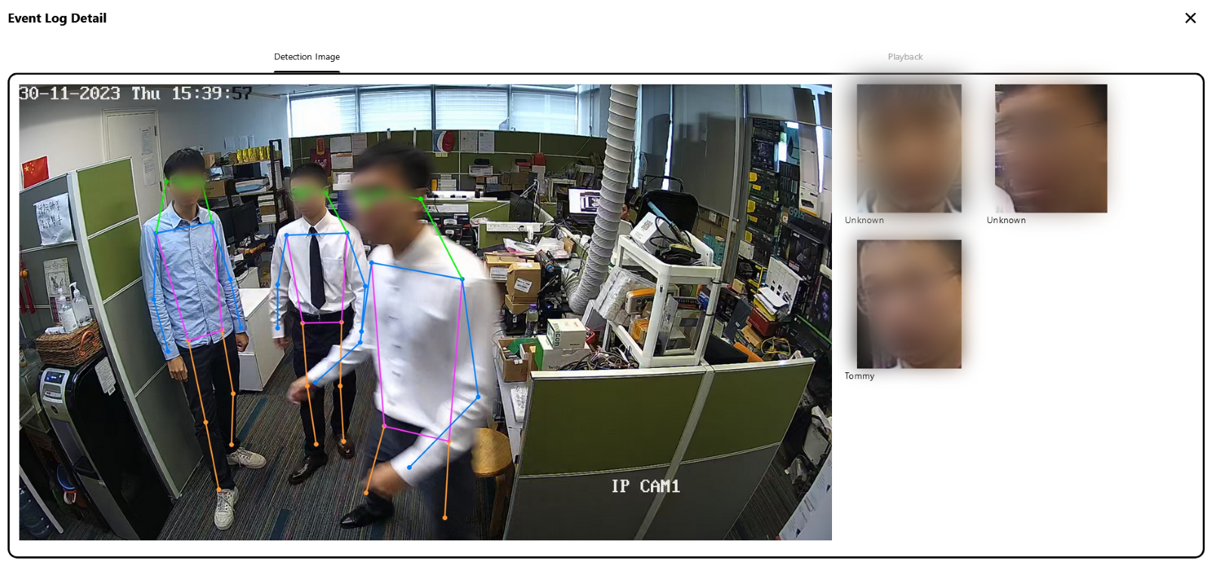

Slide 30
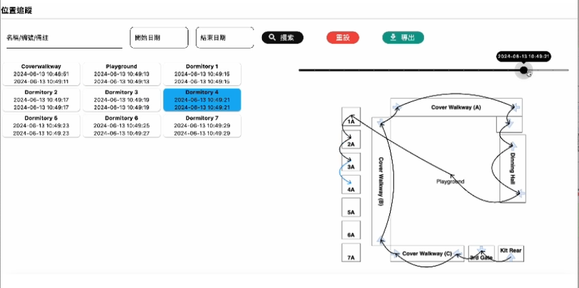

Slide 31
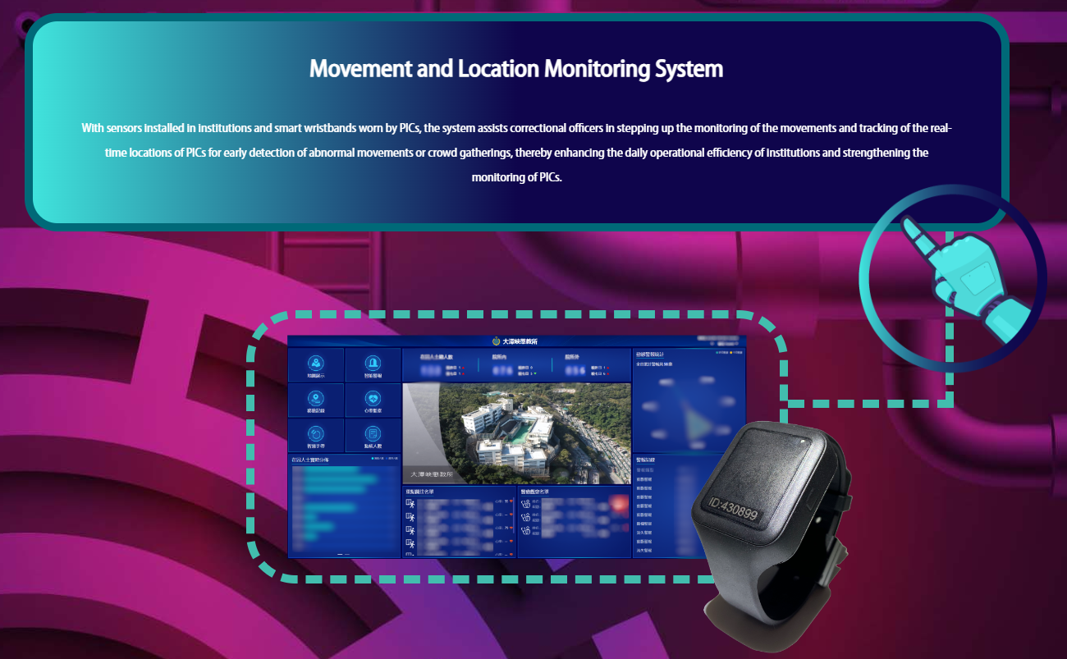

Slide 32
Movement and Location Monitoring System (MLMS)
Location tracking and health sign monitoring
Assist the operators to monitor high-density prison at both indoor
and outdoor holding area for detecting and monitoring the location and heart rate of PICs by radio frequency wireless technology.
Real-time control and monitor via designated workstations, display monitor, or/and specific devices
Suspicious behavior among the PICs with the smart wristbands

Slide 33
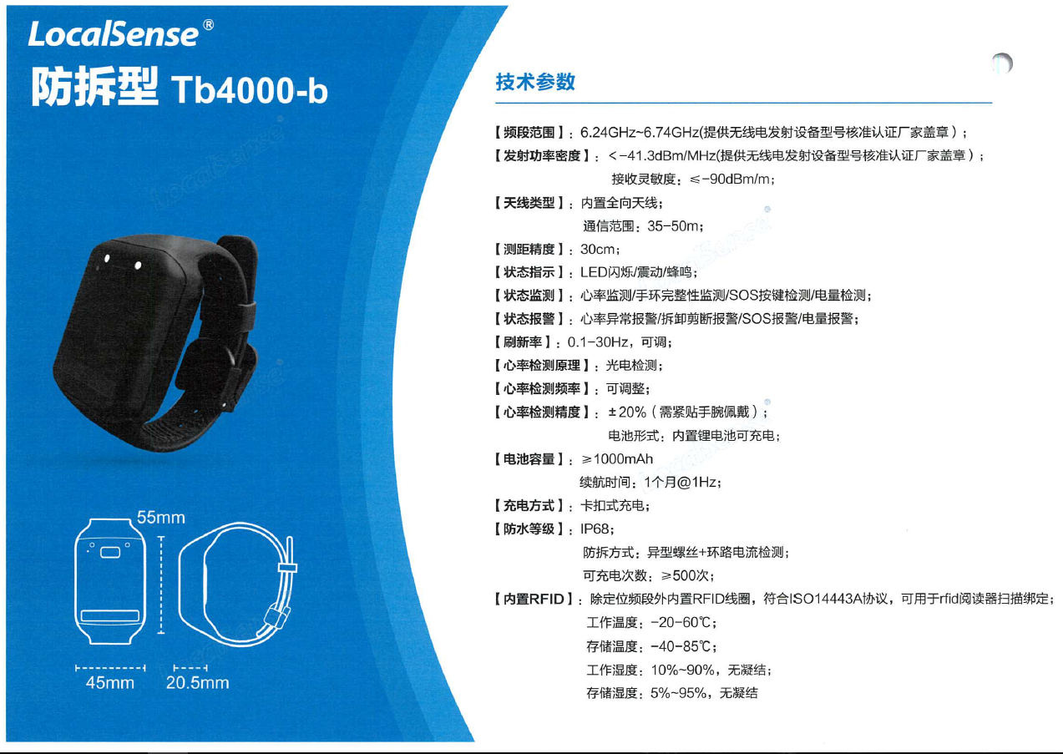

Slide 34
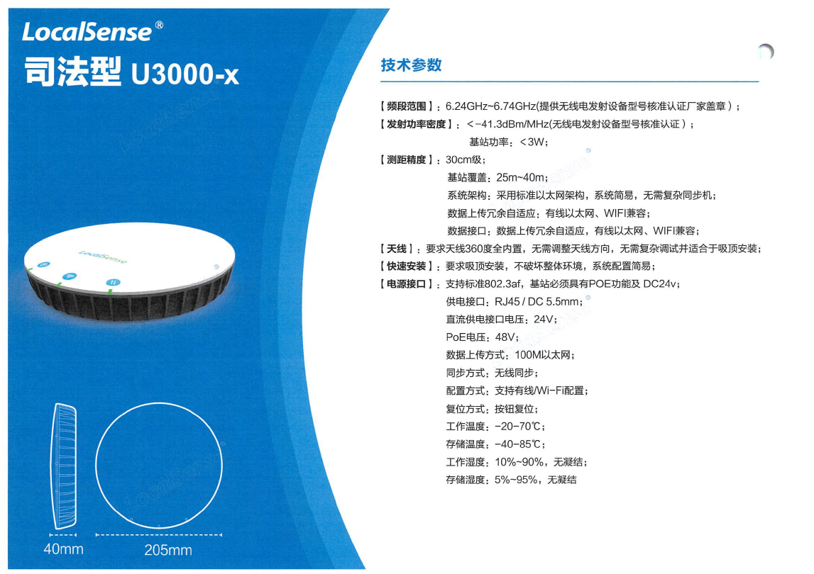

Slide 35

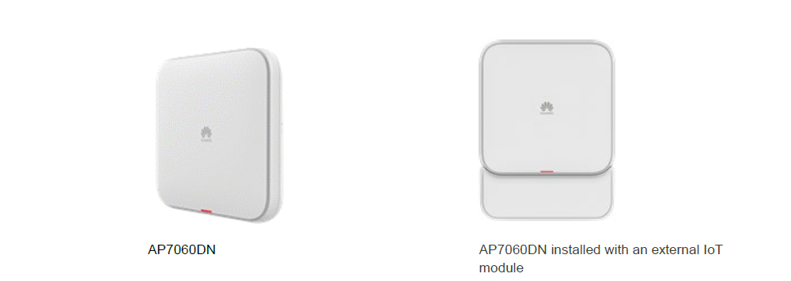

Slide 36
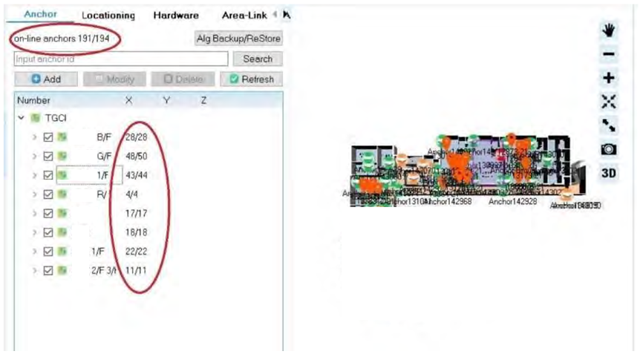
AP and UWB online status

Slide 37
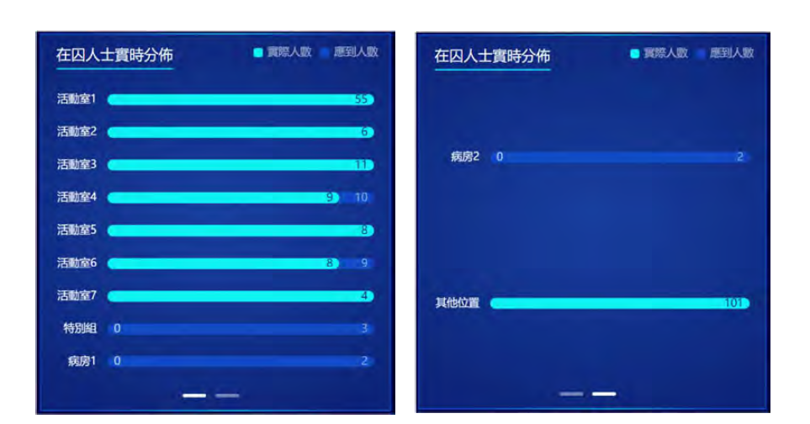
Real-time PIC Allocation Chart
Map Display
PIC Searching
Exceed Alarm
Fence Alarm
Aggregation Alarm
Heart rate Alarm
Call Alarm
Disappear Alarm
Cutting Alarm
Low-battery Alarm
Receiver Down

Slide 38
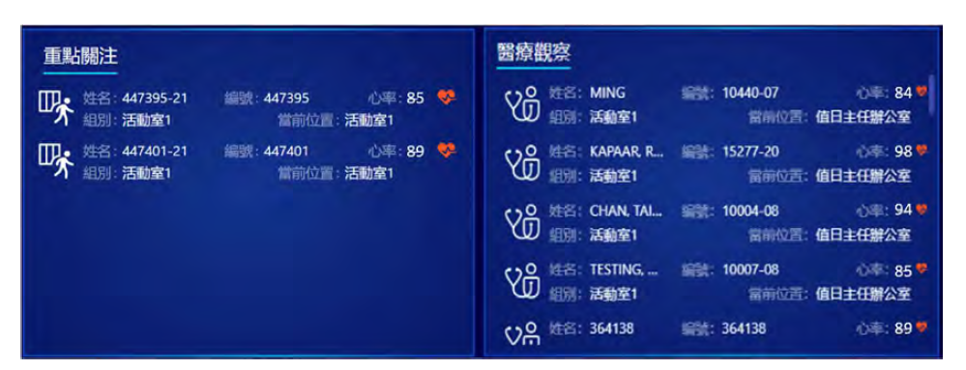
Real-time Special Observation List

Slide 39
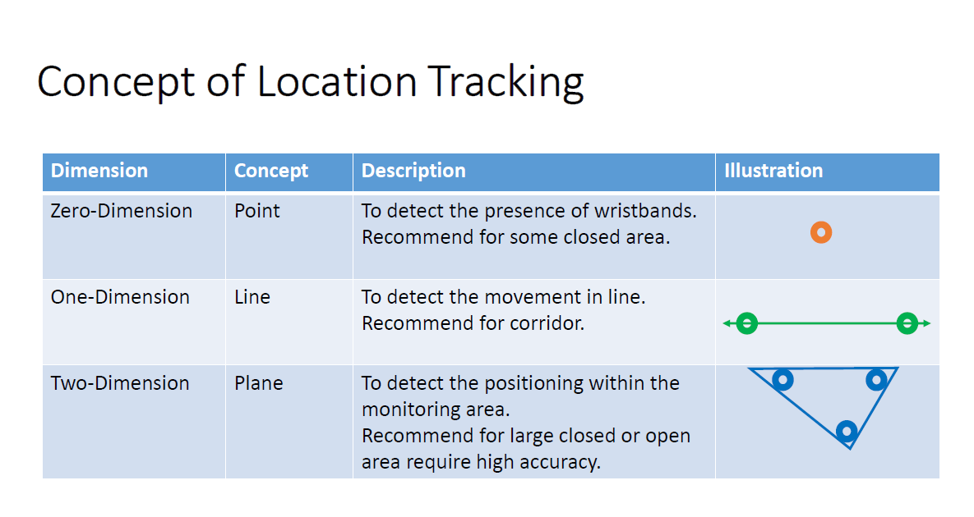

Slide 40
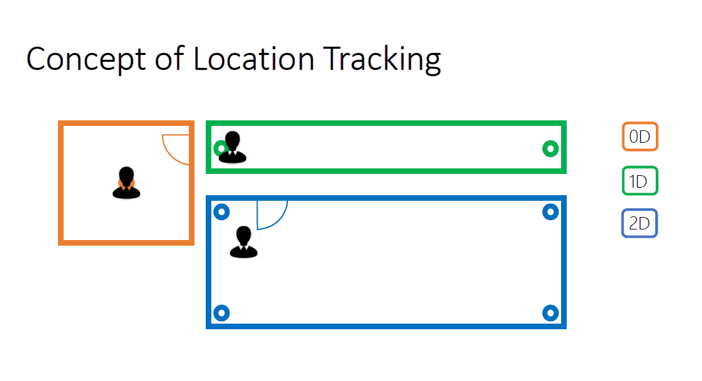

Slide 41
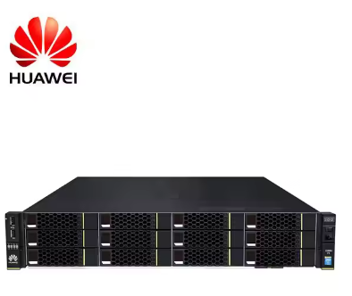
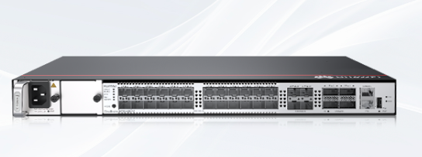
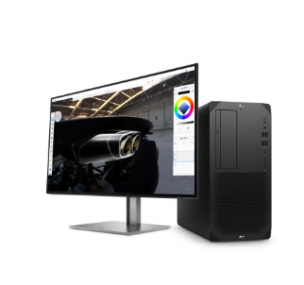
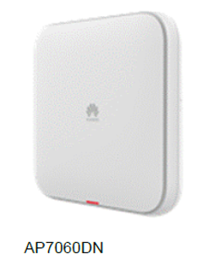
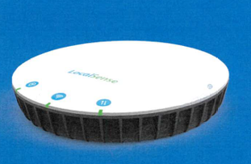
Workstation
Server
AP & UWB
Workstation
Workstation
AP & UWB
Workstation
AP & UWB
AP & UWB

Slide 42
Q & A

Slide 43
Thank you

